Slide 2
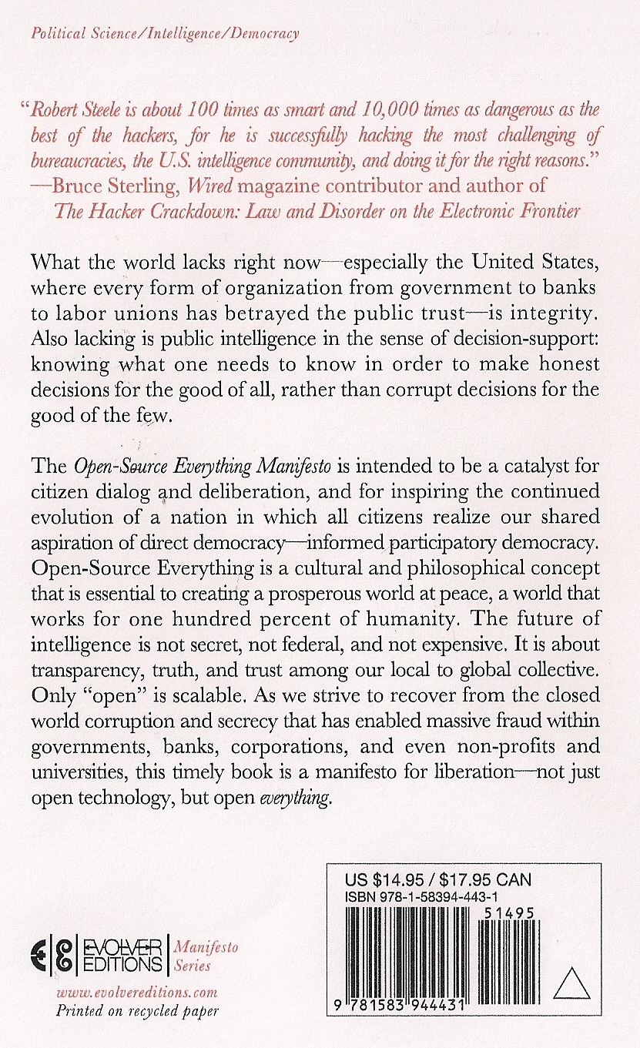

Slide 3
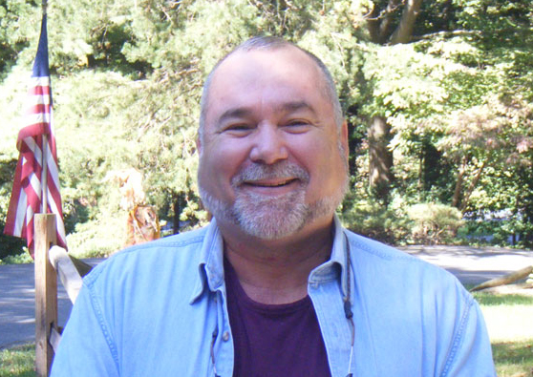
Robert David STEELE Vivas
Global travels as son of an oil engineer, ten years Asia, ten years Latin America and the Caribbean
Global travels as a Marine Corps Infantry Officer and Central Intelligence Clandestine Case Officer (spy)
Honorary hacker for hacking government, early defender of hackers as having the “right stuff”
#1 Amazon reviewer for non-fiction, reading in 98 categories
Founder of We the People Reform Coalition, Reform Party candidate for President (briefly, to learn)

Slide 4
BRING THIS AUTHOR HERE!
Togather
Crowd-Sourcing Book Visits
http://www.togather.com/
robert-steele
GO to the above URL.
WE have created an EVENT
YOU can RSVP or Buy Book
HIT target HE Comes Here.
IT is called “fan-sourcing.”
You can also request other authors
EVENT: 30 + 30 + 60
30 minute briefing
30 minute Q&A
60 minute mixer/book signing
DAY/DATE:
HOUR: 1900-2100 (7-9 pm)
LOCATION: Right here

