Slide 1
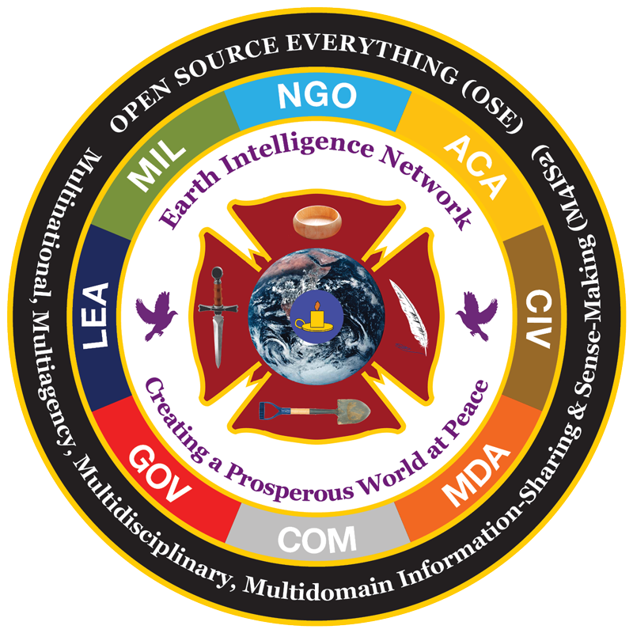
http://tinyurl.com/
Steele-Yale-6
Reality
Intelligence
Tired
Wired
Ethics
Solutions
Eight Tribes
OSE
M4IS2
New Mind
Robert David Steele
CEO (pro bono)
Earth Intelligence Network
A Virginia Non-Profit (501c3)
6 February 2014
Trumbull Room, Branford College
Notes:
I am glad to be here with you.
This briefing consists of 30 slides delivered in 30 minutes.
My intent is to provoke thought.

Slide 2
Notes:
As I lectured LtGen Dr. Brent Scowcroft one day, nothing we do matters UNLESS we devise a means of constructively influencing those who own the future.

Slide 3
Ten High-Level Threats to Humanity
01 Poverty
02 Infectious Disease
03 Environmental Degradation
04 Inter-State Conflict
05 Civil War
06 Genocide
07 Other Atrocities
08 Proliferation
09 Terrorism
10 Transnational Crime
High-Level Panel on Threats, Challenges, & Change, A More Secure World: Our Shared Responsibility (United Nations, December 2004)
Notes:
Dr. Scowcroft was the US representative on the UN High Level Panel that identified and prioritized the ten high level threats to humanity.

Slide 4
Twelve Core National Policies
01 Agriculture
02 Diplomacy
03 Economy
04 Education
05 Energy
06 Family
07 Health
08 Immigration
09 Justice
10 Security
11 Society
12 Water
Notes:
Most intelligence professionals obsess on the singular threat they have been assigned. In fact, intelligence support to strategy, policy, acquisition, and operations matters just as much.

Slide 5
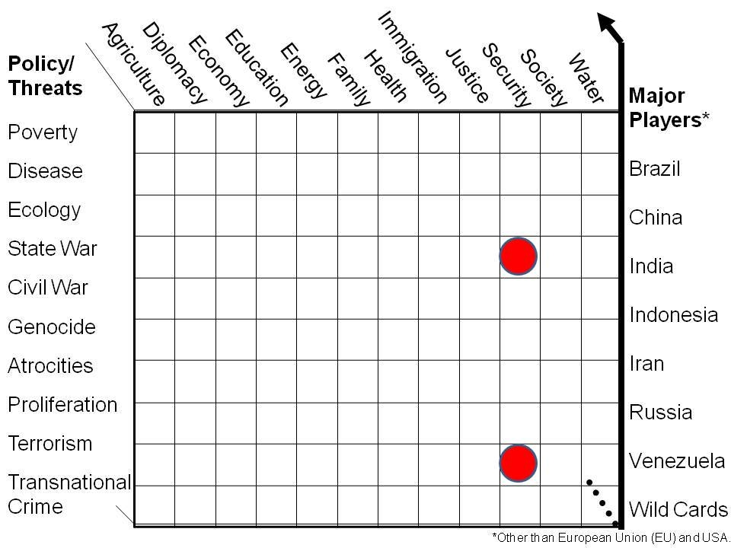
Preliminary Holistic Analytic Model
Core Gaps in Holistic Analysis
Essential to Future-Proofing
What US IC Focuses On..
Nigeria
Notes:
This is what a holistic analytic model looks like. All threats and all core policies however defined.
Note that our government obsesses on the two red dots and ignores everything else.

Slide 6
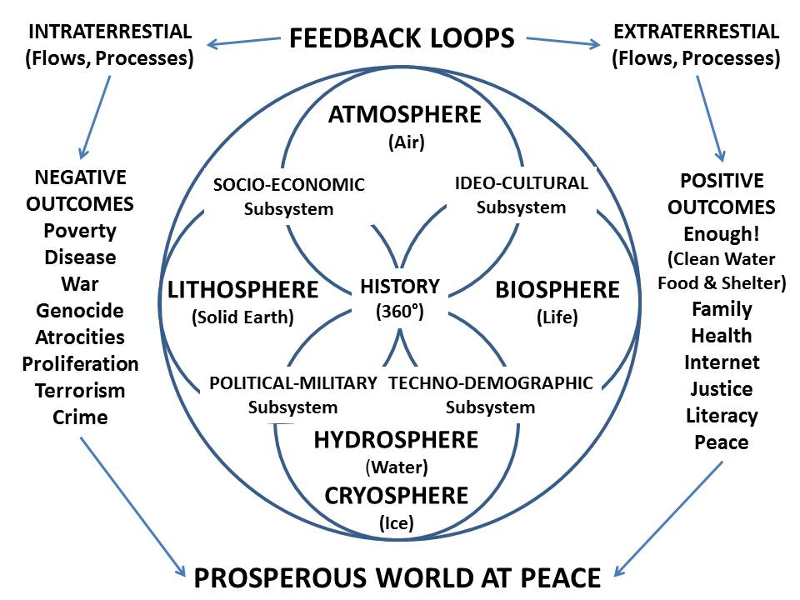
Whole Systems Analytics
Notes:
Whole Systems Analytics are essential if we are to avoid destroying ourselves.
True cost economics is a foundation ignored by most universities. I hope you will embrace this as a foundation for all your future thoughts.

Slide 7
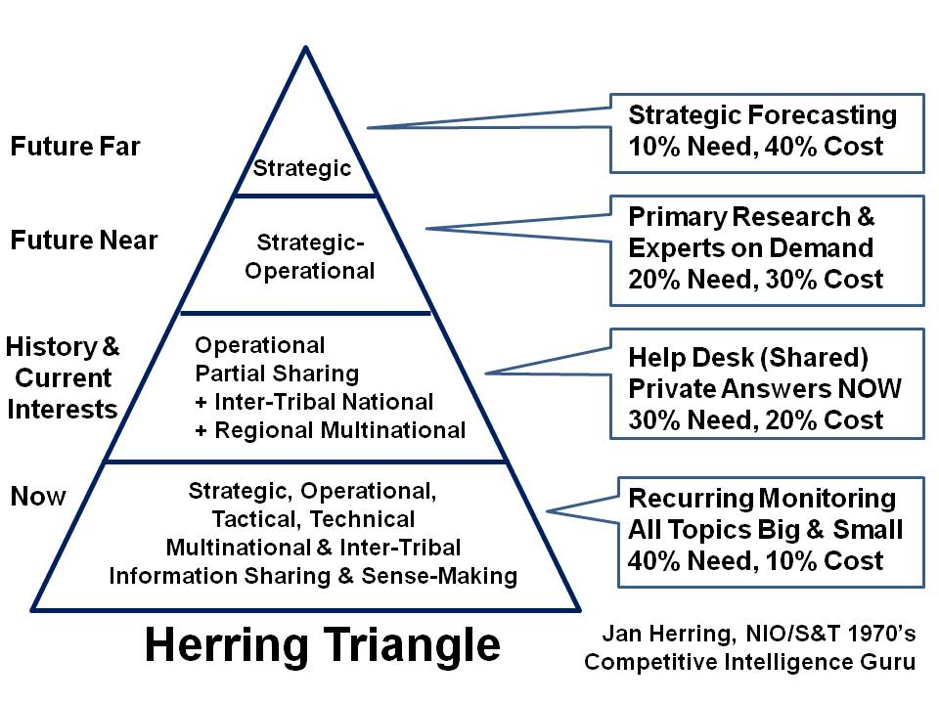
What Form Might Intelligence Take?
Notes:
This is a simple look at what intelligence should be doing – four levels, with sharing being a very important attribute.

Slide 8
First & Second Era Intelligence
Collection
Human
Technical
Covert Action
Black Ops
Mind Ops
Leadership
Mindset
Courage
Counter-intelligence
Defensive
Offensive
Analysis
Current
Estimative
Notes:
This is a very high level overview of the pieces of traditional intelligence – the first era of secret war and the second era of strategic analytics that was quickly swamped by clandestine and covert operations.

Slide 9
Notes:
As we evaluate US national intelligence today – not just NSA but CIA and all the rest, General Tony Zinni’s comment is worthy of note.
PAUSE

Slide 10
Notes:
So also is Jim Bamford commentary valuable. NSA has not prevented a single terrorist attack – what is has done is spent hundreds of billions of dollars to little good effect.
PAUSE

Slide 11
Notes:
In relation to all available relevant information in 183 languages we do not speak, this is a depiction of what the secret world touches.

Slide 12
Notes:
Unfortunately, and this does includes NSA’s mass surveillance program, we process virtually nothing of what we collect. Still today, the secret world is a cut and paste community mired in old technologies and techniques.

Slide 13
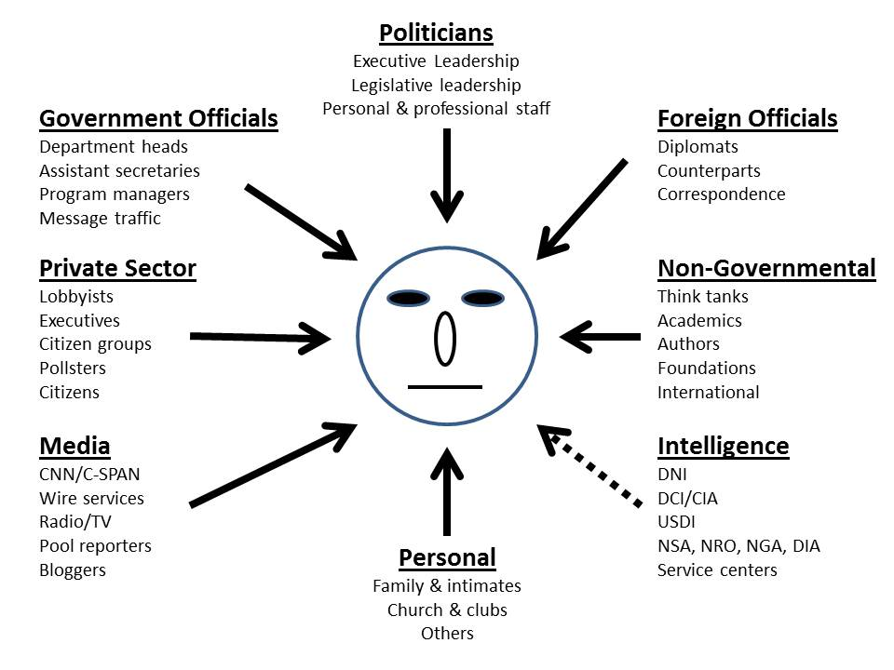
Why Is Intelligence So Feeble Part I? Money, Sex, & Spotlight Trump Secrets
Notes:
Intelligence is feeble in part because its voice is drowned out by all those with greater political, economic, and social influence over any given policy maker.

Slide 14
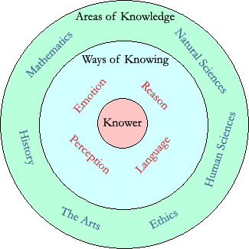
Why Is Intelligence So Feeble Part II? Secrecy & Technology Displaced Integrity & Decision-Support
Intelligence Is:
Actionable Answers
Decision-Support
Evidence-Based
Holistic Process
Intelligence Is Not:
Applied Knowledge
Beliefs in Isolation
Consciousness
Covert Action
Espionage
Secret Information
Wisdom
Notes:
Intelligence is also feeble because the cult of secrecy has displaced integrity, and spending on technical collection has displaced decision-support. The secret world moves money, it does not “do” decision-support.

Slide 15
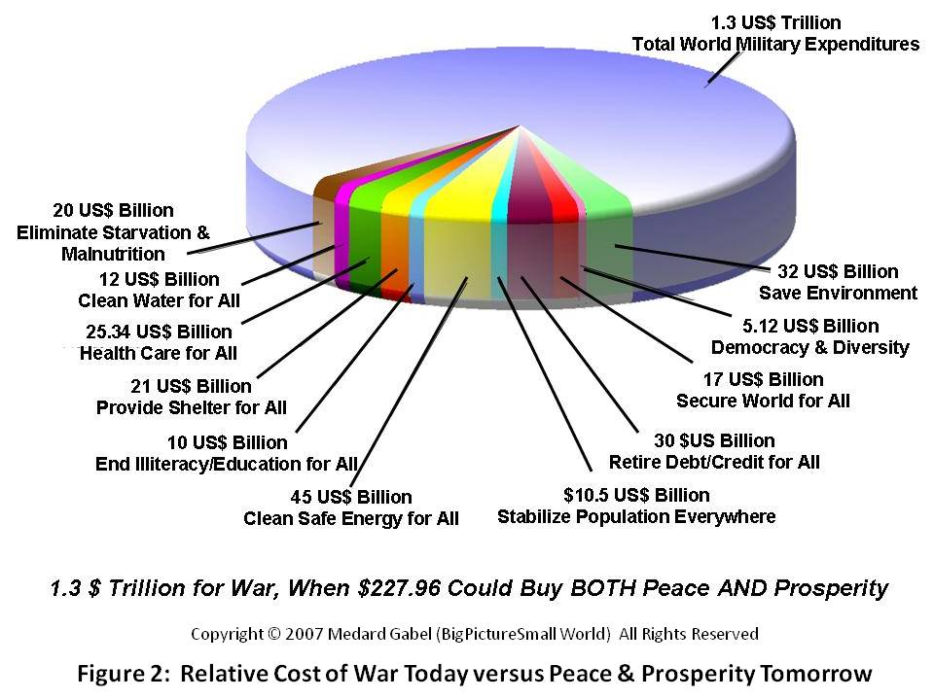
1/3 Cost of War Would Fund Rich Peace!
Notes:
By way of transition, this is what we all spend on war – and as calculated by Medard Gabel, long-time adjunct to Buckminster Fuller – a depiction of how we could resolve all global issues for one third of that amount.

Slide 16
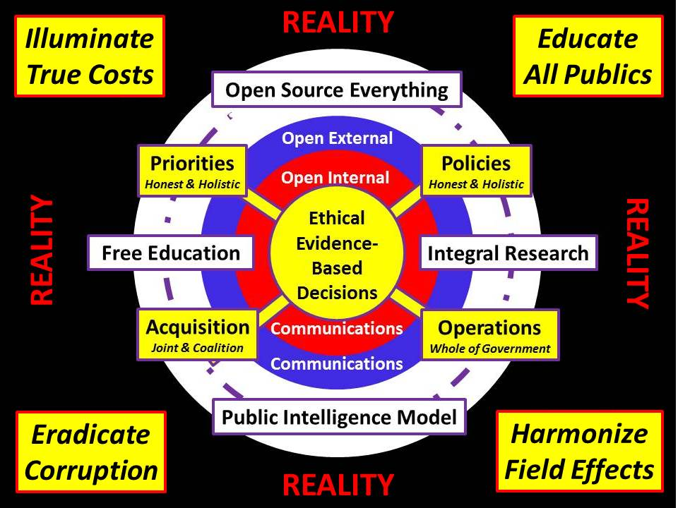
Third Era of Intelligence:
Integrity, Smart Nations, World Brain
Notes:
This is what intelligence is supposed to be doing:
- Illuminating true costs;
- Educating all publics;
- Eradicating corruption;
- Harmonizing field effects – in other words, constructively influences how others spend $.

Slide 17
Utility of Open Sources
Economic and social threats, including 95%
Poverty 99%
Infectious Disease 95%
Environmental Degradation 90%
Interstate conflict 75%
Internal conflict, including 90%
Civil War 85%
Genocide 95%
Other Large-Scale Atrocities 95%
Nuclear, radiological, chemical, and biological WMD 75%
Terrorism 80%
Transnational organized crime 80%
Notes:
A major short-coming of the secret world is that it refuses to be serious about open sources of information.
Here I show the utility of open sources in relation to the 10 threats (by my estimate).

Slide 18
Notes:
Even if we were to embrace the need to access all relevant information, there are obstacles.
Each of these is also the title of a book on that specific topic.

Slide 19
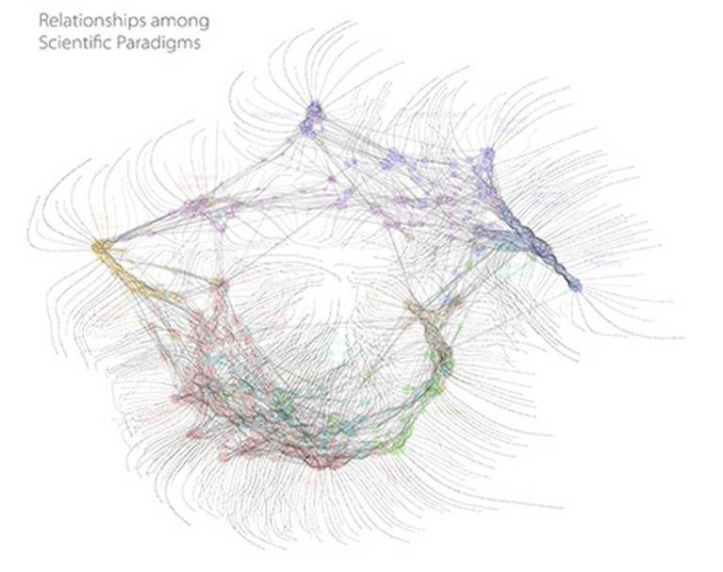
Fragmented Knowledge
Fragmented Scientific Paradigms
Humanities
Religion & Spirituality
Philosophy
Notes:
We have also allowed universities to fragment knowledge. Scientific disciplines are isolated from all others, and isolated from the humanities, religion & spirituality, and from philosophy.

Slide 20
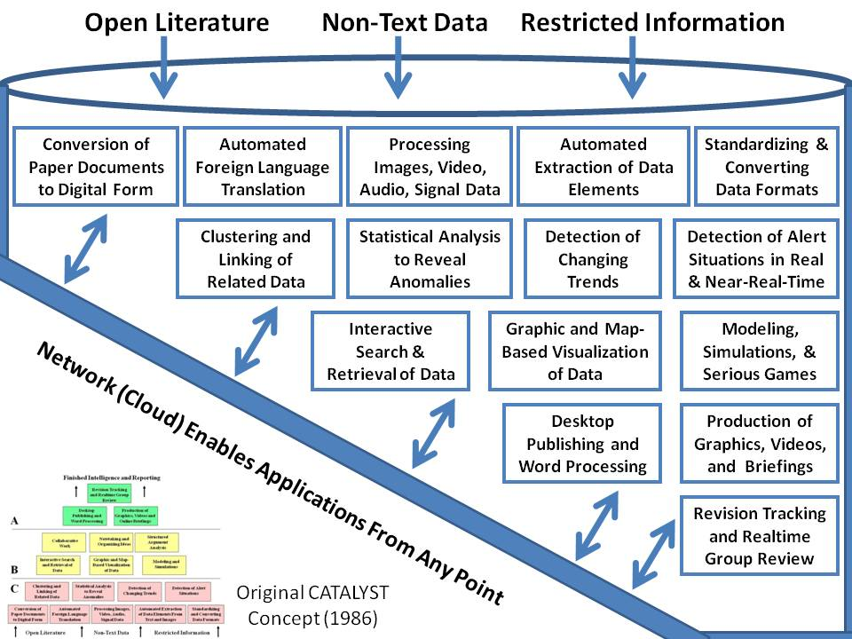
No Tools – We Asked for This in 1985
Notes:
On top of our challenges in the source arena, we still do not have serious desk-top toolkits.
This is what our best analysts asked for at CIA in 1985 – we still do not have this!

Slide 21
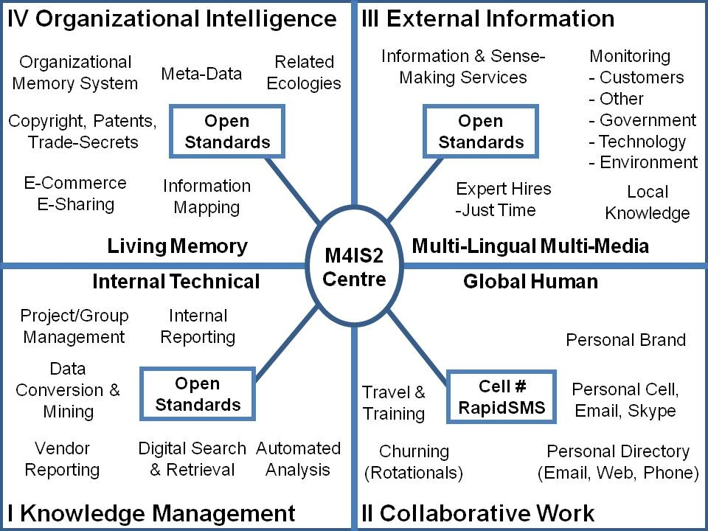
No Organizational Intelligence
Notes:
We have also failed to achieve organizational intelligence as defined by Harold Wilensky in the mid-1960’s. Most are in Quadrant I, a few in Quadrant II, virtually no one is in Quadrant III, and I know of no one at all in Quadrant IV.

Slide 22
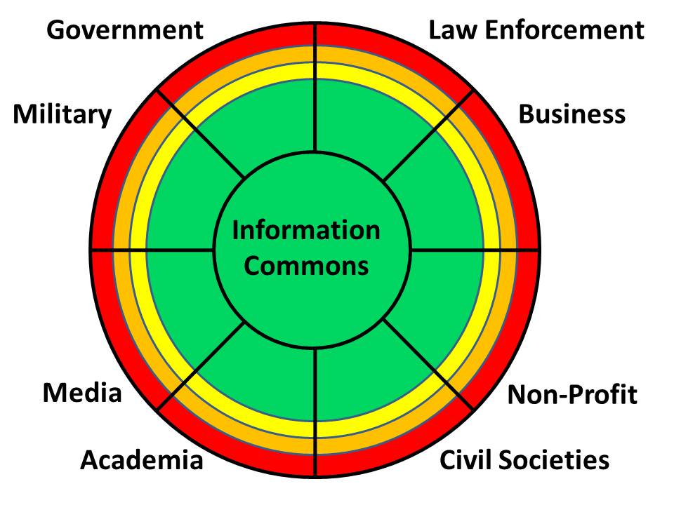
Notes:
We begin to heal ourselves by recognizing that government is the least important information tribe, and that we must unify the eight tribes. We must create a culture of sharing across these eight tribes.

Slide 23
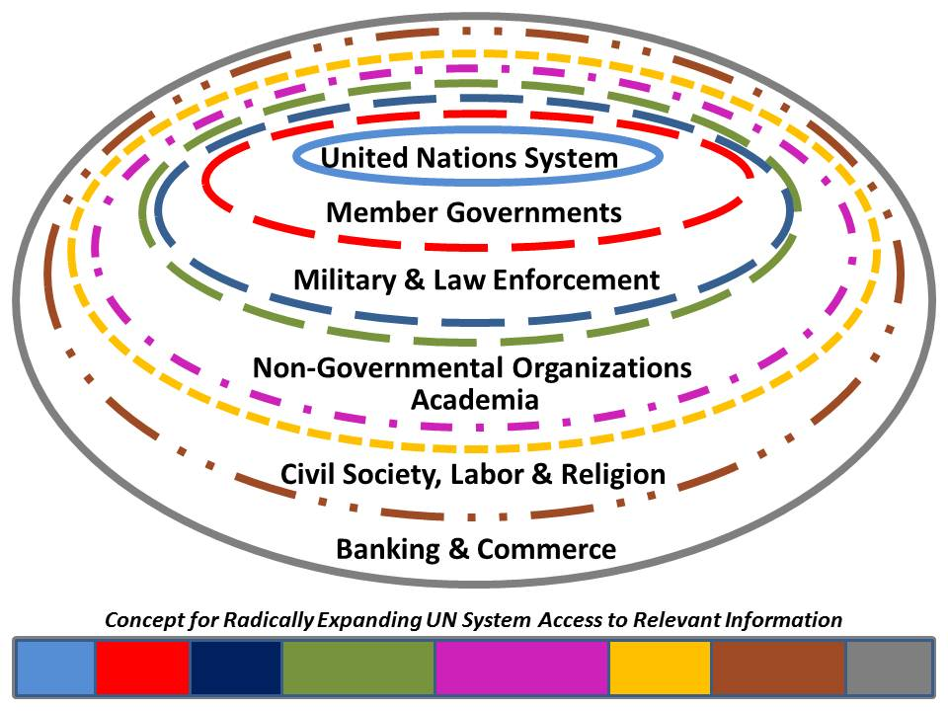
Notes:
Here is a depiction from over a decade ago on what we might accomplish – each circle shows a larger and larger cache of content and a larger and larger investment.
Sadly, this does not exist today.

Slide 24
Notes:
Just as we must unify the eight tribes, so also must we return to the best practices of the indigenous tribes – bottom up consensus taking the long view is vastly more affordable and more sustainable that elite decisions made in secret.

Slide 25
Notes:
Ethics is completely absent in most of what our government does and in most of what our corporations do. I’m not happy with our non-profits or universities either.
This is my proposed plan.

Slide 26
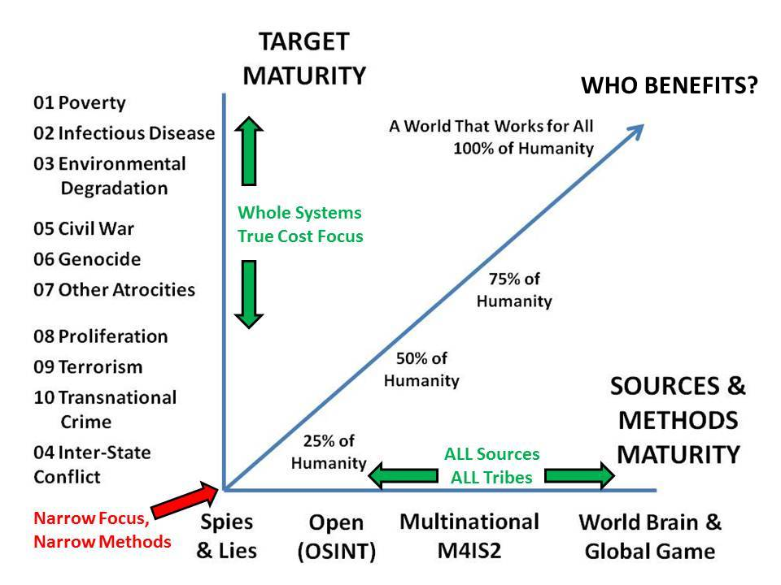
Notes:
Here I bring together the ten threats and our existing approach, spies & lies.
Here I show the alternatives we can explore that leverage both open sources and multinational sharing and sense-making.

Slide 27
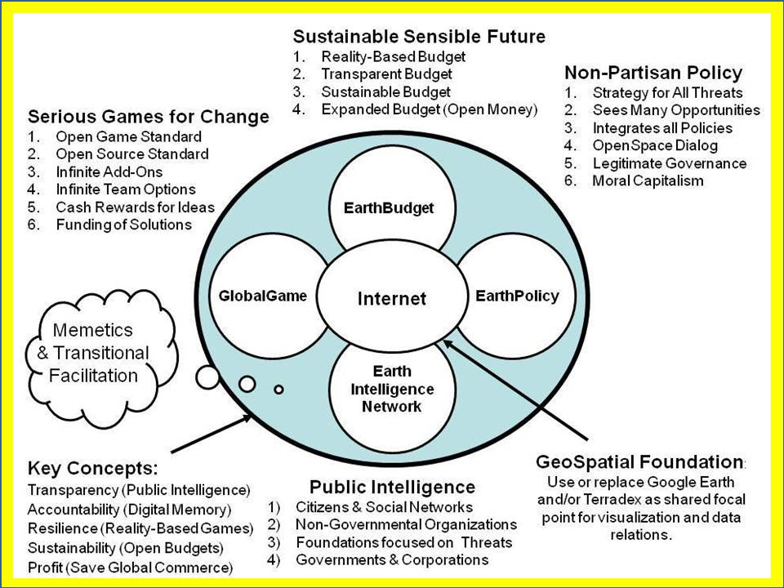
Notes:
Investments are needed. This is the six bubble concept developed by Earth Intelligence Network. With technology that exists today, we can displace dishonest elites and make all public decision both evidence-based and transparent.

Slide 28
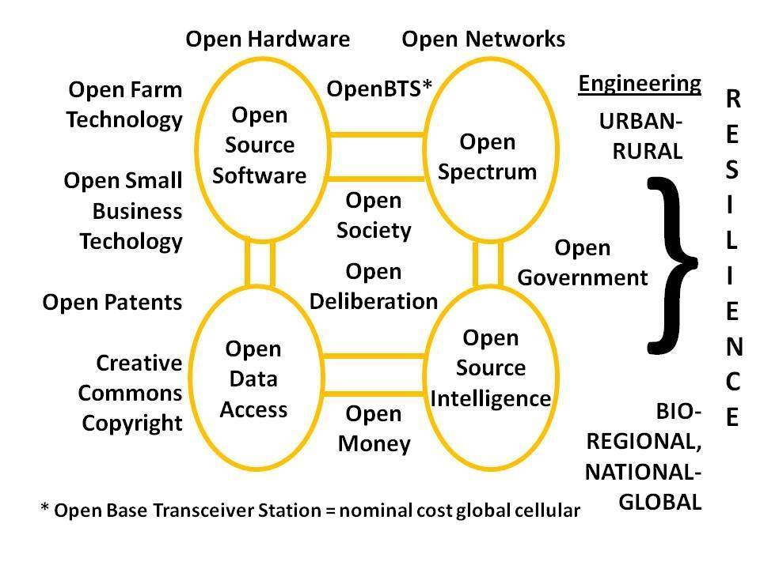
Notes:
Multinational information sharing and local to global information sharing demand a global architecture that is affordable, inter-operable, and scalable.
Open Source Everything!

Slide 29
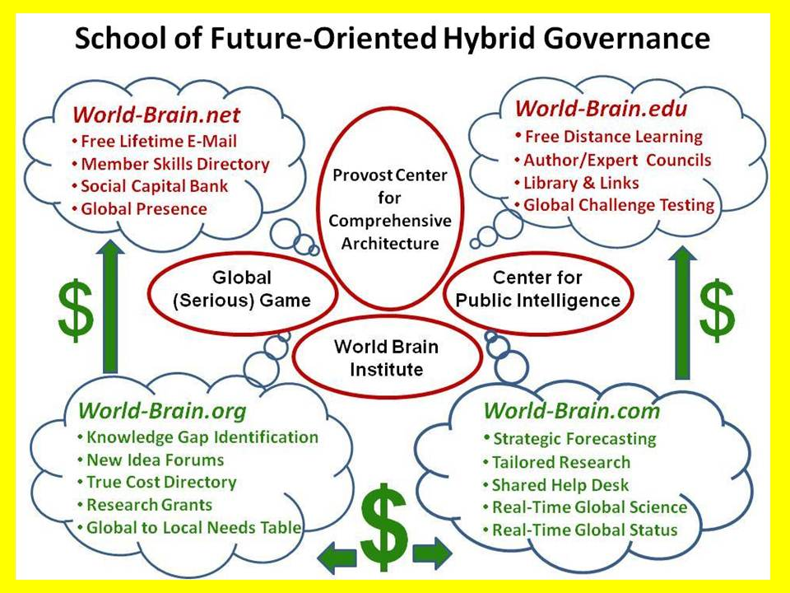
Notes:
In my view, the best way to start this revolution in intelligence affairs is to find one great university whose president or provost can embrace this plan.

Slide 30
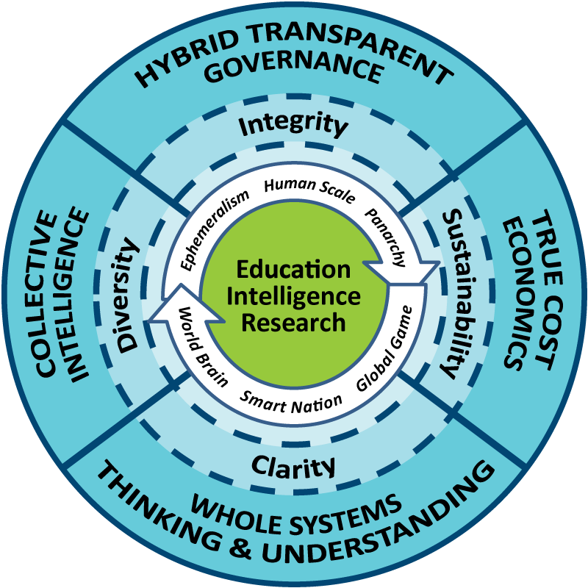
We do not lack for information.
- - - - - - - - - - -
We lack for integrity and compassion.
Always On, Always Free: Phi Beta Iota the Public Intelligence Blog
The truth at any cost lowers all others costs.
Notes:
This is a summary graphic of the method that I and a few others are championing.
We do not lack for information. We lack for integrity and compassion. THANK YOU.

