Slide 1
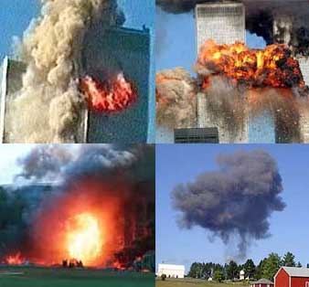
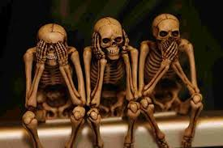
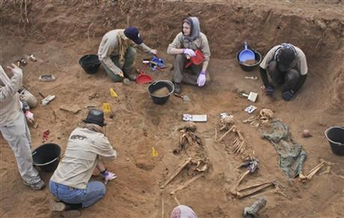
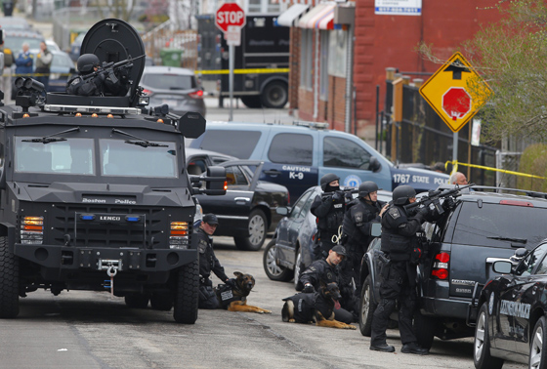
Post-9/11
Modern Conflict
Robert David STEELE Vivas

Slide 2
Conflict: Opposing Forces
Person vs Self
Person vs Person
Person vs Society
Person vs Nature
Tribe vs Self
Tribe vs Person
Tribe vs Society
Tribe vs Nature
Mental-Cultural
Mental-Cultural
Mental-Cultural
Mental-Cultural
Religion vs Self
Religion vs Person
Religion vs Society
Religion vs Nature
State vs Self
State vs Person
State vs Society
State vs Nature

Slide 3
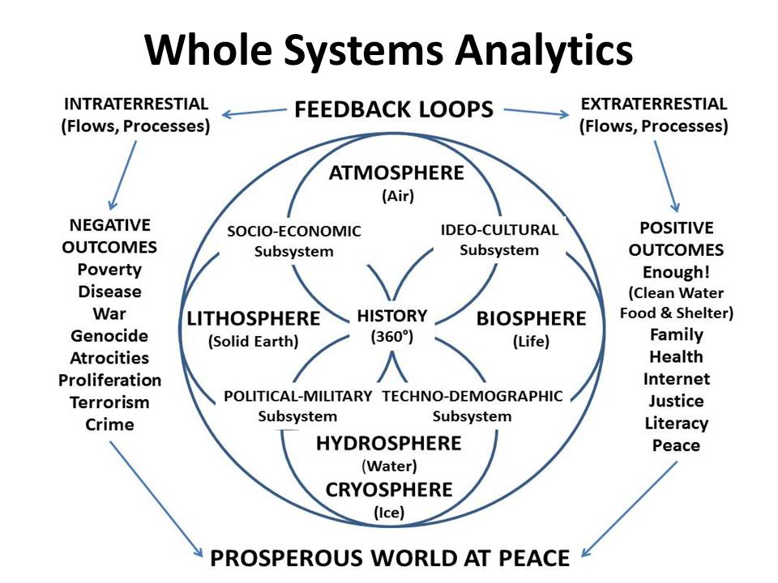
Context Matters

Slide 4
Reality (Nature) Bats Last
Bacteria have extraordinary strategies for rapid-fire external information collection and exchange, quick-paced inventiveness, and global data sharing. Species higher up on the evolutionary scale do not always retain these capabilities--they internalize capabilities while losing organic connectivity to others.
Non-conformists--diversity generators--are absolutely vital to the survival of any species because they are "option generators"--but too often those in power shut out and even ruin the very non-conformists needed to adapt to external challenges it does not understand.
Think for yourselves. We are losing the inter-species contest because we are self-destructing across multiple fronts.

Slide 5
Fundamental Questions
What’s the threat?
What’s the terrain?
Who are the players?
What’s the history?
Where’s the gold?
What are the rules?
What can we afford?
Who benefits?
How does this end?
Learning Objective:
Do you ask these questions before picking a fight?
Does your leadership ask these questions before going to war?
Are these questions ANSWERED before going to war?

Slide 6
7 Generations of Military Intelligence
1st Generation Easy: Where is the opposing army?
2nd Generation Easy: Where are the trenches?
3rd Generation Moderate: How many with what where?
4th Generation Hard: Watch every non-state actor.
5th Generation Hard: Watch everything on the fly.
6th Generation Hard: Make sense of billions of bits.
7th Generation Very Hard: 24/7, 33+ languages and get your
own house in order. As soon as possible, 183
languages going back 200 years, then 400. Plot
all this on a universally-accessible geospatial
visualization and show the true costs of every
product, process, service, and behavior.

Slide 7
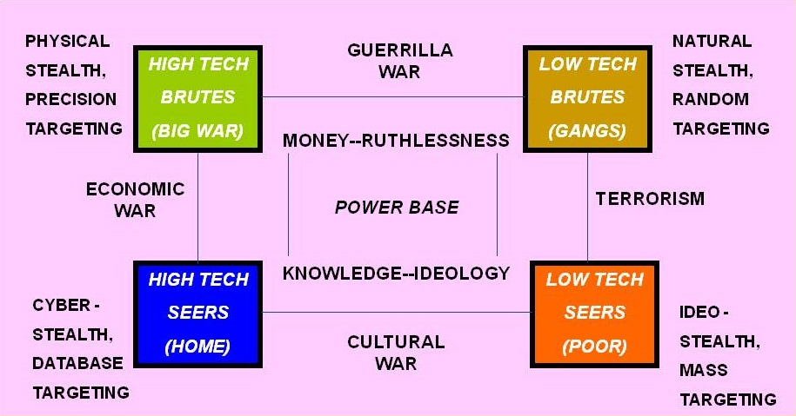
Four Modern Threats to the State

Slide 8
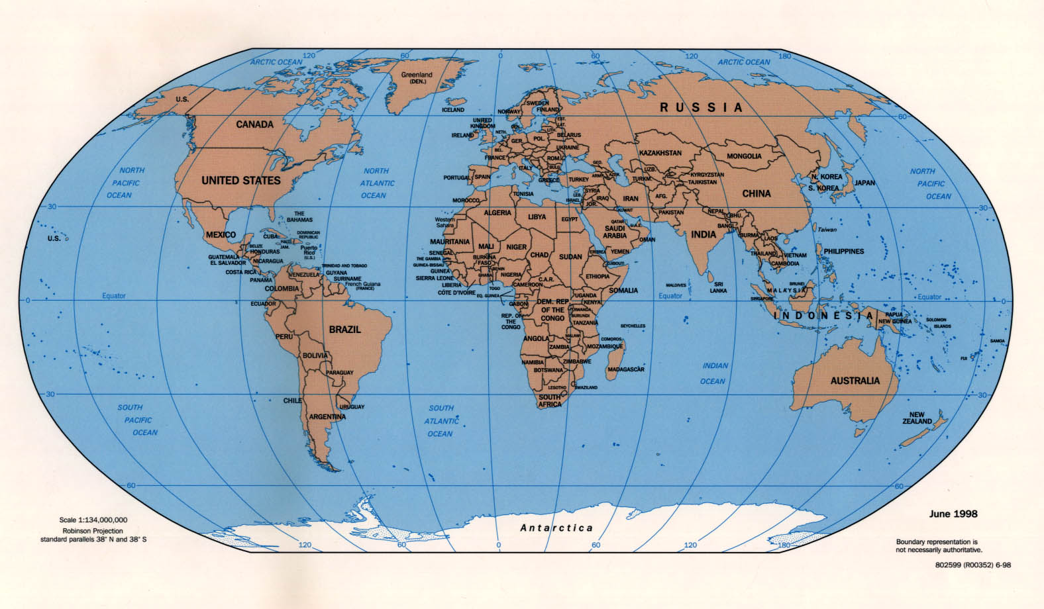
Post-9/11 Conflict 23 LIC+, 79 LIC-, 175 VPC
LIC: Low-Intensity Conflict VPC: Violent Political Conflict
Source: PIOOM (NL), data with permission © 2002 A. Jongman
Notes:
This is the reality that our Pentagon is not ready to deal with. We have a world that is largely unstable and at war with itself.
In 2002 there were 23 conflicts killing over 1000 people a year, 79 killing under 1000 a year, and 175 violent political conflicts internal to a specific country.

Slide 9
Post-9/11 Global Threats Known but Not Acknowledged by USG as Threats to USA
Complex Emergencies
32 Countries
Water Scarcity &
Contaminated Water**
Refugees/Displaced
66 Countries
Ethnic Conflict 18 Genocides Today**
Food Security
33 Countries
Resource Wars, Energy Waste & Pollution**
Modern Plagues*
59 Countries & Rising
Corruption Common
80 Countries
Child Soldiers
41 Countries
Censorship Very High
62 Countries
*State of the World Atlas (1997), ** Marq de Villier (Water), John Heidenrich and Greg Stanton (Genocide), Michael Klare et al (Resources), all others from PIOOM Map 2002
Notes:
The instability of the world is relevant to our homeland security because it spawns migrations, criminal activity, and disease as well as terrorism.
There are 32 complex emergencies involving over 20 countries that are considered to be “failed states.” We have millions of refugees, millions of starving people, millions of people subject to plagues and epidemics.

Slide 10
US Home Front
Vulnerabilities
Singleton Individuals
Shock & Disrupt
If Washington Refuses to
Listen, What Then?
Public Education & Health
CYBER/DATA
Corruption
I wrote the warning letter to White House in 1994.
War College
Papers
Nailed
These in
1990-1994
ECONOMIC BLAHS
No Fly No Spend No Hire
MILITARY ACHILLES’ HEELS
Off-base power, down-links, antennas
ELECTRONIC INFRASTRUCTURE
Power, Financial, Comms, Transportation
PHYSICAL INFRASTRUCTURE
Tunnels, Pipelines, Bridges, Dams, Towers
Notes:
At the same time, we are very vulnerable at home. We built our great society on the assumption that there might be occasional acts of God, but never on the assumption that suicidal terrorists would be willing to blow up tunnels, bridges, pipelines, apartment buildings, dams, or banking centers.
Our economy, our data, our public health are all hostage to the possibility of suicidal terrorists. Our existing national security capabilities are simply not effective against this threat. There is nothing in the current homeland security program that actually makes America any safer!

Slide 11
What Changed About the Threat?

Slide 12
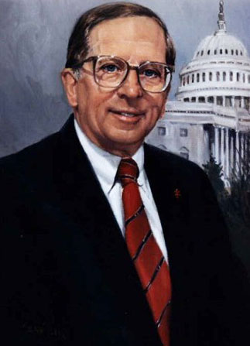
How Do You Address the Threat?
I am constantly being asked for a bottom-line defense number. I don’t know of any logical way to arrive at such a figure without analyzing the threat; without determining what changes in our strategy should be made in light of the changes in the threat; and then determining what force structure and weapons program we need to carry out this revised strategy.
Senator Sam Nunn (D-GA)
Chairman
Senate Armed Services Committee
3 Jan 1987 to 3 Jan 1995

Slide 13
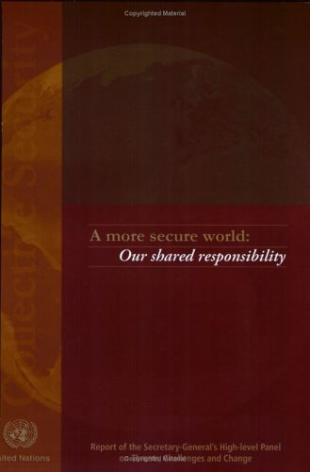
What Is the Total Threat Picture?
Threats to Humanity (Priority Order)
01 Poverty
02 Infectious Disease
03 Environmental Degradation
04 Inter-State Conflict
05 Civil War
06 Genocide
07 Other Atrocities
08 Proliferation
09 Terrorism
10 Transnational Crime
Per LtGen Dr. Brent Scowcroft, USAF (Ret) & other members of the UN High Level Panel on Threats, Challenges, & Change, 2004.

Slide 14
Taxpayer Dollars Focused
on Just 10% of the Threat
Notes:
When you evaluate the Pentagon and what we have today in our national security structure, against the real-world threats, you quickly establish that our capabilities are helpful only 10% of the time.
The other 90% of the time we are forced, for lack of mature and considered advance planning, to jury-rig very expensive and always inadequate responses.
We need a strong national security program, but it must be a smart program that is relevant to the full range of real world threats.

Slide 15
Persistent Ethnic Fault Lines 18 Genocides On-Going
Source: Dr. Greg Stanton
Notes:
It gets worse. Everyone knows about the Holocaust against those of the Jewish faith during World War II.
What most people do not realize is that there have been over 70 genocides in history, and that there are 18 genocides taking place today as we gather here to consider national security and the future of America.

Slide 16
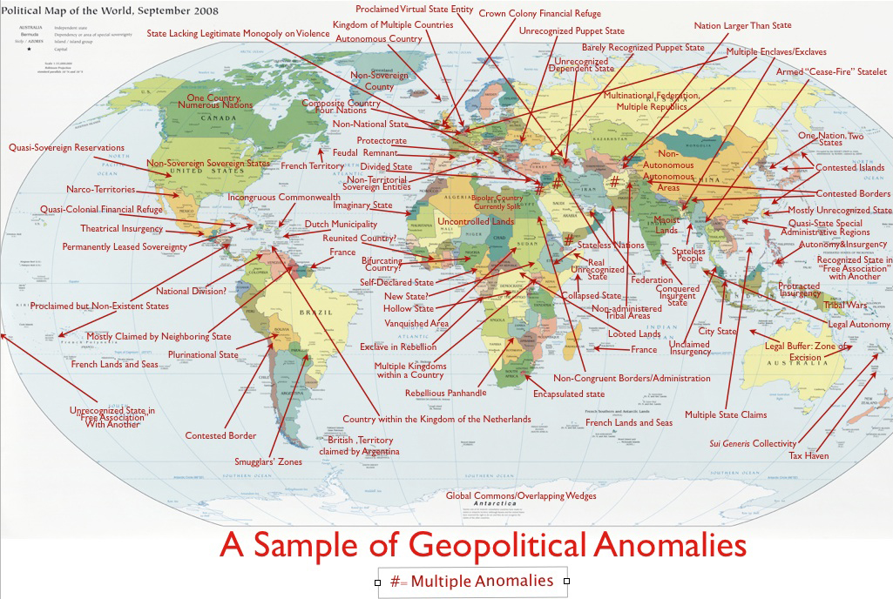
Geo-Political Anomalies Mostly Imposed Colonial Boundaries

Slide 17
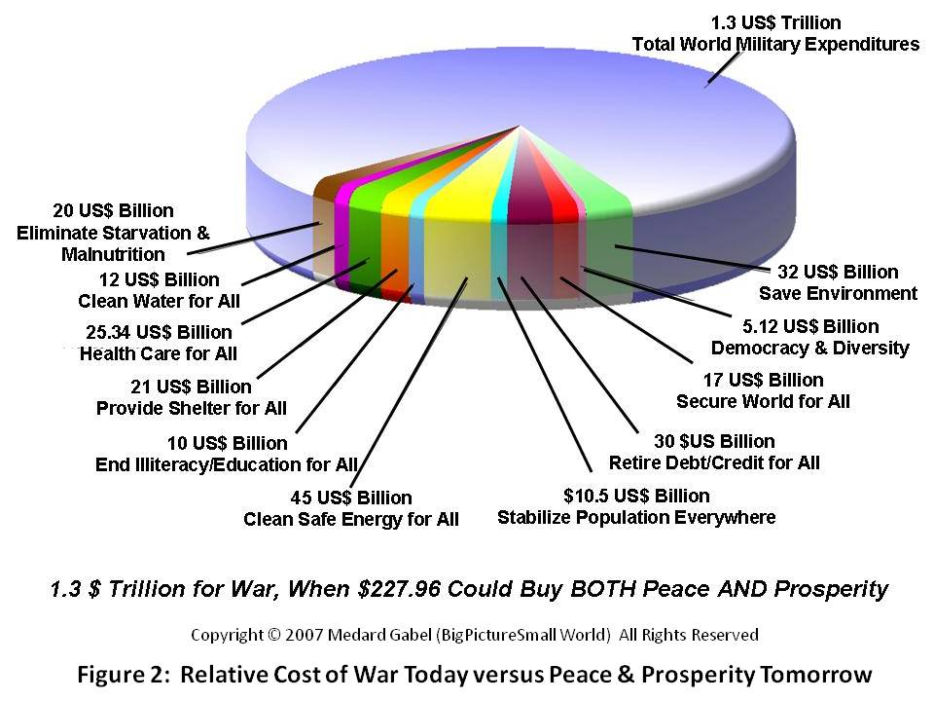
Cost of War versus Peace Assume Just 3 Trillion for AF/IQ – Opportunity Cost!

Slide 18
7 Conflicts Loved by Eugenicists Not Counting Death by Doctor, Drugs, Alcohol, Pollution, or Obesity
1) Democratic Republic of Congo: First & Second Congo Wars, aftermath (1996 – present)
2) First and Second Liberian Civil Wars (1989-2003)
3) Eritrean – Ethiopian War (1998-2000)
4) Darfur conflict (2003 – present)
5) Iraq: US invasion, insurgency, civil war (2003 – present)
6) Mexican Drug War (2006 – present)
7) Syrian conflict (2011 – present)
5,000,000+ DEAD
300,000 DEAD
150,000 – 300,000 DEAD
300,000+ DEAD
100,000 – 600,000 DEAD
60,000+ DEAD
150,000+ DEAD

Slide 19
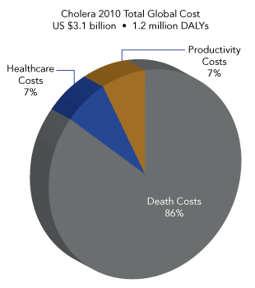
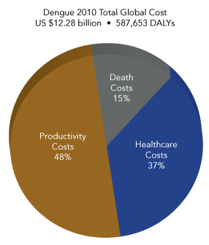
Infectious Disease True Cost Add Cost of Blocking Natural Cures…

Slide 20
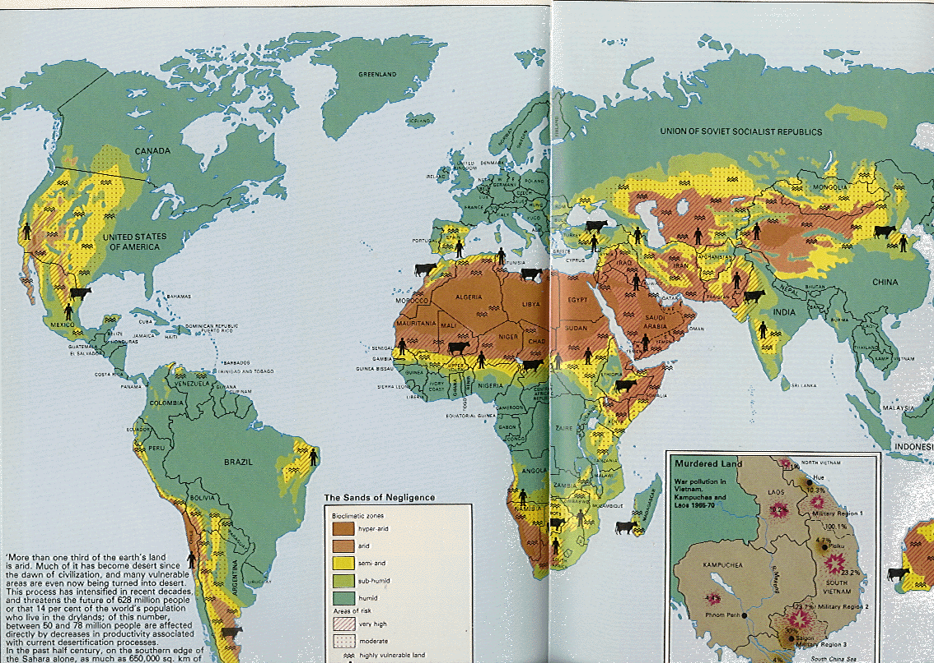
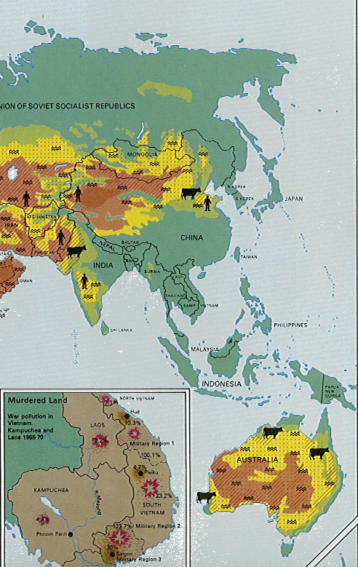
Water As Source of Conflict
4
Hyper-Arid
1
3
Arid
5
Semi-Arid
6
Sub-Humid
2
Water Pollution
Source: The State of the World Atlas (1997), chart 54, 53
Notes:
These ethnic conflicts tend to coincide with conditions of severe deprivation.
Note the red line---some of the worst water scarcity and some of the worst ethnic conflicts are along the Russian borders with both the Islamic states of Central Asia, and the Chinese state.
Water scarcity is a national security threat that does not receive enough attention.

Slide 21
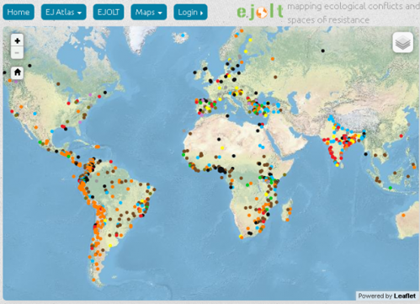
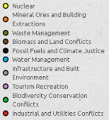
Ecological Conflicts Today

Slide 22
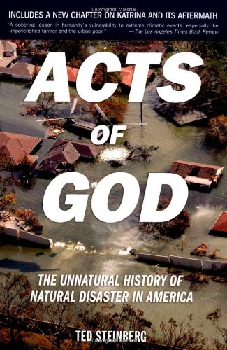
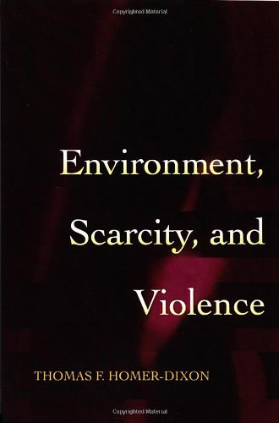
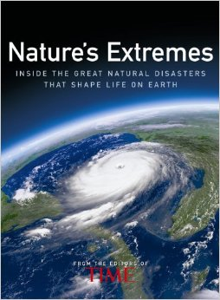
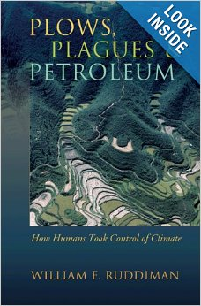
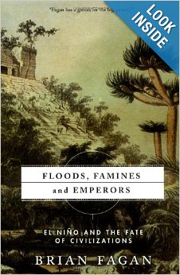
Weather & Waste Paving Over the Poor
Paving Over Wetlands & Flood Plains is a Deliberate Scam:
1. Screw over the poor and those of color
2. Amortize high risks taken by the rich across the entire taxpayer base – we conceal and deceive to keep investment coming in
3. Further land speculation, with insurance company and government complicity
4. Conceal, lie, deceive as to the actual premediated decisions that occasioned the disaster turning into a catastrophe.

Slide 23
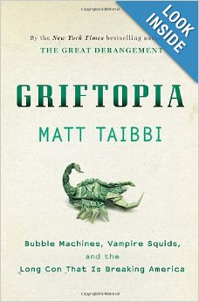
Wall Street Screwed Us Good… And the Two-Party Tyranny Protects Them…
QUOTE (32): What has taken place over the last generation is a highly complicated merger of crime and policy, of stealing and government. Far from taking care of the rest of us, the financial leaders of America and their political servants have seemingly reached the cynical conclusion that our society is not work saving and have taken on a new mission that involved not creating wealth for us all, but simply absconding with whatever wealth remains in our hollowed out economy. They don’t feed us, we feed them.

Slide 24
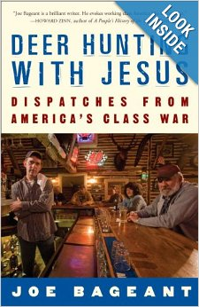
All Elites Are Taking Advantage
It’s not just the federal government that must be watched and kept honest – all across America every small town elite and every city government cuts deals with corporations that line individual local elite pockets while screwing the poor, blue collar, and middle class out of education and infrastructure.
Education among the lower middle class and impoverished – white, black, other – is considered a luxury. Lacking education, they get screwed over and over by snake oil salesmen be they religious, political, or financial.
Over half the poor in USA are white and this number has almost doubled in past eight years. Trailers, trucks, insurance, health for the poor are all designed to cheat them in a way no educated person would tolerate.
Television really has made us stupid.

Slide 25
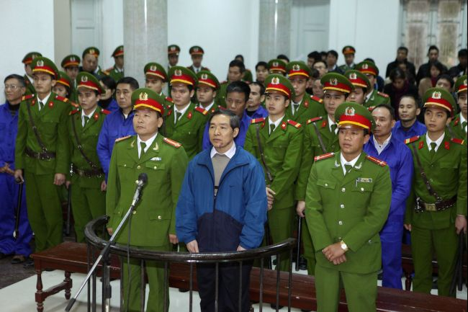
Death Penalty or Guantanamo? Vietnam is sentencing corrupt bankers to death, by firing squad
In the USA, 7,000+ Occupy protesters arrested – fewer than 10 bankers

Slide 26
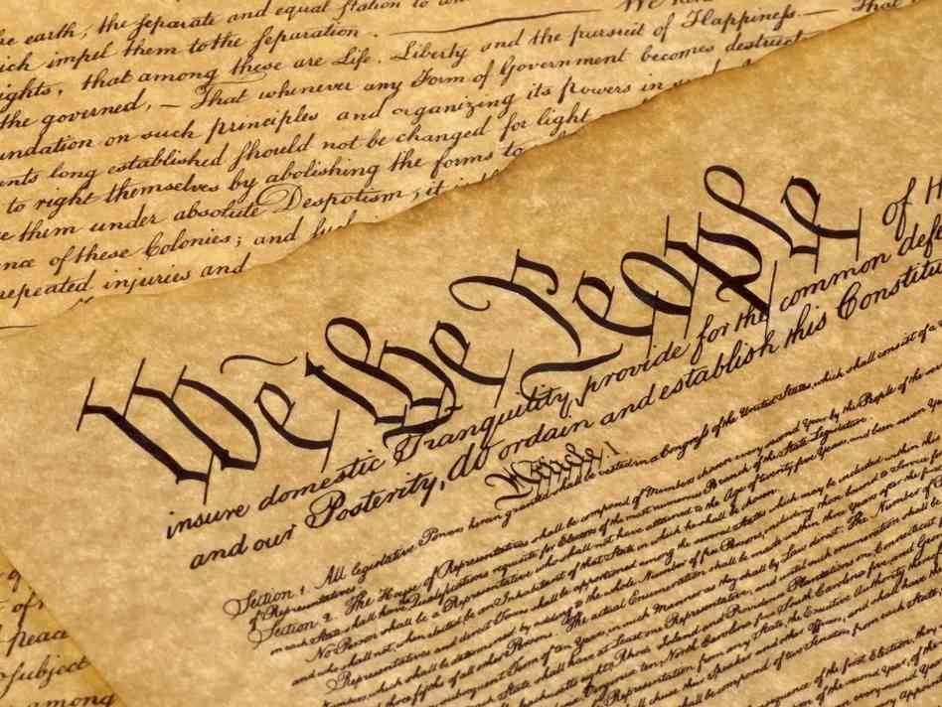
Back to Basics
We the People of the United States, in Order to form a more perfect Union, establish Justice, insure domestic Tranquility, provide for the common defence, promote the general Welfare, and secure the Blessings of Liberty to ourselves and our Posterity, do ordain and establish this Constitution for the United States of America.
Really Big Questions:
Who gave Congress right to borrow a trillion a year in our name?
Who allowed Congress to stop following Article 1 of the Constitution?
Who allowed Congress to suspend the Bill of Rights and permit secret prosecutions?
Who are WE? Who “counts?”
Do Individuals yield to the We?
How do We come together?
What role free speech?
What role privacy?
What role justice for all?
When do We declare “enough?”

Slide 27
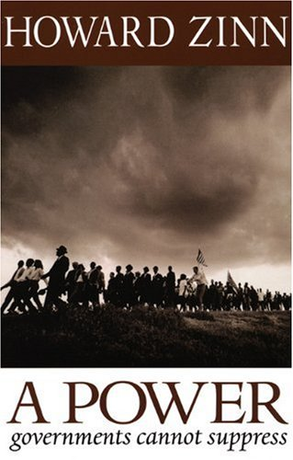
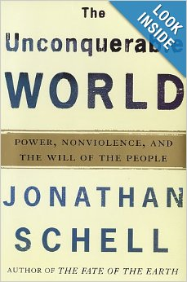
You Are the Change Your ability to think is our salvation
Once aroused, the public cannot be suppressed by any government, by any corporation, by any degree of violence.
Only the public can discern the great truths. Governments are intermediaries able to understand small and medium truths.
The great truth that our public must discern, embrace, and promulgate is that science and concentrated wealth have outpaced the humanities and our ability to self-govern.
The change starts here and now with each of you. Your ability to think for yourselves going into the future is our salvation.

Slide 28
Here Is One Analytic Model Holistic Matters – True Cost Matters

Slide 29
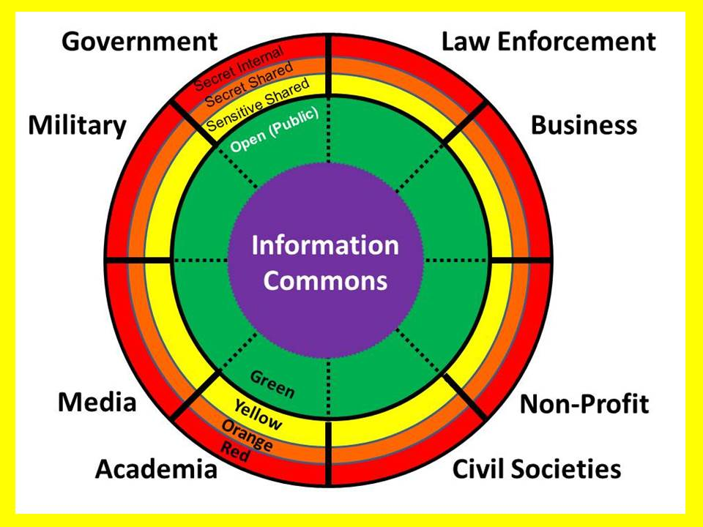
Here is One Outreach Model Knowing who knows is half the answer

Slide 30
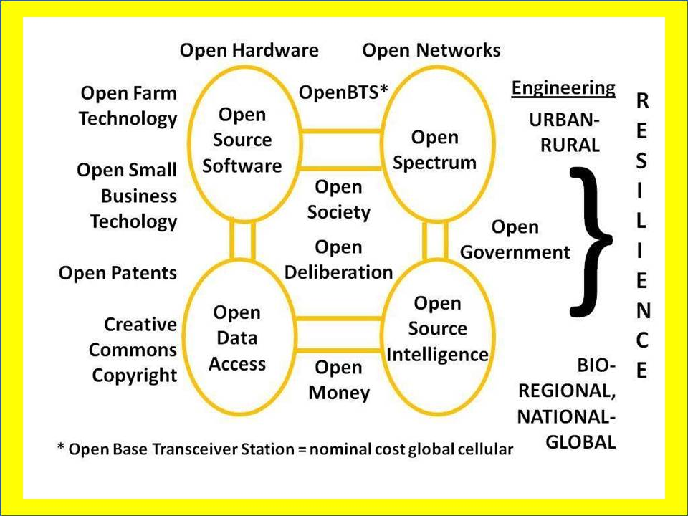
Here is One Technical Model Affordable, Inter-Operable, Scalable

Slide 31
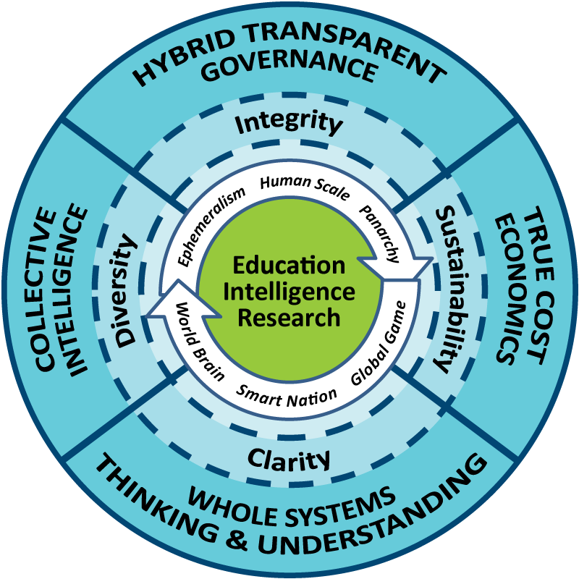
Here is One Moral Model If you remember just one world, let it be INTEGRITY

Slide 32
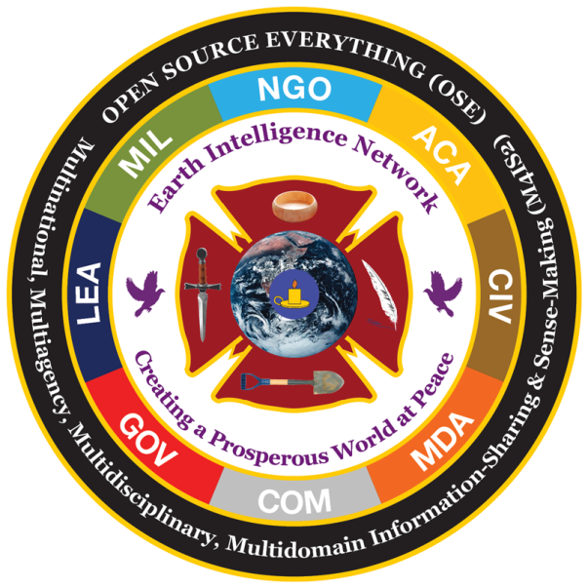
Learn More If You Wish… I stress the value of book reviews by others
Phi Beta Iota Public Intelligence Blog
http://www.phibetaiota.net
See especially: Books (Page)
Worth a Look: Book Review Lists (Positive Future-Oriented)
Worth a Look: Book Review Lists (Negative Status-Quo)
Worth a Look: Recent Books on 10 High Level Threats
Worth a Look: Recent Books on 12 Core Policies
Worth a Look: Book Reviews on Democracy Lost & Found
Worth a Look: Book Reviews on Corruption 2.0
Worth a Look: Recent Books on True Cost Economics
Worth a Look: Recent Books on All the Opens
Worth a Look: Book Reviews on Religion & the Politics of Religion
Robert Steele: Online Review Books on Education, Intelligence, Research
The truth at any cost lowers all other costs.

