Slide 1
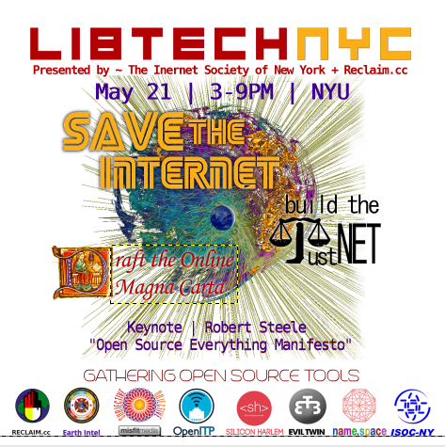
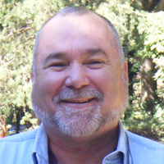
Leah Lynn Plante – Prisoner of State
Robert
David
Steele
Earth Intelligence Network
21 May 2014
The Open Source Everything Manifesto:
Transparency,
Truth, &
Trust
Notes:
I am honored to be in your company. I have been marginalized by my own government, which I have tried to help since 1988. Elements of that government stole my international conference and destroyed my business. So I stand before you impoverished but free and hopeful. Leah Lynn Plante, at the time a prisoner of state, represents in my view everything that is good about America the Beautiful. The government -- and the predatory capitalist octopus it supports – is not us, not the Republic. Our task is to restore public agency , to restore the Constitution, to demand of our government that it demonstrate integrity and be of, by, and for We the People.

Slide 2
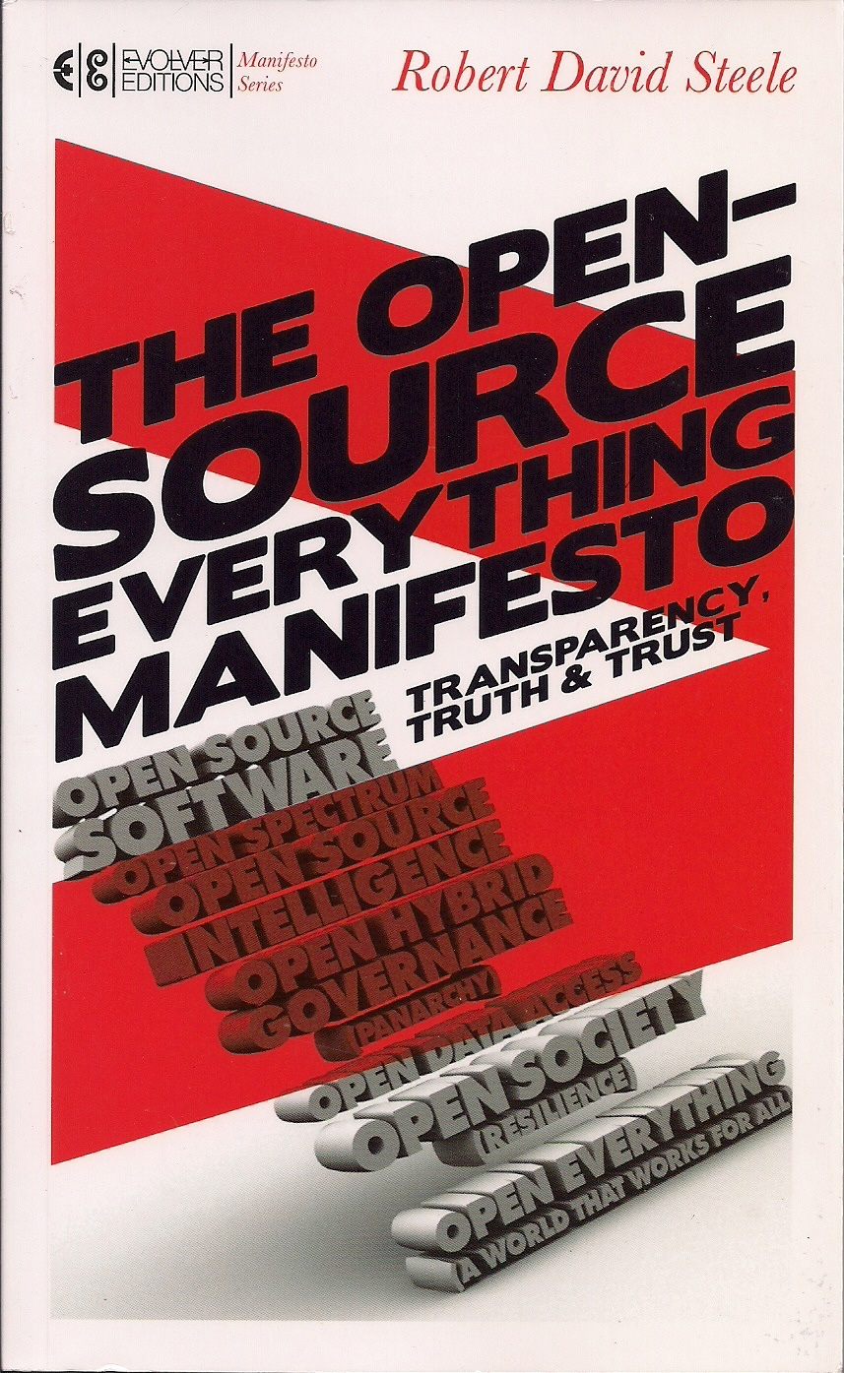
Open Source Everything Manifesto: Extracts
http://tinyurl.com/OSE-2014
Notes:
Today you are receiving a completely original but very short version of my vision for creating a prosperous world at peace through open source everything.
The first and long version of the briefing was presented at Gnomedex in Seattle in 2007.
The Manifesto chapter and excerpts from the book are free online. I regret that this is the only one of my nine books that is not free online, this was a compromise I made to get it into bookstores.
This briefing and all the free stuff on this theme is at the tiny url shown, OSE-2014.

Slide 3
Notes:
I want to start with a brief overview of where we are in human history, touch briefly on the preconditions of revolution, most of which exist in the USA today, and then conclude with “What Is To Be Done.”
Here are the key negative trends. All five of these trends can be attributed to corruption and the loss of public integrity and public agency. The 1% are sucking the life out of the planet and blocking all attempts to escape from their matrix of control, greed, genocide, and other atrocities.

Slide 4
Notes:
There is good news. The best news is that there are not enough guns on the planet to repress the public, something Howard Zinn, Vaclav Havel, and others have understood. We are not listening.
It is within our power to shut down the stock market, end all foreign currency transactions, end all income and sales taxes, end government borrowing, end government war-mongering, end government abuses against the public interest.
We have the power – we are simply not using that power nor conceptualizing good and achievable ends. Had Occupy listened to me in 2011, we would have achieved electoral reform by now.

Slide 5
Revolution Simplified Version
Notes:
This is the simplified model showing the key ingredients in revolution.
Most critical is leaders that betray the public trust and legalize crime while undertaking elective wars that are about enriching the 1% rather than protecting the public interest.
Across all mission areas today, from agriculture and the economy to education, energy, family, health, and water, among others, the US Government is in constant betrayal of the public trust.

Slide 6
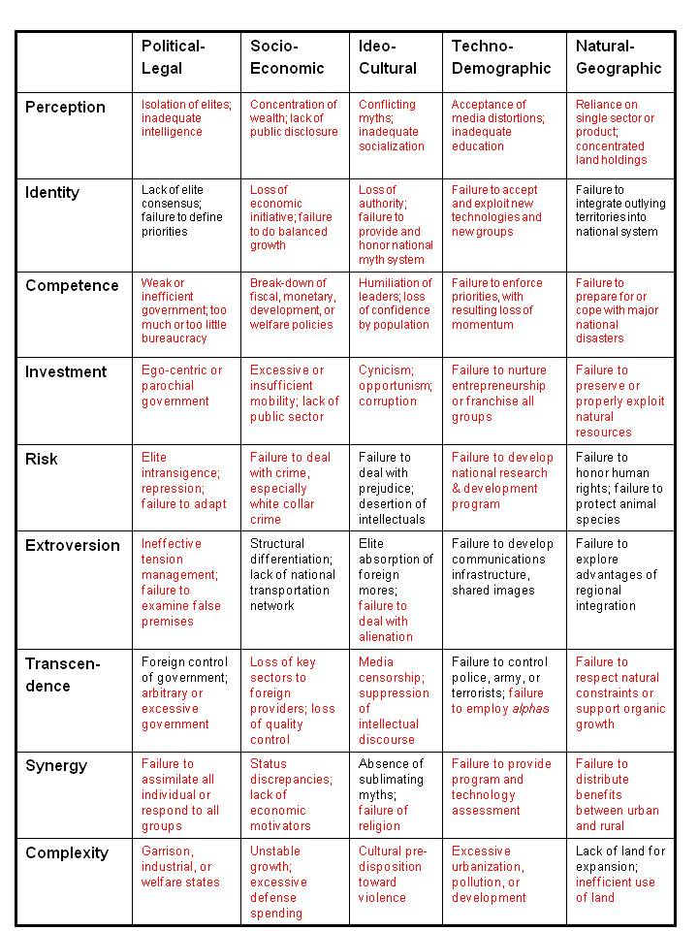
Revolution Complicated Version
These are some of the preconditions of revolution that exist today in the USA. There are many others.
GRIFTOPIA!
FBI protects the wealthy, the pedophiles, the traitors.
NSA spies on us while $80 billion a year produces no useful intelligence (decision-support).
USG does not represent US.
Notes:
Here is the complicated version. My 1976 thesis on preconditions of revolution could do with updating, but the essentials are all here across the various domains – political-legal, socio-economic, idio-cultural, techno-demographic, natural-geographic.
At the highest level of thinking, it boils down to a loss of government legitimacy, and a majority of the public being unemployed, abused, and increasingly desperate. We are out of balance.

Slide 7
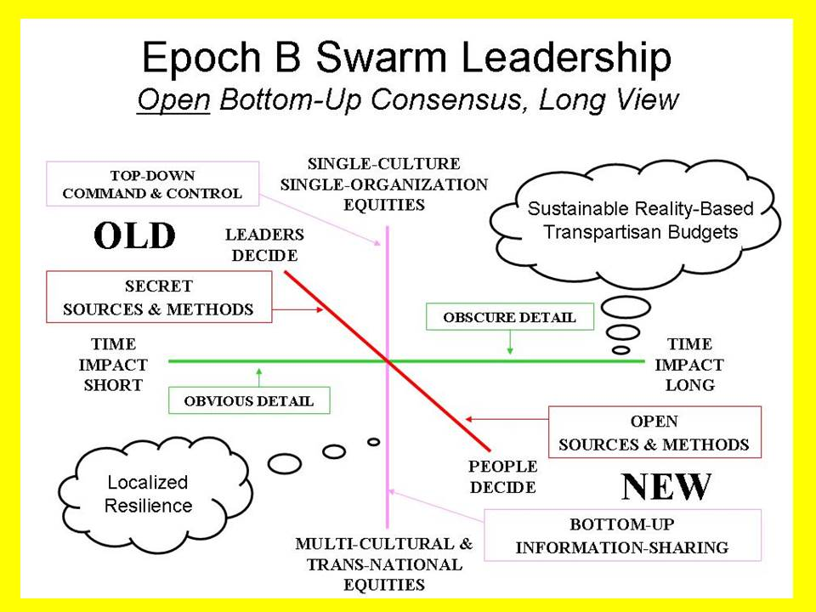
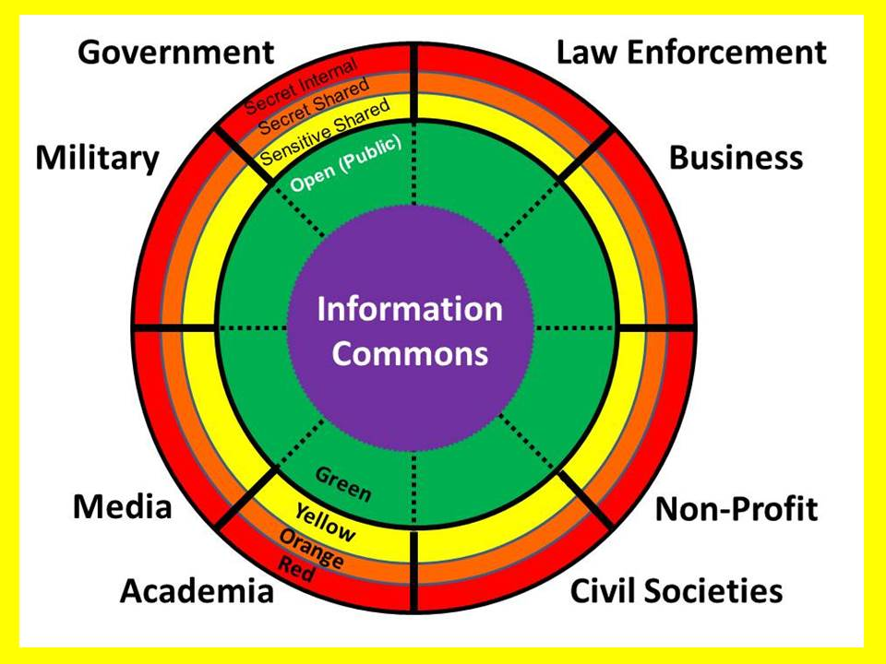
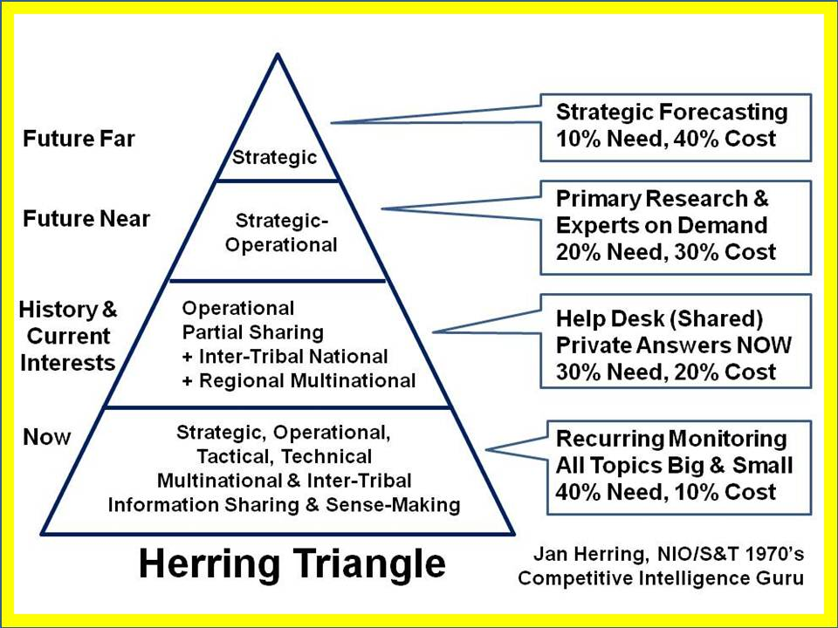
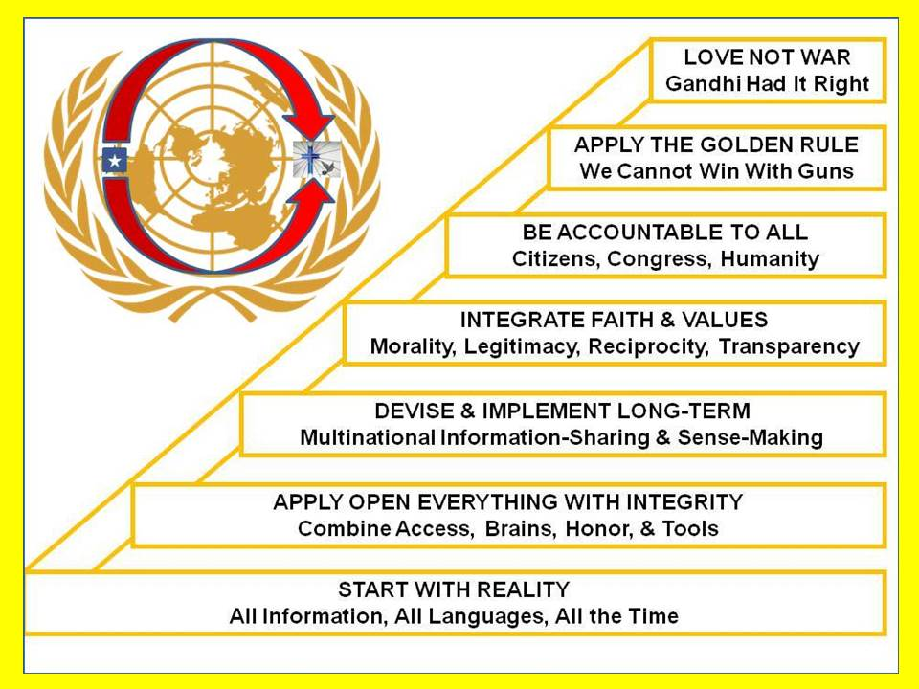
What Is To Be Done?
Notes:
What is to be done? As briefly as possible, with the intent of leaving half the time for questions, I see four huge positives that are within our grasp.
First is the indigenous or native American concept of bottom up consensus leadership that takes the long view based on ethical evidence-based decision support: open source leadership.
The other three slides show the eight tribes of information that do not share information now; a concept for creating mostly public intelligence from my colleague Jan Herring; and a strategy for creating a prosperous world at peace.

Slide 8
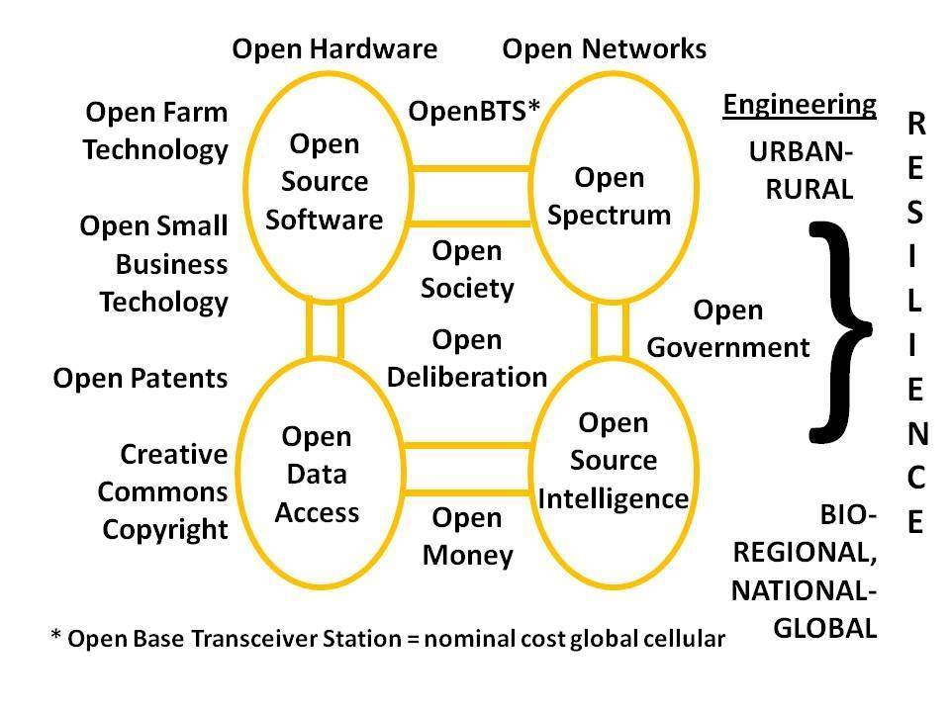
Open Source Everything!
Notes:
In relation to this event and its theme, the future of information, this is my most important slide.
Open Source cannot be effective unless we embrace it and go “all in” across all the opens. Open Data without Open Software and Open Hardware is not real. Open Government is fiction unless we also have Open Intelligence and Open Access. Open Networks cannot be effective without Open Cloud and Open Spectrum.
The cyber-commons is the foundation for humanity’s future, and cannot be enclosed and destroyed – as the earth has been – by corrupt governments and their predatory capitalist owners.

Slide 9
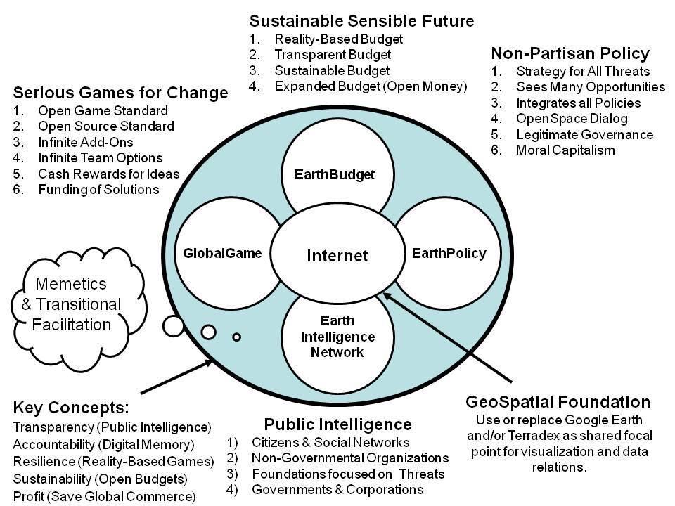
Public Everything!
Notes:
Back in the day when I had money, I channeled my surplus funds into creating Earth Intelligence Network, an accredited but now unfunded 501c3. I led 23 others in creating this concept for getting a grip on public information to create public intelligence in the public interest.
Medard Gabel, co-creator with Buckminster Fuller of the analog World Game, was our architect for the GlobalGame. A digital global game would represent the true cost of all products and services and behaviors, and deliver to your hand-held device a red, yellow, or green advisory for every barcode or name you care to consider.

Slide 10
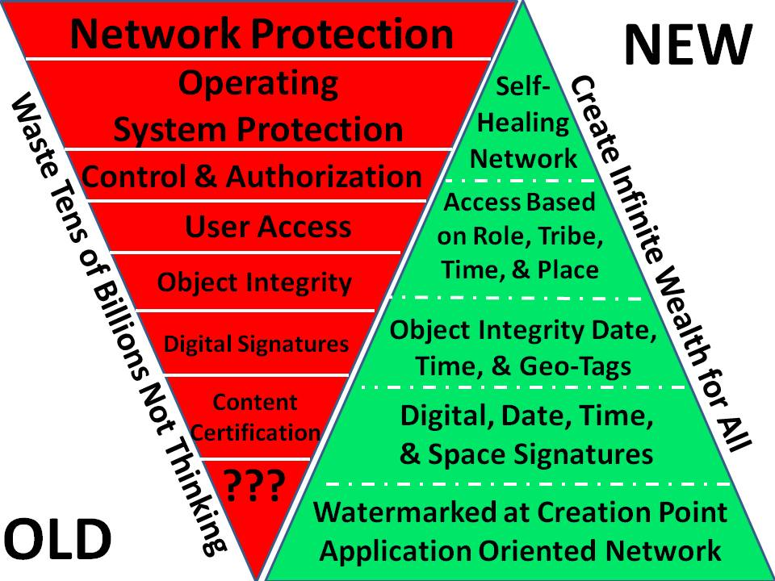
Cyber-Commons Activism
Notes:
I wrote the letter to the White House in 1994 calling for a billion dollar a year investment in cyber-everything, and was ignored. More recently in 2010 I published a commentary on “America’s Cyber-Scam” in Homeland Security Today.
Apart from the debility of all governance bodies for cyber-space, we have a real problem in that those making decisions do not know what they need to know. They literally do not understand or care to contemplate the alternative approach to cyber that I show here, created in partnership with Robert Garigue (RIP). We need an Autonomous Internet and we need to do this for ourselves.

Slide 11
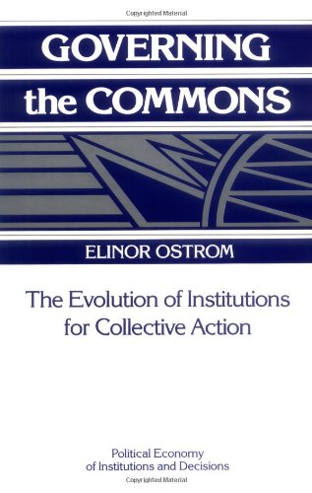
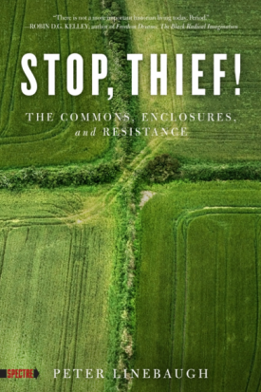
Ideas of Others
Worth a Look: Recent Books on 10 High Level Threats Worth a Look: Recent Books on 12 Core Policies Worth a Look: Recent Books on 12 Major Political Players Worth a Look: Recent Books on True Cost Economics Worth a Look: Recent Books on All the Opens
Worth a Look: Book Review Lists (Positive Future-Oriented)
Worth a Look: Book Review Lists (Negative Status-Quo)
Worth a Look: 9/11 Books, DVDs, Videos, and Other
Worth a Look: Book Reviews on Intelligence (Most)
Worth a Look: Book Reviews on Corruption 2.0
Worth a Look: Book Reviews on Democracy Lost & Found
Worth a Look: Book Reviews on Religion & the Politics of Religion
800+ Authors on Open Source Intelligence and Public Intelligence in the Public Interest: http://www.phibetaiota.net
Notes:
As I draw to my conclusion I want to leave you with some pointers to the ideas of others. Quite by accident I have ended up being the top Amazon reviewer for non-fiction, reading in 98 categories.
Here I offer the covers of two of the most important books I have found relevant to our theme, and some of the lists of lists of reviews I have done that are easily found online – a free master’s round table on important topics.
I recommend another of my briefings easily found online, 2007 Amazon as Hub of World Brain, it also comes in movie form, also free online.

Slide 12
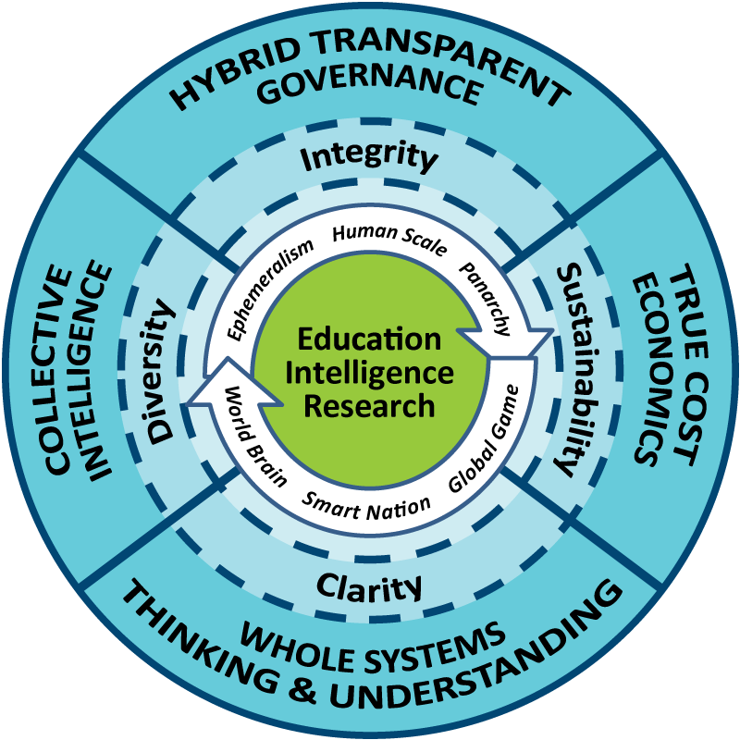
Peer-2
Whole
Peer
Earth
Open
Integrity
Source
Notes:
After a lifetime of thinking about this – but hopefully with another 20 years of public service ahead of me, this is what I have conceived.
Education, Intelligence, and Research must be managed as a whole.
Governance must be hybrid in nature.
We must achieve whole systems understanding and analytics replete with true cost economics.
We must all be engaged informed citizens.
Peer to Peer, Whole Earth, Open Source Everything – this all adds up to INTEGRITY.

Slide 13
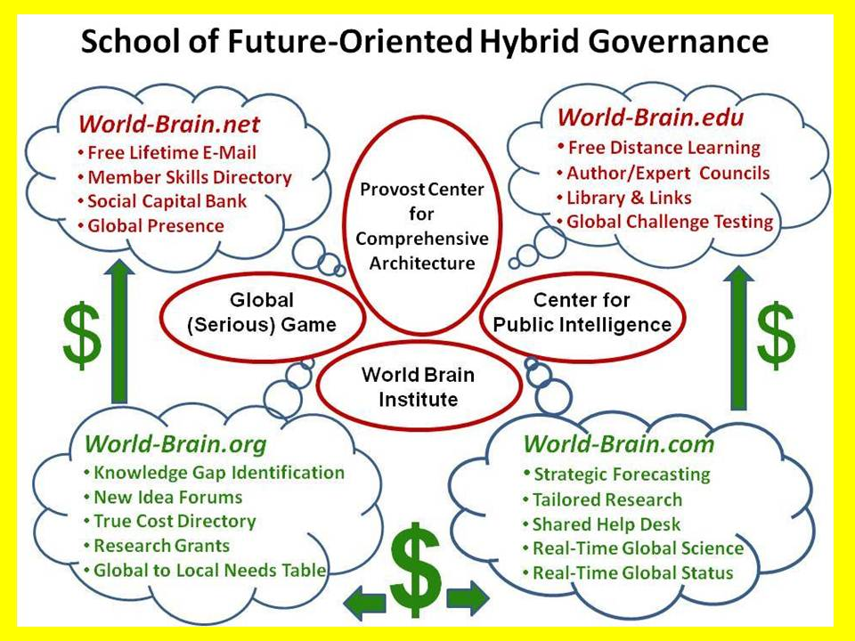
Notes:
This is how I would build it, if I could find a single great university, ideally in NYC, willing to listen and commit to raising $100 million against this needed capability.
There is PLENTY OF MONEY with which to create this, and it becomes self-sustaining fairly quickly as corporations and governments discover that the only sustainable profit is that profit that is based on truth, transparency, and trust.
Apart from this private sector initiative I also believe that we must demand that our government fund the Open Source Agency that I champion.

Slide 14
Notes:
My honorable colleagues succeeded in getting an Open Source Agency on to pages 23 and 413 of the 9/11 Commission Report. OMB has twice approved an Open Source Agency at $125M IOC toward $2B FOC – even in these constrained times – provided a Cabinet Secretary or the White House ask for it.
At a national level I have been blocked by CIA as I have repeatedly tried to get a briefing to Hillary Clinton, John Kerry, Chuck Hagel, and others.
I have posted for all of you and others a complete copy of my 1 May correspondence to Vice President Joe Biden. Whether he saw it or not, I commend it to you for public study and action.

Slide 15
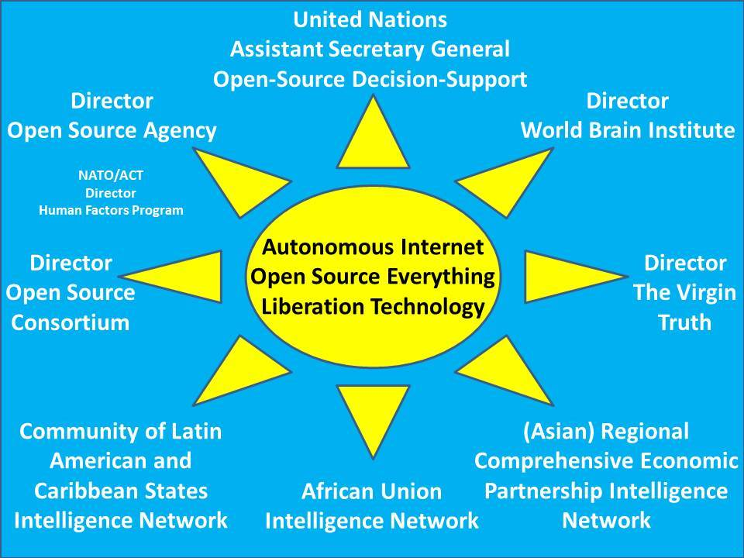
Notes:
Lastly, I happen to be a fan of the United Nations. What the UN lacks is a United Nations Open-Source Decision-Support Information Network (UNODIN).
If I had Presidential or Congressional support, the Open Source Agency (OSA) budget would easily fund the creation of a UN Assistant Secretary General position and inspire and perhaps subsidize the other pieces shown here.
The bottom line is simple: decisions of global import today are made on the basis of who pays to be heard, not on the basis of ethical evidence-based decision-support. Open Source Everything is an enabler of this righteous objective. - o -

