Slide 1
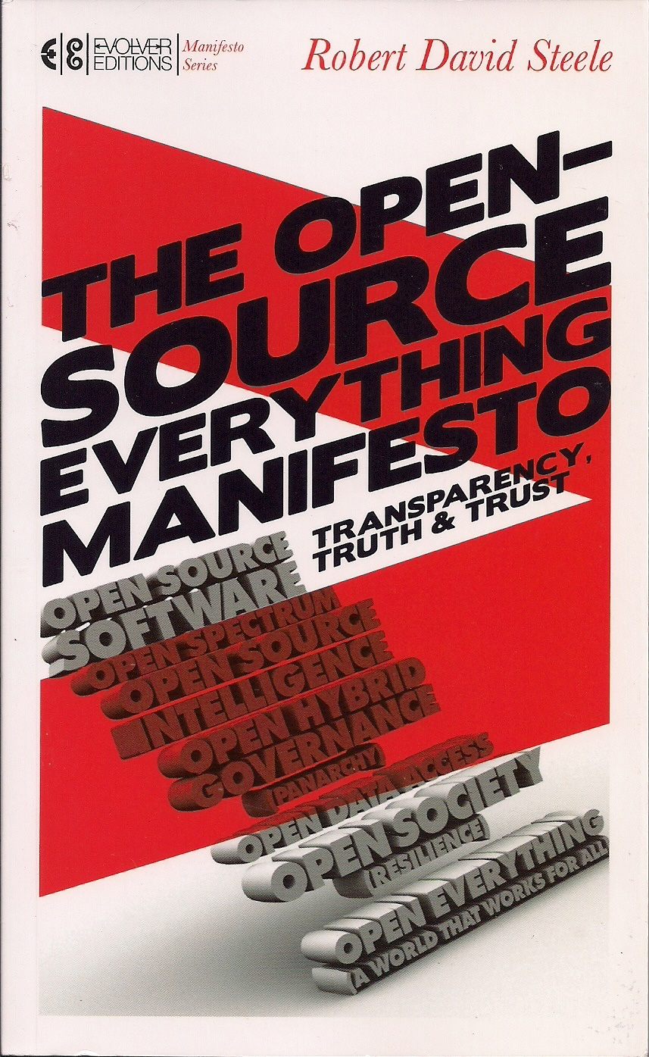
Open Source Everything Manifesto: Extracts
http://tinyurl.com/OSE-2014
Notes:
Today you are receiving a completely original but very short version of my vision for creating a prosperous world at peace through open source everything.
The first and long version of the briefing was presented at Gnomedex in Seattle in 2007.
The Manifesto chapter and excerpts from the book are free online. I regret that this is the only one of my nine books that is not free online, this was a compromise I made to get it into bookstores.
This briefing and all the free stuff on this theme is at the tiny url shown, OSE-2014.

Slide 2
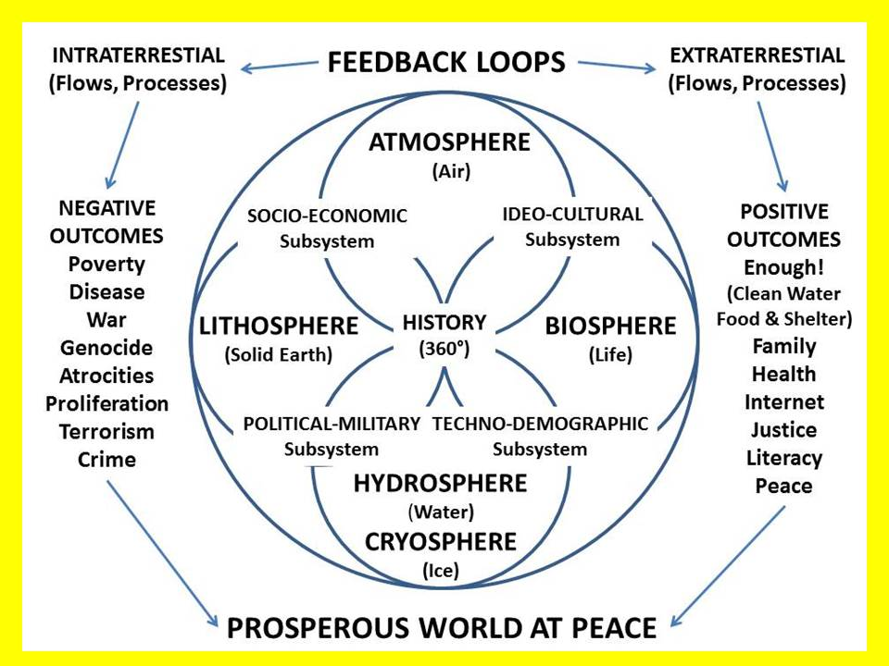

Slide 6
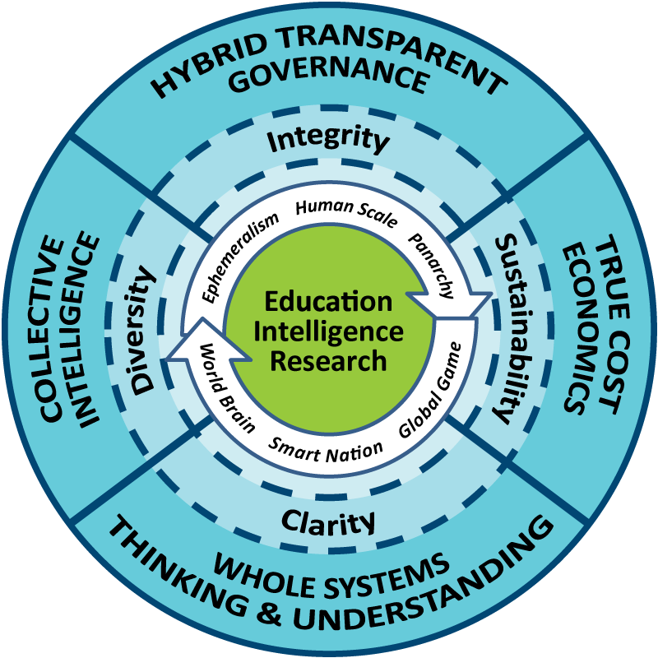
Peer-2
Whole
Peer
Earth
Open
Integrity
Source
Notes:
After a lifetime of thinking about this – but hopefully with another 20 years of public service ahead of me, this is what I have conceived.
Education, Intelligence, and Research must be managed as a whole.
Governance must be hybrid in nature.
We must achieve whole systems understanding and analytics replete with true cost economics.
We must all be engaged informed citizens.
Peer to Peer, Whole Earth, Open Source Everything – this all adds up to INTEGRITY.

Slide 8
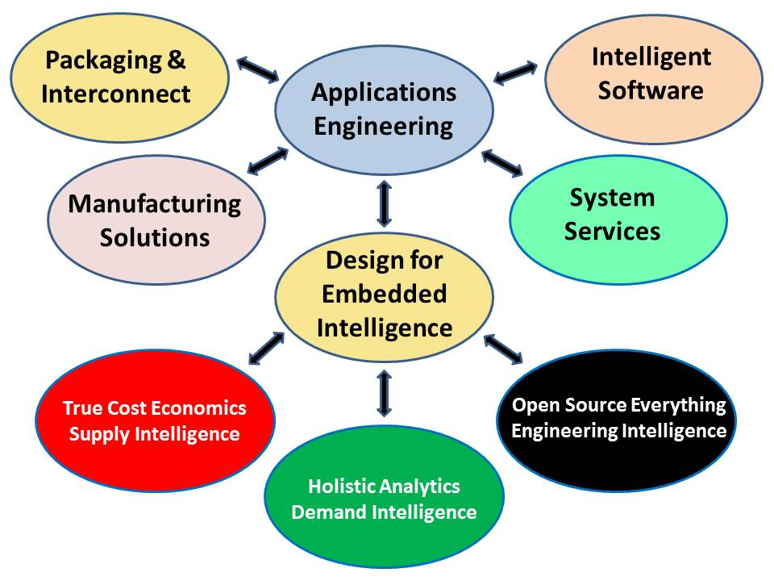

Slide 9
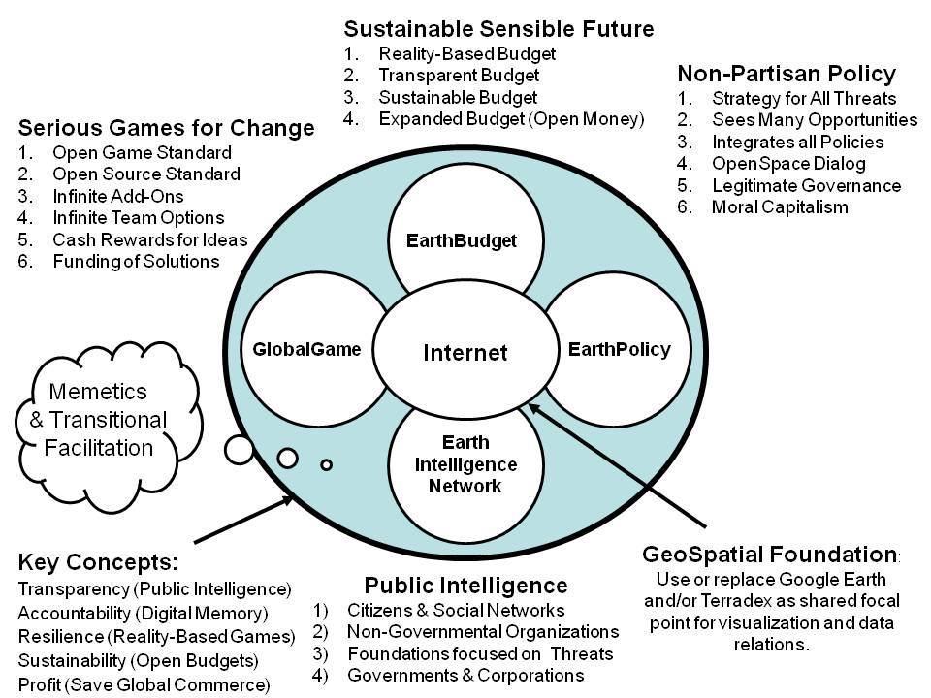
Public Everything!
Notes:
Back in the day when I had money, I channeled my surplus funds into creating Earth Intelligence Network, an accredited but now unfunded 501c3. I led 23 others in creating this concept for getting a grip on public information to create public intelligence in the public interest.
Medard Gabel, co-creator with Buckminster Fuller of the analog World Game, was our architect for the GlobalGame. A digital global game would represent the true cost of all products and services and behaviors, and deliver to your hand-held device a red, yellow, or green advisory for every barcode or name you care to consider.

Slide 10
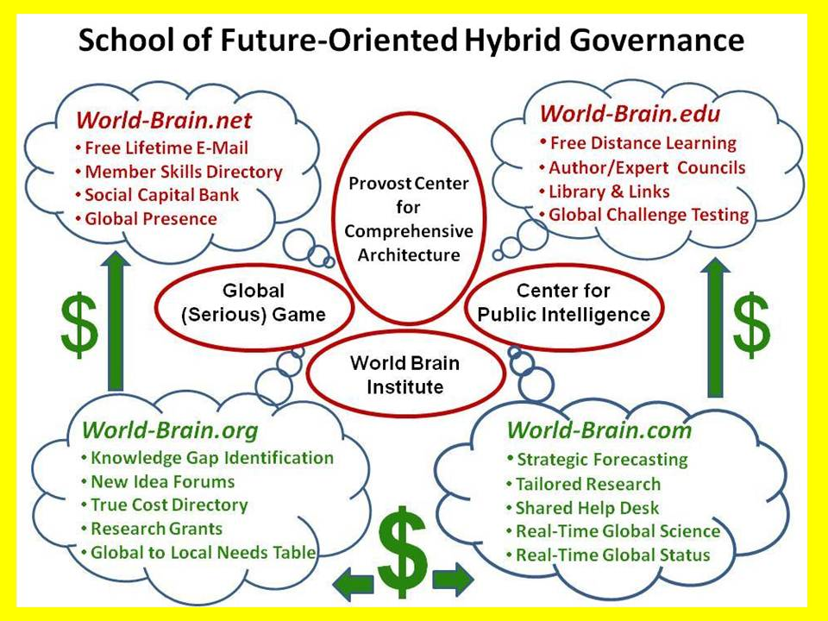
Notes:
This is how I would build it, if I could find a single great university, ideally in NYC, willing to listen and commit to raising $100 million against this needed capability.
There is PLENTY OF MONEY with which to create this, and it becomes self-sustaining fairly quickly as corporations and governments discover that the only sustainable profit is that profit that is based on truth, transparency, and trust.
Apart from this private sector initiative I also believe that we must demand that our government fund the Open Source Agency that I champion.

Slide 11
