Slide 1
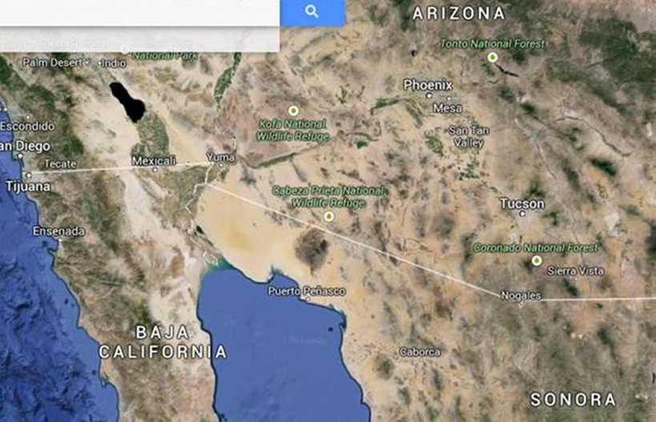
$25M/Year Buys Water
IOC 5MGD FOC 50MGD
168 Miles

