Slide 1

OSINT
What it’s not

Slide 2


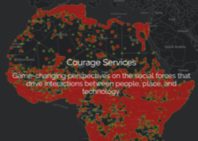

NATO OSINT HANDBOOK, 2002
Open Source Data (OSD): raw, from a primary source. (Unexploited)
Open Source Information (OSIF): data that can be put together…by an editorial process, some filtering and validation. OSIF is generic information that is usually widely disseminated.
Open Source Intelligence (OSINT): information deliberately discovered, discriminated, distilled, and disseminated to a select audience, to address a specific question.

Slide 3


Why Online?
“…80% of what [is] needed in order to produce policy, acquisition, and operations intelligence was not secret, not online, not in English, and not available from anyone in the National Capital Area (NCA).” - USMCIC, 1992
2016
Voluminous Data Available
Accessibility vs Time/Travel
Virtual Replication

Slide 4
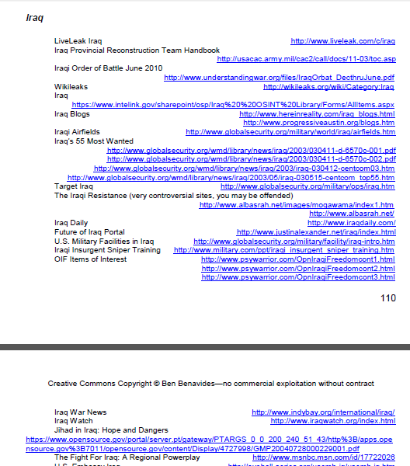
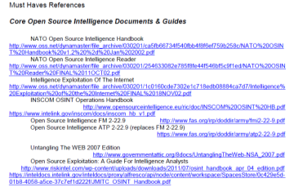
Commonly Used Open-Source Tools
www.phibetaiota.net

Slide 5

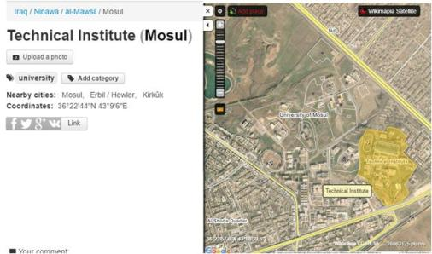
Commonly Used Open-Source Tools
Mapping / GeoINT Tools
Content provider (e.g., Google)
Data aggregation
“Authoritative”
Wiki-based
Crowd-sourced
Ground-truth / perception

Slide 6


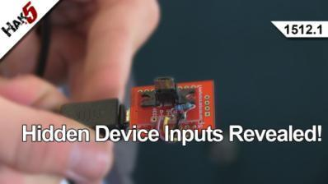
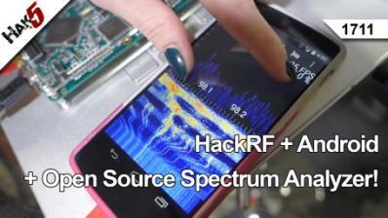
Commonly Used Open-Source Tools
Online How-To

Slide 7

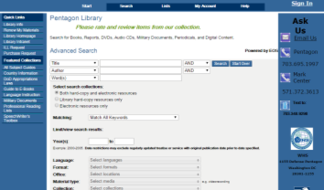

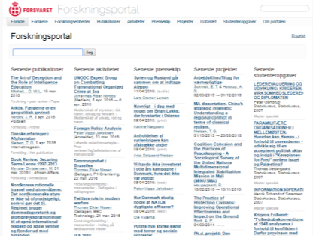


Commonly Used Open-Source Tools
Reach-back Resources

Slide 8


Commonly Used Open-Source Tools
Fermi Problems
How many jelly beans fill a one-liter bottle?
What is the approximate size a jelly bean?
Do jelly beans "completely fill the liter bottle“?
The number of jelly beans is the occupied volume of the jar divided by the volume of a single jelly bean
2cm length x 1.5cm dia.
~80%
Jellybean = ~3.75cc
1L x 80% / 3.75cc (mL)
213 jellybeans
How many Foreign Fighters are in the CJOA?
What is the population of Iraq +Syria?
How much of the population is ISIS?
How much of ISIS is foreign fighters?
Other sources of information
Iraq 37M + Syria 16M (down from 22.85M) 53M
>1, but < 53M
Estimates between 70K and 200K Shooters vs. All ISIS (judges, governors, police, etc.)
Count from OSINT and other reporting = ~ 1/3 23K-66K
Foreign Fighter border forms = 22K* >16K
Mar 29, 2016 - It is estimated that over 27,000 foreign fighters have travelled to Iraq and Syria since fighting broke out in 2011. While there are no confirmed figures for the official tally, experts predict that many are still fighting in the conflict zone - while an estiated 20 to 30 per cent have travelled home. - www.telegraph.co.uk

Slide 9
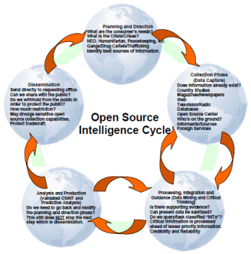
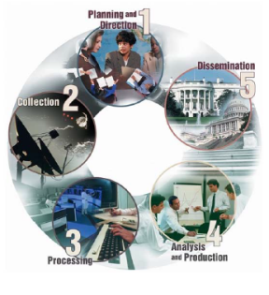
Using OSINT like all other -INTs
Collection Requirements
Translation / Culture
Processing / Fusion
Cueing / Collection
Vetting
Validation
5Ws
Audience
Tgt Audience
Platform
Attribution
Ownership
Allegiance
Support
History
Track Record
Cognitive dissonance
Trigger topics
Language
Dialect/slang
Social mores
Customer
Deliverables
INT Confirmation
Tip other INT
Define gaps
Expand reach

Slide 10
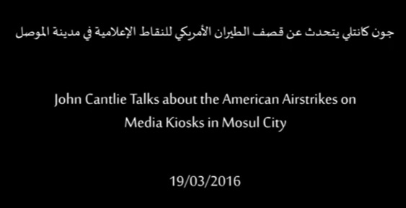
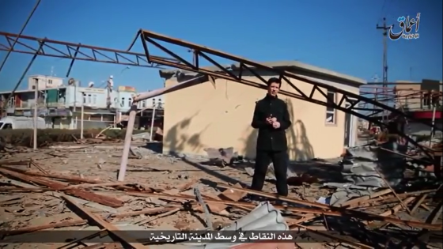
Analysis

Slide 11
Information Environment Considerations

Slide 12
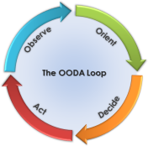
Information Environment Considerations
Cognitive
Perceptions
Virtual
Media message
Physical
Observable events
Full Alignment
Virtual Mismatch
Physical Mismatch
Observed Reality matches messaging received
Physical / Virtual alignment creates / shapes / reinforces Cognitive reality
Competing or Counter message in Virtual space disrupts Cognitive reinforcement when “ground truth” is known
Virtual space may be irrelevant for isolated populations without other access (e.g., Mosul)
Virtual message can be less effective when competing observables are available to the audience
Remote audiences (e.g., Western countries) may not have Physical frame of reference, basing perception only on Virtual message

Slide 13
Challenges
Non-attribution - webmaster tracking, domains, cookies, cache
Denial / Deception - false positives, bias confirmation, dual stream
Counter-Intelligence - focused CI operations, tipping/cueing

Slide 14
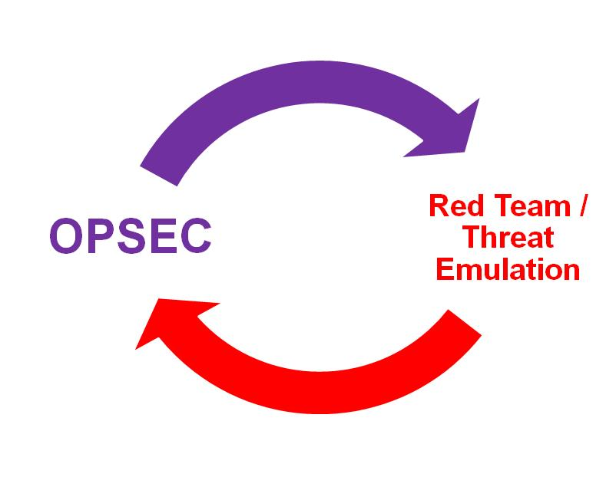
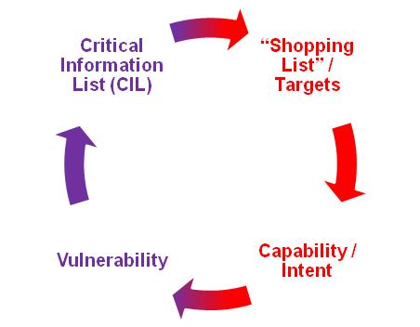
OPSEC / Red Team

