Slide 1
TOXIC LEADERSHIP
Leadership style, organizational climate and organizational effectiveness: What’s style got to do with it?
George Reed
george.reed@sandiego.edu
619-940-4102

Slide 2
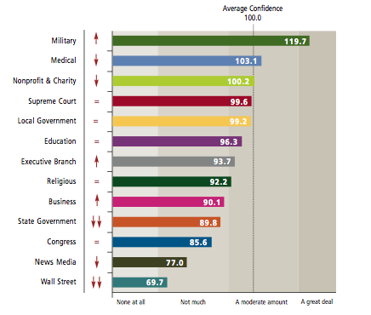
National Leadership Index
Rosenthal, S. A., Moore, S., Montoya, R. M., & Maruskin, L. A. (2009). National Leadership Index 2009: A National Study of Confidence in Leadership. Center for Public Leadership, Harvard Kennedy School, Harvard University, Cambridge, Massachusetts.

Slide 3
Reed’s 4-F Affiliation Theory
Funds
Tangible
Fun
Fellowship
Intangible
Feeling

Slide 4
Ross McGinnis

Slide 5
Definition of Style
Leadership style is the pattern of behavior used by a leader as recognized by those who are led.

Slide 6
Does leadership style matter?
Organizational effectiveness is usually defined by near-term accomplishments.
Where do we assess the long-term health of our company and the people in it?
Is there a cost that must be paid for leaders with a destructive leadership style?

Slide 7
Stress
90% of all physician’s office visits are ultimately stress related.
Stress is linked to six of the leading causes of death: heart disease, cancer, lung ailments, accidents, cirrhosis of the liver and suicide. Chronic stress can result in:
Anxiety Depression
Chest pains Irregular heartbeats
Diabetes Anorexia
Forgetfulness Panic attacks
Irritability
Framberger, M. (2007). “Stress Management Strategies.” The Connection, (11), pp. 27-29.

Slide 8
Impact of Toxic Leadership
Fun ⬇
Fellowship ⬇
Feeling ⬇
All measures of Satisfaction ⬇
Senior officers (O5 and above) suffer and are inclined to stay
Mid-grade officers suffer and are inclined to leave

Slide 9
Leadership Matters
Some leaders impart energy and maximize potential. Good leaders add value.
Some leaders, by virtue of their personality and style consume unit energy. Even high performing organizations can be “run into the ground.”
Sometimes systems of performance evaluation and selection does not distinguish between the two.

Slide 10
Toxic Leaders
Some in leadership positions have a style that is so destructive that they not only do not add value, they are a detriment to their organizations.

Slide 11
Definition of toxic leadership
An apparent lack of concern for the well-being of subordinates.
A personality or interpersonal technique that negatively affects organizational climate.
A conviction by subordinates that the leader is motivated primarily by self-interest.

Slide 12
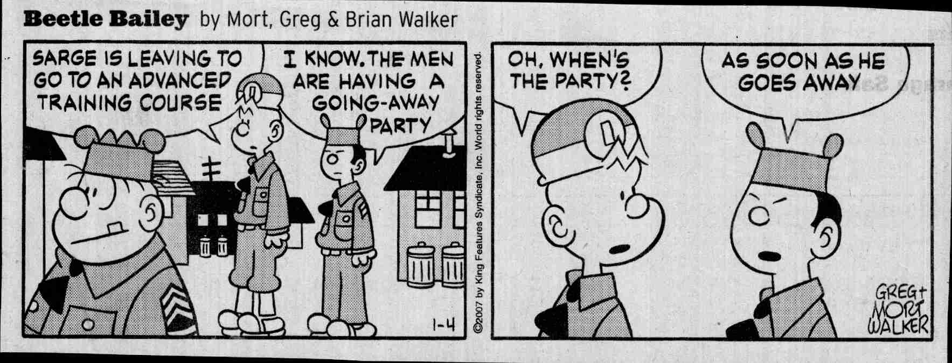

Slide 13
Respect
It is possible to impart instructions and to give commands in such a manner and in such a tone of voice as to inspire in the soldier no feeling but an intense desire to obey, while the opposite manner and tone of voice cannot fail to excite strong resentment and a desire to disobey.
The one mode or other of dealing with subordinates springs from a corresponding spirit in the breast of the commander.
He who feels the respect which is due others cannot fail to inspire in them regard for himself; while he who feels, and hence manifests, disrespect toward other, especially his inferiors, cannot fail to inspire hatred against himself.
Major General John M. Schofield, 1879

Slide 14
The Asshole Test
Test One: After talking to the alleged asshole, does the “target” feel oppressed, humiliated, de-energized, or belittled by the person? In particular, does the target feel worse about him or herself?
Test Two: Does the alleged asshole aim his or her venom at people who are less powerful rather than at those people who are more powerful?
Sutton, R. I. (2007). The no asshole rule. New York: Warner, p. 9

Slide 15
A cautionary note
Not all loud, demanding, and “large personality” supervisors are toxic.
There is a time and place for almost any leadership style. The art is in matching the appropriate style to the context of a given situation.
Self-awareness and adaptability are key traits

Slide 16
An organizational problem
Toxic leaders leave a wake in their path that extend long beyond their tenure.
Superiors do not see or acknowledge the negative impact of toxic leaders.

Slide 17
We should ask
Do we create toxic leaders?
Do we tolerate them?
What should we do about them?
How many toxic leaders are in your organization?

Slide 18
Solutions/Antidotes
Name the problem (toxic leadership) and talk about it openly.
Develop and select with an eye to leadership style, not simply short term effectiveness.
Implement the “no asshole rule.”
Hold supervisors responsible for the style of their subordinates.
Implement climate assessments. Look for the weak signals.
Evaluate the long term health of the organization as well as accomplishment of the short term goals.
Implement 360 degree or multi-faceted evaluations for development, and eventually as a data point for promotion, selection, and assignment.
Have the hard discussions.

Slide 19
Results and leader behavior
Positive Leader Behaviors
Poor Results
Good Results
Negative Leader Behaviors

Slide 20
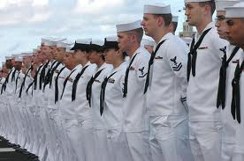
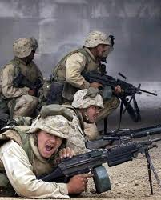
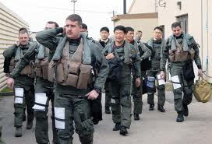
What kind of leadership do they deserve?

Slide 21
Questions/ Discussion
George Reed
george.reed@sandiego.edu
619-260-7444

Slide 22
Additional Resources
Hornstein, H. A. (1996). Brutal Bosses. New York: Riverhead.
Kellerman, B. (2004). Bad Leadership: What It Is, How It Happens, Why It Matters. Boston: Harvard Business School Press.
Kusy, M. & Hollway E. (2009). Toxic Workplace! San Francisco: Jossey Bass.
Lipman-Blumen, J. (2006). The Allure of Toxic Leaders: Why We Follow Destructive Bosses and Corrupt Politicians--and How We Can Survive Them. New York: Oxford University Press.
Reed, G. (2004). “Toxic Leadership,” Military Review.
Reed, G. & Olsen R. (2010). “Toxic Leadership: Part Deux,” Military Review
Reed, G. & Bullis, R. (2009). “The Impact of Destructive Leadership on Senior Military Officers and Civilians,” Armed Forces and Society.
Sutton R. (2007). The No Asshole Rule: Building a Civilized Workplace and Surviving One That Isn’t. New York: Warner Business Books.
Whicker, M. L. (1996). Toxic Leaders: When Organizations Go Bad. New York: Doubleday.

