Slide 1
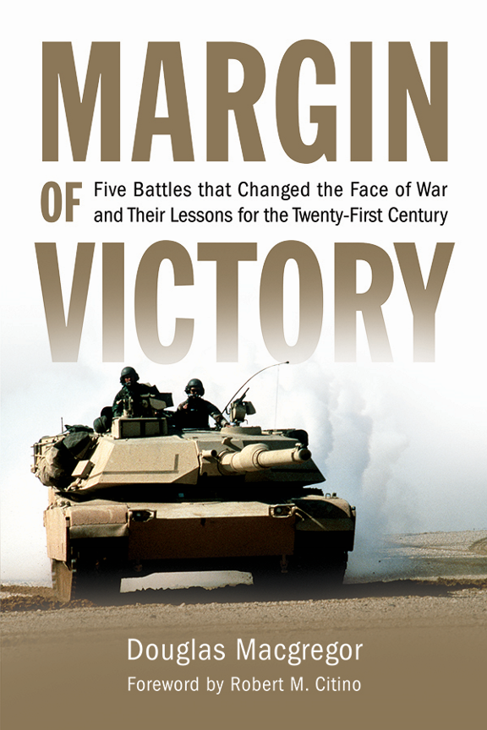
Author’s Presentation
“The “margin of victory” is always slim, and the walk from the victory lane to the losers’ club is all too short.”
Robert Citino, Foreword to Margin of Victory
Notes:
COVER SLIDE

Slide 2
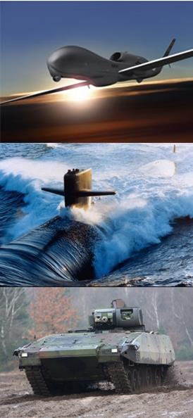
Why Margin of Victory?
“War makes the victor stupid.”
Friedrich Nietzsche
The story of mankind is the “eternal returning of the same.”
Friedrich Nietzsche
Notes:
Margin of Victory employs twentieth century battles to demonstrate that military success against weak, non-state opponents does not equate to success against capable, nation-state enemies.
Margin of Victory’s conclusions discuss the challenge of “contested environments;” and the future impact of technology that already exists in the world’s military establishments, but has not yet been employed against American forces.
Ultimately, the conclusions argue for a National Defense Staff and Standing Joint Force Headquarters in the regional unified commands to facilitate the integration of ground maneuver forces within the growing complex of ISR and Strike capabilities in the AF and the Navy.

Slide 3
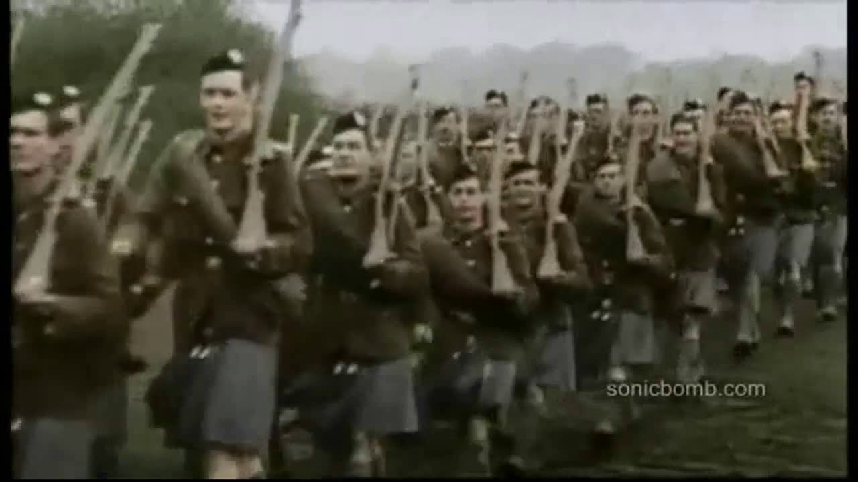
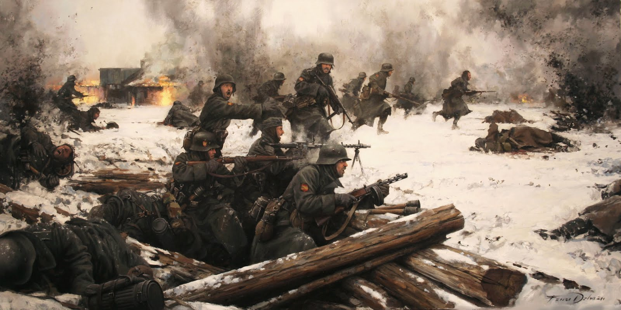
5 Battles in
5 Wars of Decision
The Battle of Mons, 1914
(Just in time to avoid defeat)
The Battle of Shanghai, 1937
(Pyric Victory)
The Destruction of Army Group Center, 1944
(Total versus Limited War)
Counterattack Across the Suez, 1973
(Adapt or Die)
The Battle of 73 Easting, 1991
(Preordained Success)
Notes:
Margin of Victory focuses on wars Clausewitz called “absolute wars” or wars of decision, not “wars of observation,” or wars of choice.
The ‘about right’ combination of organization, technology and human capital is the foundation for victory.
Most Senior Military Leaders can rarely reform and reorganize the old force to build the new, aforementioned combination for the next war. Informed civilian leaders must do it.
Wars of decision are interstate conflicts that affect nations’ vital strategic interests, if not the very survival of nation-states;
A future war of decision is brewing; the old military alliances and the interests that supported them are changing;
Building effective military power takes time, resources and imagination;
If today’s U.S. Armed Forces were hit and hit hard, the forces and their commanders would be shocked, even paralyzed;

Slide 4
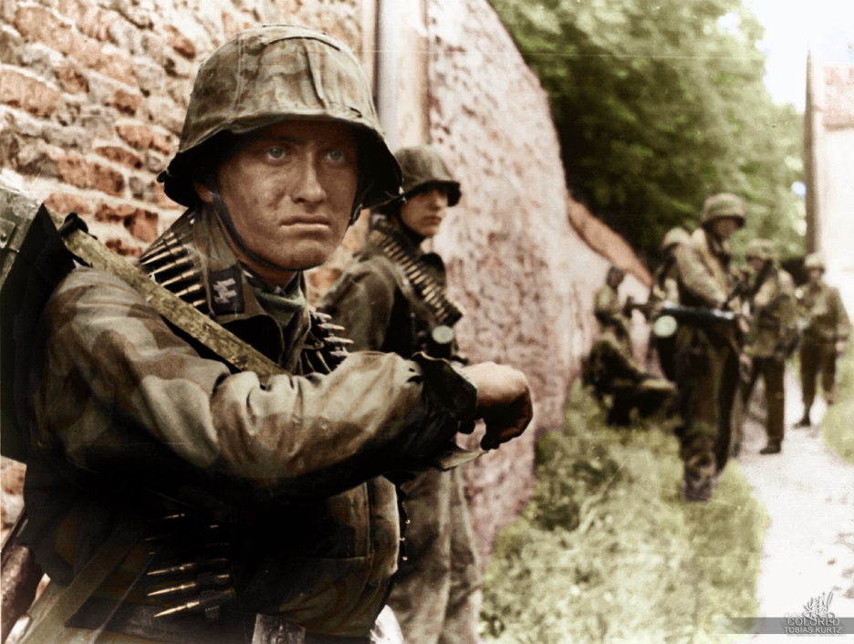
Strategy
Strategic decisions are often taken “in the
fever of a fanatical urge to act.”
Self-assessments of one’s own strengths
and weaknesses are missing.
Military strategy is seldom congruent with
national culture, geography and scientific-industrial capacity.
Purpose?
Method?
End-state?
“Holding ground” pushed German ground forces, air power, and logistics to the breaking point.
As a result, the Soviet high command
could commit resources when and where they were needed to overwhelm
the Wehrmacht.
Notes:
Grand strategy, if it exists at all, consists of
avoiding unnecessary conflict, not starting it.
The ability to employ military power, rather
than the valid strategic requirement to use force, dominates national security decision-making.
Realistic answers to the questions of strategic
and operational purpose, method, and end state before and during wartime operations are missing.
Without a rational strategic framework in
place, Military Leaders will always shrink existing forces until money and people are provided to restore the last war’s force to its former size.

Slide 5
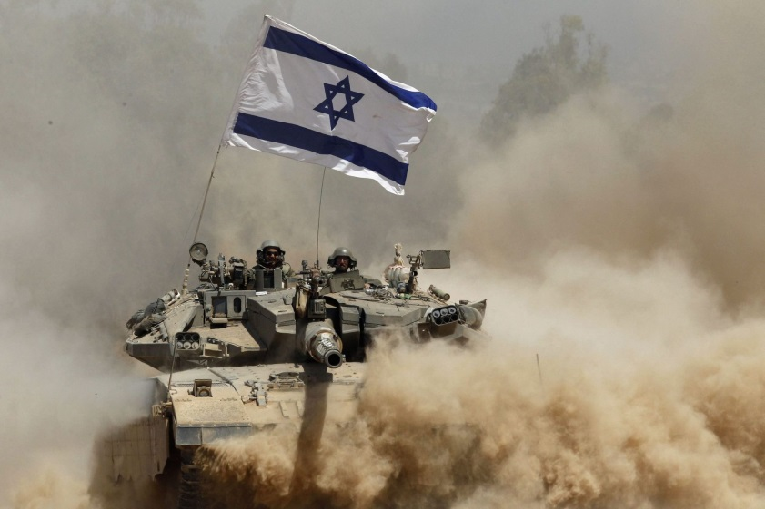
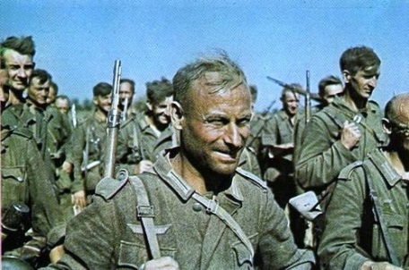
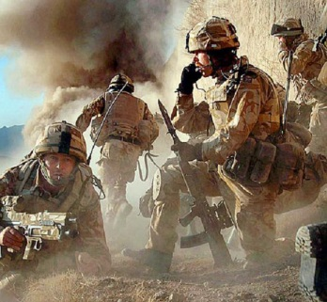
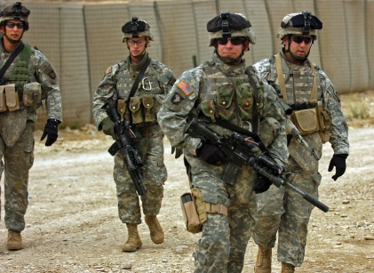
National Culture and
Human Capital
“Life is tough. It’s tougher when you’re stupid.”
John Wayne, American Military Theorist
“The advantage that stands the test of time...
is people.” Character, Competence, Intelligence (C2I).
When national military strategy is realistic and
armed forces organize to exploit technology effectively, “Quality trumps Quantity.”
Israeli soldiers and officers could improvise, adapt, and counterattack.
Egyptian soldiers were culturally disinclined to seize the initiative and exploit the opportunities that battle offered.
Notes:
National culture is responsible for the pool
of high-quality Soldiers, Sailors, Airmen and Marines that populate the armed forces.
National Culture is the foundation for the
emergence of tens of thousands of exceptional leaders who can analyze, synthesize, and act independently within a known operational framework.
In a wartime environment where the first
technology to fail is always communications with higher headquarters, superior human capital at the lowest level is indispensable.

Slide 6
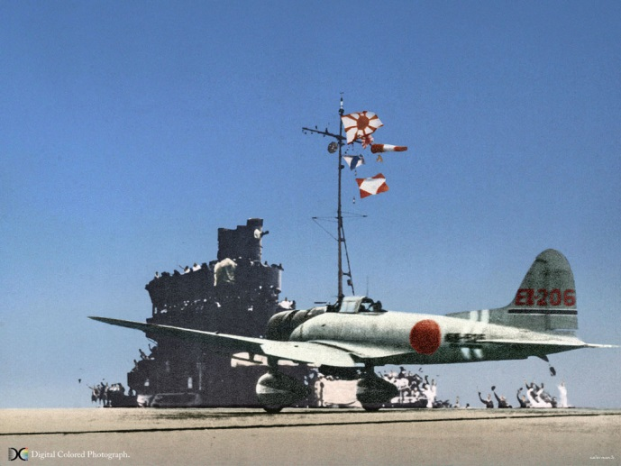
Unity of Effort
Without unity of command, there is no unity of effort.
The Soviets won, in part, because the STAVKA
(High Command) imposed unity of command from top to bottom.
In 1973, the IDF recovered from strategic
surprise because the IDF High Command imposed unity of effort.
The Imperial Japanese Army generals fought reform, and modernization as hard as they fought the Imperial Japanese Navy.
Lashing up hundreds of single-service headquarters—air, land, and sea—(each of which fought its war on its own terms), failed.
Notes:
The path to unity of effort demands the coherent
organization of military power from the strategic to the tactical levels together with the command structure to integrate and employ capabilities across service lines.
The combination of the two is the foundation for
unity of effort in war—the essential ingredient for victory in battle and war.
In the new century, the United States needs the
means to comprehensively plan and direct joint, integrated ISR-Strike and Maneuver operations—an American Military High Command.

Slide 7
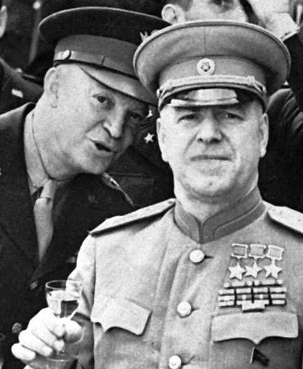
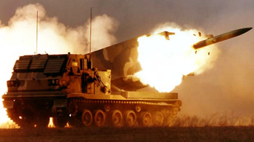
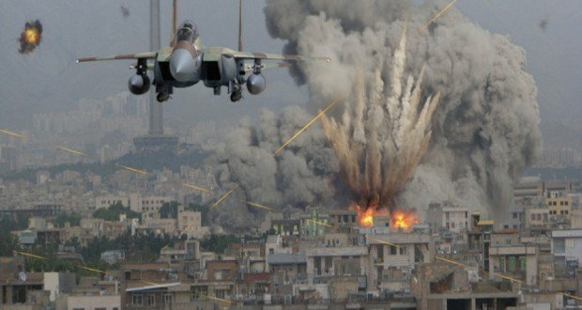
ISR-Strike
Strike is the targeted application of massive firepower
from standoff attack weapons across service lines in all domains.
Strike’s effectiveness depends on the marriage of
space-based and terrestrial ISR capabilities with the timely exploitation of intelligence through networks.
In 1944, a Soviet Marshal could do in minutes what General Eisenhower took months to do: unleash 700 long-range bombers to attack and destroy 50,000 German troops encircled by Soviet tank forces.
Notes:
M_{i} (Maneuver Index) = (Firepower) x (Attrition Tolerance) x (Mobility)
S_{i} (Strike Index) = (Explosive Effects) x (Rate of Fire; Launch; Release)
ISR_{i} (Intel, Surveillance, Reconnaissance Index) = (Area) x (Resolution/Analysis) x (Dissemination Speed)
L_{h} (Logistics Handicap) = (Consumption Rate/Replenishment Capability Rate)
EE_{c} (Combat Effectiveness and Efficiency)

Slide 8
ISR-Strike creates a
paradigm shift in warfare.
A tremendous strategic advantage will accrue to U.S. Military Power if we develop and apply the ISR-Strike-Maneuver-Sustainment Framework.
Transformation under Fire, Praeger, 2003

Slide 9
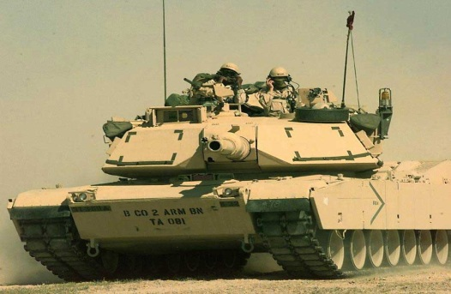
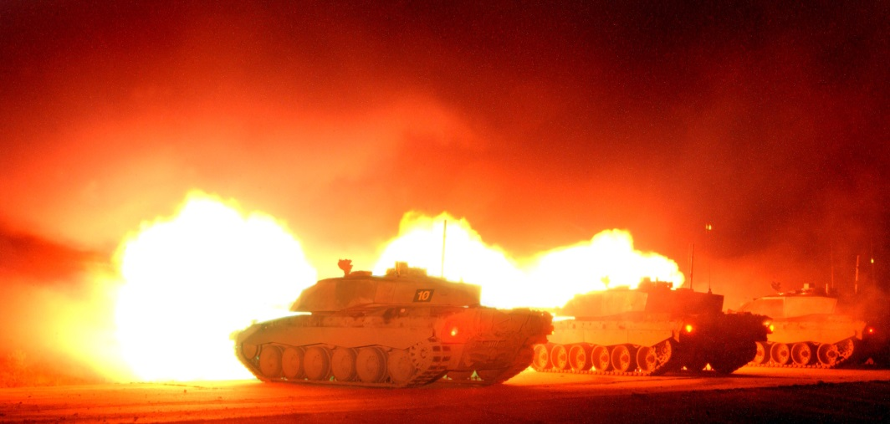
Maneuver Forces
Maneuver Forces exploit the profound, but
temporary paralysis that Strike induces.
Maneuver forces destroy the enemy with
accurate, devastating firepower; they don’t hold ground.
Maneuver Forces close with the enemy take
losses, keep fighting, and attack decisively. (Athleticism does not equal warfighting capability).
The Battle of 73 Easting was a battle of annihilation.
The outcome was preordained by the training, technology, and leadership regime that Generals Depuy and Gorman established after Vietnam.
Notes:
Maneuver Forces are still essential to
exploit the profound, but temporary paralysis that Strike induces.
Maneuver Forces must be able to close
with and survive contact with the enemy.
Strike cannot substitute for accurate,
devastating firepower from mobile armored forces that can take losses, keep fighting, and attack decisively.
“Athleticism in uniform” does not equal
fighting power in modern war. Light infantry—whether airborne, airmobile, or amphibious—is a fragile, niche capability, not the foundation for a twenty-first-century Maneuver Force.

Slide 10
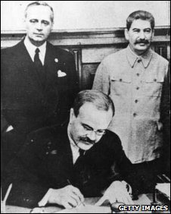
Implications
for U.S. Strategy?
Like the British in 1905, we do not know precisely which
power or alliance of powers we may fight in 10, 15 or 20 years;
If Grand Strategy exists, it consists of avoiding wars, not starting them;
Prepare for strategic (and/or technological) surprise;
In future wars, there will be no time for a “pickup game;”
Build forces-in-being designed to win the first fight,
because we may not get the chance to win a second;
Focus on the conduct of “all arms-all effects” warfare.
“A single unexpected change, such as that of the Soviet-German Pact in 1939, had an influence on many relations in a way which [conventional wisdom and quantitative analysis] could not foresee.”
Quincy Wright, A Study of War

Slide 11
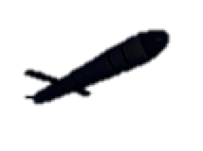
“All Arms-All Effects Warfare”
60-80 km front w/ 80-100 km zone/sector of operation
(terrain dependent)
Forces focus on killing the enemy, not on holding ground.
Forces are capable of mobile, dispersed operations.
Self-contained, independent battle groups operate on land the way Navy ships operate at sea are essential.
Army ISR-Strike assets augment, not duplicate, Joint AF/Naval Strike capabilities.
ISR-Strike Systems dispersed for 360 protection
Maneuver Battalion Kill Zones
Maneuver Battalion Kill Zones

Slide 12
Blueprint:
A future war of decision is coming—the last 15 years eroded U.S. military-technological edge and operational flexibility;
A major reset of national military strategy within constitutional parameters is vital—(Conflict Avoidance);
Focus on access to “Global Commons” and Limited Liability Partnerships—No Permanent Enemies;
Establish an American Military High Command (C2I);
Create Joint Force Commands (JFC) inside the regional unified commands;
Organize to conduct “All Arms-All Effects” Warfare.
“Quality trumps Quantity,” (Build Forces-in-Being);

Slide 13
Final Thoughts
In the struggle for badly needed change in thinking, organization, structure, technology, and human capital, the enemy is not external.
The enemy is us.
Questions?

