Slide 1
The Virtual Caliphate: Between Two (or More) Evils
Version 2.2 as presented 28 January 2016
http://tinyurl.com/Saudi-Threat-2016
Robert David Steele
Earth Intelligence Network (501c3)
Oakton, Virginia
The views expressed in this report are those of the author and do not necessarily represent the official policy or position of any government, corporate, or non-governmental organization. This briefing is provided for public consideration and can be found online at http://tinyurl/Saudi-Threat-2016.

Slide 2
Plan for this Brief
Part I – Answer the Questions
The virtual caliphate is an idea convenient to state-sponsors of terrorism
ISIS is theater – bad theater – on the margins.
ISIS – and other revolutionary and secessionist groups – survive as a direct consequence of high unemployment in the context of failed states -- and with the direct support of specific autocratic states including Saudi Arabia, Israel, and Turkey [Erdoğan not bureaucracy] and – at the very least indirectly – the USA.
The only viable competitor to ISIS and all the other criminal and revolutionary organizations is legitimate governance – multinational governance – committed to full employment and social justice.
Part II – Strategic Perspectives
Sunni- Shi’ite War to the Death is central to all of this. Could go nuclear.
Saudi Arabia and the billions it spends exporting Wahhabism to our prisons and neighborhoods and around the world is the far greater threat to peace in both Middle East and everywhere else
Israeli plan to Balkanize the Middle East is central to all of this
Saudi Arabia, Turkey, and Israel are central to starving ISIS to death
Jobs and governance reform are the long term solution
Understanding what elements of USG are doing (CIA, JSOG) is a first step
Understanding our own commercial interests is a necessary second step

Slide 3
Questions
1. What basically is a Virtual Caliphate, in general?
2 What does ISIS’s Virtual Caliphate look like?
Who runs it? Key personnel – where are they? Is there a decision-making structure? How does this work?
What technology does it depend on? What technology is it looking to acquire? Why?
What/where is its infrastructure?
What are their websites?
Are they going “Dark”? Why?
How is it used today – where do you see it going to in the future?
How sophisticated are their defensive/offensive capabilities?
Is there a “WMD” program in their Virtual Caliphate?
What are the estimated annual costs to ISIL to keep a Virtual Caliphate going? How is it funded?
3. Could ISIS survive as a stateless global movement via its Virtual Caliphate, should it be forced out of where it is now – ground presence? Why or why not?
4. Who are ISIS’s competitors for dominance over the ISIS Virtual Caliphate? How do the competitors’ capabilities compare/contrast/compete with ISIS? Who is/are the front runner(s) today?
5. Is there a moderate counter to ISIS’s Virtual Caliphate? How does it stack up against ISIS? Who is/are the leader(s) of the moderate counter?
6. Can the ISIS Virtual Caliphate be defeated/marginalized? If so, how? What are its vulnerabilities?
7. Is the West’s (US, UK, others) strategy to confront ISIS’s Virtual Caliphate effective? Why or why not? What can be done to make these strategies more effective? What do you think would be ISIS’s response to the more effective measures taken by the West?

Slide 4
The Original “Real” Caliphate

Slide 5
1. What is a Virtual Caliphate?
“Virtual” concept emerged in late 1980’s
Use of Internet became an issue in 1990’s
SOCOM Study: 396 sites in 29 languages
Who is the audience?
Who is the sponsor?
What is the desired end-state?
Virtual caliphate is an idea convenient to state-sponsors of terrorism – it is not “real.”
What is real is Saudis spending $100 billion to export Wahhabism to prisons and the poor across USA and world-wide while inspiring mass illegal immigration into Europe. There is a difference. This is the real threat, since 1988.¹
NUMBERS
ISIS Today
30,000?
Illegals
2015 1.22M
2014 672K
Syrian Army
ACDU: 125K
RSV: 125K
Viet-Nam
PAVN: 1M?
VC: 80K++
US Army
ACDU: 480K
NG: 559K
NOTE 1: Yousaf Butt, “How Saudi Wahhabism Is the Fountainhead of Islamist Terrorism,” Huffington Post, March 22, 2015. Previously briefed in 2002 to Pentagon with blowback, now it is common sense: Briefing Depicted Saudis as Enemies, The PowerPoint That Rocked the Pentagon.

Slide 6
2-1. What does it look like? (Meta)
Grass roots (e.g. North Africa):
An alternative to corrupt failed states and reinforcement of sectarian tensions
A job opportunity with weapons & women
A home team sticking it to dictators & the West
Europe & USA
A family with meaning when both are lacking
A chance to be a bad ass when you are a zero
A job with free housing, health, and sex slaves
ISIS is theater – bad theater – on the margins.

Slide 7
2-2. What does it look like? (Micro)
a) Who runs it?
Saudi and Iraqi Sunnis, some Israeli non-official cover officers, some CIA and JSOG on the margins. Plenty of articles on this, most ignore the blatant government ties. You need to know that CIA does not have serious clandestine HUMINT, relies on liaison services for its “intel,” while NSA is largely inept at Arabic, Farsi, and Hebrew and not that great at Chinese and Russian. You also need to know that too many of the answers you are seeking are buried in Special Access Programs (SAP) you will never see.
b) What technology does it depend on?
Off the shelf weapons, mobility, and communications systems funded by Saudis or provided by the Americans or captured from the Syrians with some Kurdish and Turkish sourcing as well. ISIS depends on smoke, mirrors, and governments that find it convenient to their ends.
c) What/where is its infrastructure?
Virtually none. This is a come as you are nomadic movement of opportunity.
d) What are their websites?
Lists are online. This really does not matter and is a distraction. I did 396 terrorist, insurgent, and opposition websites for SOCOM in 1997, in 29 languages – not something NSA or CIA were capable of doing then or now. Cyber is a sideshow. The real money and the real threat is the $100 billion Saudis have spent spreading Wahhabism as a foundation for state-sponsored terrorism.
e) Are they going “Dark”? Why?
Yes, as are all others who hold mass surveillance in contempt, but this is not very important. The best communications are face to face and not subject to the low-rent capabilities of NSA and Cyber-Command. Leaders generally do not carry cell phones.
f) How is it used today – where do you see it going to in the future?
The 80-20 rule is always a good one. I judge 80% of ISIS funding, command & control, and capabilities to be directly connected to Saudi Arabia, Turkey, and Israel. The Dark Web and profits from illicit trade other than oil to Turkey are in the 20%.
g) How sophisticated are their defensive/offensive capabilities?
Not very. Any sophistication is second hand – they are not as good as the IRA or PLO where PhDs were in abundance.
h) Is there a “WMD” program in their Virtual Caliphate?
Highly doubtful. There is certainly an effort to do false flags blaming the Syrians for WMD, and the US² and UK are known to have been actively involved in doing this. Erdoğan also provided Sarin Gas to Al-Nusra. There are also some captured munitions in the WMD category, often accidental and sometimes used without realization. This is over-blown. Trade in women and children and body parts is more interesting to me.
NOTE 2: Leaked Documents: U.S. Framed Syria in Chemical Weapons Attack, Popular Resistance, 26 August 2013;
Whose sarin?, London Review of Books, 19 Dec 2013.

Slide 8
2-2. Funding
i) What are the estimated annual costs to ISIL to keep a Virtual Caliphate going? How is it funded?
A great deal of what is written about ISIS funding appears to be misinformation. For example, they did not rob a bank and escape with $425M. The story was based solely on accounts from the former mayor of Mosul and was later found to be not credible by The Financial Times and, ultimately, US officials themselves.
My best guess is that ISIS is operating on no more than $300 million dollars and possibly half that. The estimates of $2 billion a year are in my view completely bogus [Fairfax County spends roughly 3.5 billion a year on 10,000 people at US rates with benefits, schools, justice, health, transportation, and more.]
ISIS has three primary sources of income: multi-million dollar donations for wealthy individuals in Saudi Arabia, Qatar, and the United Arab Emirates; multi-million dollar sales of oil to Erdoğan and his family; and internal taxes, extortion, and outright theft.
The radical drop in oil prices, the Russian attacks on tankers into Turkey, and the successful US attack on an ISIS bank appear to support my view that the media is over-stating ISIS revenues. I am seeing too many cute “meme cartoons” on this that take on a life of their own and are simply not documented.
Cautionary note: covert operations include media misinformation, there are a lot of players corrupting both the open source and classified information streams, absent direct hands-on access to field information, I consider anything in writing in all channels to be suspect.

Slide 9
3. Could ISIS survive as a stateless global movement without territory?
Short answer is yes, on the margins, with IRA and PLO-like fund-raising & sanctuary but ISIS is nothing like the IRA & PLO.
Long answer is no, provided that Turkey, Saudi Arabia, and Israel, and USA indirectly -- stop supporting it.
ISIS – and other revolutionary and secessionist groups – survive as a direct consequence of high unemployment in the context of failed states -- and with the direct support of specific autocratic states including Saudi Arabia, Israel, and Turkey [Erdoğan] and – at least indirectly – the USA.

Slide 10
4. Who are competitors for dominance over the ISIS Virtual Caliphate?
Core concept: come as you are mix and match
From Central America to North Africa to Central Asia, corrupt government officials, criminal gangs, neo-Nazi ideologues, angry displaced illegal immigrants, and organized terrorist or revolutionary groups and shady businesses seeking easy profit without taxes are engaged in a wide variety of collaborative relationships.
One competitor: legitimate governance
The only viable competitor to ISIS and all the other criminal and revolutionary organizations is legitimate governance – multinational governance – committed to full employment and social justice.

Slide 11
5. Is there a moderate counter to ISIS’s Virtual Caliphate?
Yes. It’s called legitimate governance.
As long as we tolerate the Saudi government’s commitment to exporting Wahabbist terror and to taking down Syria – as long as we support the Israeli master plan of Balkanizing the Middle East³ to include the dismantling of Syria, as long as we support Turkey (a NATO member) allowing its corrupt President to buy oil from ISIS with impunity, this will be a problem.
ISIS will not spread to North Africa unless we want it to spread to North Africa (and down to Niger and Nigeria where we lust for their oil).
NOTE 3: “Plans for Redrawing the Middle East: The Project for a “New Middle East”, Global Research, 18 November 2006; ”
“Greater Israel”: The Zionist Plan for the Middle East,” Global Research, 29 April 2013.

Slide 12
6. Can the ISIS Virtual Caliphate be defeated/marginalized?
Short answer, no, not in the near term.
Long answer, yes, without question.
The key word is integrity. Are we prepared to control ourselves and end our tolerance for Saudi Arabian and Israeli fanaticism in the region? Are we prepared to stop CIA training of Russian and Chinese terrorists⁴ and work with all parties toward stabilization & reconstruction?
NOTE 4: Wayne Madsen: CIA; Turks created caliphate to launch attacks on Russia and China UPDATE 2 Russians Accuse CIA on ISIS, Phi Beta Iota Public Intelligence Blog, 7 October 2015.

Slide 13
7. Is the West’s strategy to confront ISIS’s Virtual Caliphate effective?
No. Not even close.
First, we created ISIS and we support ISIS.*
Second, we tolerate Saudi Arabia and Turkey making ISIS their own tool for destabilization.
Third, Europe lacks intelligence with integrity on how to handle the massive immigrant break-out that I predicted in 2002.
Fourth, the USG continues to support dictators world-wide as well as Israeli operations against Palestine (some call this Genocide, it certainly qualifies under UN definition of Other Atrocities), while also pursuing regime change, drone assassinations, and legalized financial crime that takes down entire economies.
* Ten selected references on Notes page.
Notes:
Representative Sources
The Red Line and the Rat Line, London Review of Books, 17 Apr 2014
'Thank God for the Saudis': ISIS, Iraq, and the Lessons of Blowback, The Atlantic, 23 Jun 2014
America Created Al-Qaeda and the ISIS Terror Group, Global Research, 19 Sep 2014
Suspicions Run Deep in Iraq That C.I.A. and the Islamic State Are United, New York Times, 20 Sep 2014
THE COVERT ORIGINS OF ISIS: UNITED STATES, CIA IN LIBYA, SYRIA, IRAQ, AFGHANISTAN , Voice of Detroit, 9 Feb 2015
Secret Pentagon Report Reveals US "Created" ISIS As A "Tool" To Overthrow Syria's President Assad, Zero Hedge, 24 May 2015
Now the truth emerges: how the US fuelled the rise of Isis in Syria and Iraq, The Guardian, 3 Jun 2015
Pentagon Directly Supports the “Islamic State”: US Air Force Provides Air Transport for ISIS Leaders in Iraq. “US Weapons and Foodstuff for the Terrorists” 29 Jul 2015
Russia presents proof of Turkey’s role in ISIS oil trade 2 Dec 2015
U.S. Relies Heavily on Saudi Money to Support Syrian Rebels, New York Times, 23 January 2016

Slide 14
Near-Term Worst-Case Scenario
The ISIS Map of the World, Daily Mail, 14 January 2016 [Possibly Bogus]
ISIS: Iraq-Syria ISIL: Iraq-Syria-Lebanon-Israel-Jordan Caliphate 1: above.
Caliphate 2: Muslim countries in Asia, India (2nd largest Muslim population after Indonesia)

Slide 15
Current Operating Zones

Slide 16
Ostensible Formal Affiliates
Institute for the Study of War - Hambhir Garleen
http://www.politico.com/magazine/story/2015/12/isil-paris-san-bernardino-affiliates-213438

Slide 17
Fragile States World-Wide Long-Term Worst Case
http://fsi.fundforpeace.org/map/2015heatmap.png

Slide 18
Islam & Oil – Iranian Shi’ites Win
Other Hidden Planets
Saudi war on Iran & Shi’ites
Saudi youth unemployment (ages 15-24) 29.43%
UAE & Qatar fear of Shi’ites
Israeli Balkanization concept for Middle East
Turkish war on Kurds and Shi’ites
Russian insistence on keeping Syria as a platform, sea base
Syrian energy reserves in Mediterranean Sea
Cheney drilling in Golan Heights
Goldman Sachs oil futures bets gone bad – they need a war
CIA training of Uighurs & Chechens as terrorists
European neo-Nazis
One Map That Explains the Dangerous Saudi-Iranian Conflict, September 2008

Slide 19
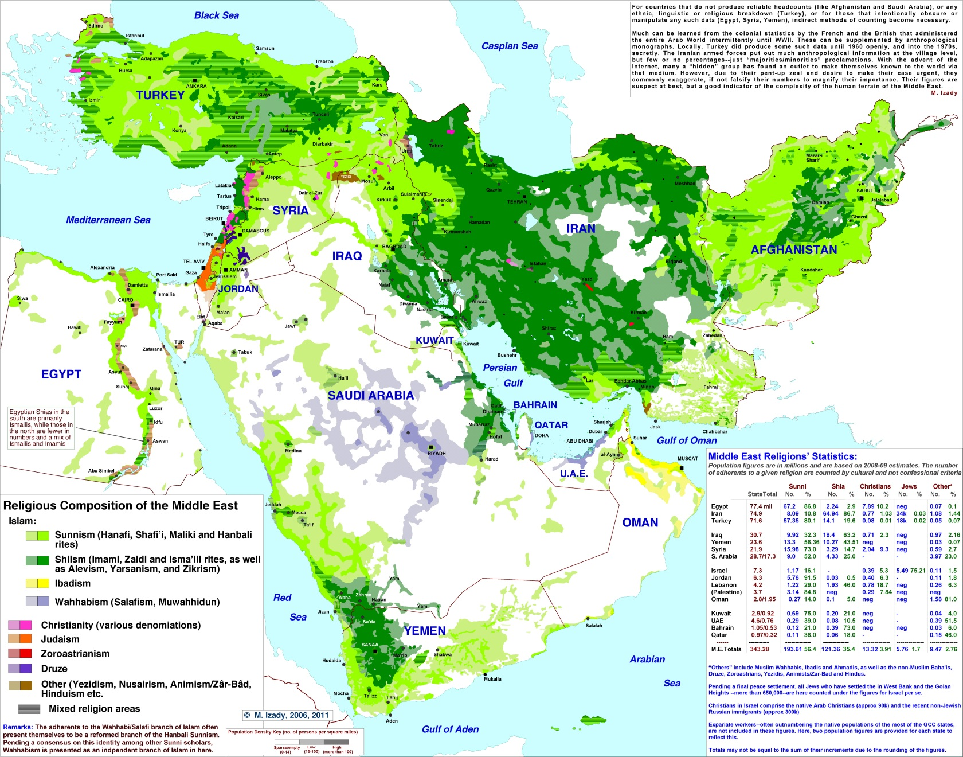
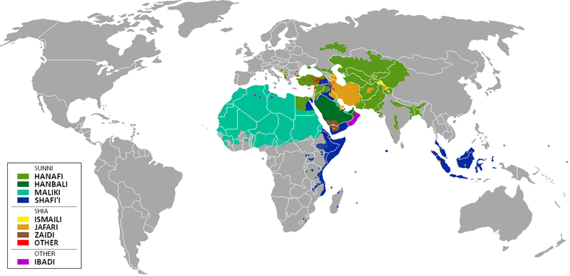
Sunni – Shi’ite War – Could Go Nuclear
ISRAEL
“Undeclared”
PAKISTAN
“Undeclared”
“Undeclared”
NUCLEAR POWERS

Slide 20
Revolution is Timeless

Slide 21
Predicted in 1989
Gray, Al (Ghost-Written by Robert Steele), “Global Intelligence Challenges in the 1990’s,” American Intelligence Journal, Winter 1989-1990, pp. 37-41.

Slide 22
US Nodes Identified in 1994
Steve Emerson, PBS in 1994, Book & Video American Jihad: Terrorists Among Us in 2001

Slide 23
Predicted in 2002

Slide 24
VIRTUAL CALIPHATE | Online Presence | Mosque & Community Presence | Obedient & Participating Humans
Strategy
Policy
Acquisition
Operations

Slide 25
COUNTER STATUS | Attack the Network | Defeat the Device | Train the Force
Strategy
Policy
Acquisition
Operations

Slide 26
Peace Costs Less

Slide 27
USA Needs a Grand Strategy

Slide 28
Cost Per Person to Settle ISIS
For $500 per person⁴ we can deport all illegal immigrants back to unoccupied areas of Arabia and North Africa, and give them free energy, desalinated water, pressed-brick shelters, free cellular and Internet, and an aquaponic industry as well as a start at an open source maker industry.
War creates profit for the few and terror for the many. We will never be successful in an environment where war is the default.
NOTE 5: 2013 Robert Steele: $500 Million to Resettle 1 Million on a Moonscape with Sun, Dirt, & Salt Water….Exploring the Practical Edge of Intelligence with Integrity — Call for Substantive Ideas 2.0 Habitat Cost Sheet Posted

Slide 29
ISIS/ISIL Doomed to Fail
ISIS Caliphate Doomed to Fail
A careful study of the first caliphate (632-661 C.E.) demonstrates that the ISIS caliphate launched by Abu Bakr Al-Baghdadi in Iraq is a non-starter. A viable Islamic caliphate would most certainly abolish the kingdoms of Saudi Arabia, Bahrain, Jordan, and Morocco, the emirates of United Arab Emirates, Kuwait, and Oman, and the autocratic governments of Egypt, Syria, and Sudan.
Why ISIS fighters quit
Too brutal to fellow Sunnis, corrupt leaders, living conditions terrible for some [for others, a huge improvement on their past], not fighting in place and for leader anticipated, Islam seen to be visibly misrepresented and mis-applied.
CAVEAT: Saudi export of Wahhabism, and indoctrination of prisoners world-wide who are “repatriated” with Saudi funds upon release, remains the major threat.

Slide 30
Between Two (or More) Evils

