Slide 1
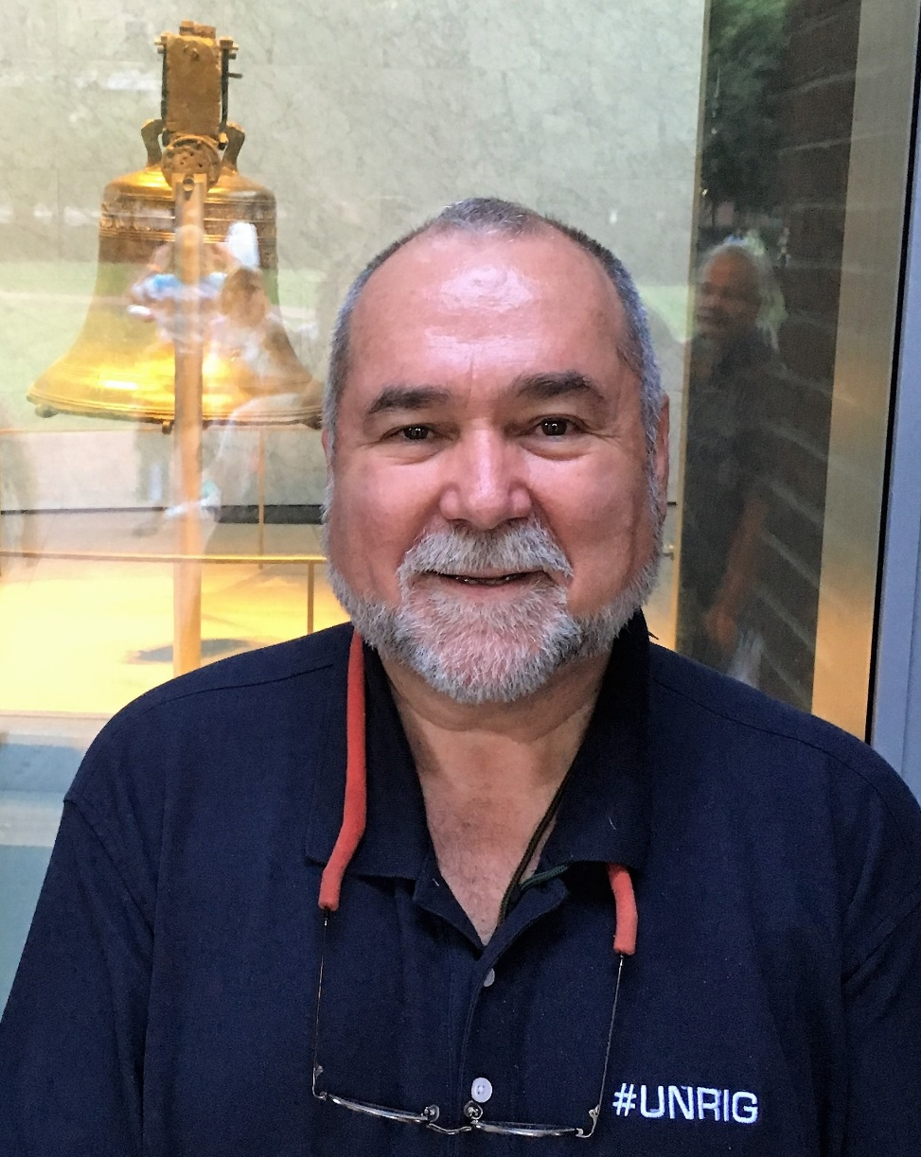
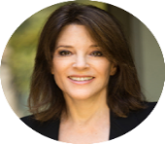
IF I WERE PRESIDENT
Individualism, Inclusion,
Intelligence, Integrity & Imagination
Constitutional, Localized,
Open Source Everything
One Nation under God, Indivisible,
with Liberty and Justice for All
Love, don’t forget the love…
Notes:
I am not running for President. While I have been disappointed by unkept promises our President has been fighting the Deep State from Day One, and I believe he can and should be re-elected provided he meets my three non-negotiable conditions:
Defend the Constitution, especially the 1st, 2nd, and 4th Amendments;
Put America First, not Israel First; and
Enact #UNRIG – election reform – in time for us to put Independents, Libertarians, Greens, and others into Congress in 2022.
One Nation, under God, indivisible, with liberty and justice for all. Not what we have today.

Slide 2
68 Answers & 24 Presidential Policy Issues
#Borg Main Enemy #GoogleGestapo $21 - $43 Trillion Stolen 911 - What, How, Who, Why Abortion Alternative Everything Archeology of Giant Remains Arrests & Sealed Indictments AG Barr - controlled Bushie? Background checks for Politicians Bio-morphing, Inter-Species Budget Lies Catastrophic Infrastructure Failures Censorship Against Us All Cheating Culture CIA Illegal Domestic Operations Climate Hoaxes Constitution Not Being Defended Dams as Scam & Danger Decision-Support Corruption Deep State Defined, Methods Deep Underground Military Bases (DUMBS) Democracy Lost - How? | DHA/FEMA/TSA New Gestapo? Directed Energy, Judy Wood? Drone Assassination Earth Hollow, Deep Water? Election Manipulation Electromagnetic (EMF), 5G & Genocide ESP, Dumbing Us Down ET & Secret Tech - Free Energy False Flag Operations False Reductionist Medicine & Science FBI, NSA Illegal Parallel Construction Fox News Controlled Opposition? GMO- True Cost to Humanity Geoengineering, Moon, Saturn Glyphosate as Ligand, True Cost Healing with IT & Energy Waves Health Secrets Hidden Technology Humanity as Cosmic Experiment Immigration as Contrived Threat Intelligence without Integrity Mandela Effect, Alternative Memories Military Bases as Lily Pads Mind Control, TI, Voice of God | Money, Monetary Policy, Inflation Moral Decline, Liberalist Threat NRA Controlled Opposition? Natural Law & Rights of Man Nuclear Power Plants Flooding Pedophilia & Empire Propaganda in USA Legalized Religions as Forms of Abuse Rendition & Torture Operations RICO against Social Media? Satanists, SRA, Adrenochrome Traitors Among Us, DNA tests? True Cost Economics TRUMP Is he a Zionist Puppet? Truth At Any Cost Lowers All Other Costs USA - Terminate the Corporation USA in State of Emergency? Vaccine Hazards Waste - 50% of the Economy Water as New Gold - stolen? Weapons of Mass Instruction Zionism vs. Judaism, 48 Strikes | ECONOMIC ISSUES Budget & Economy Government Reform Social Security Tax Reform Technology & Infrastructure Welfare & Poverty SOCIAL ISSUES Abortion Corporations Education Families & Children Health Care Principles & Values DOMESTIC ISSUES Civil Rights Crime Drugs Environment Gun Control Jobs INTERNATIONAL ISSUES Energy & Oil Foreign Policy Free Trade Homeland Security Immigration War & Peace
Not here, not today. Go online.
Briefing, Answers, & Issues Free Online at http://tinyurl.com/Steele-DD-2019
Notes:
I will NOT be addressing most of the questions that over 750 of you suggested when I posted a call for questions, and I will NOT be addressing the specifics of each policy issue that I would lean toward if I were President.
All of this is free online – I have answered every question, and provided links to further reading, as well as provided my 2008 policy platform that I will update after the two-party tyranny confirms its candidates.
All free online at http://tinyurl.com/Steele-DD-2019.

Slide 3
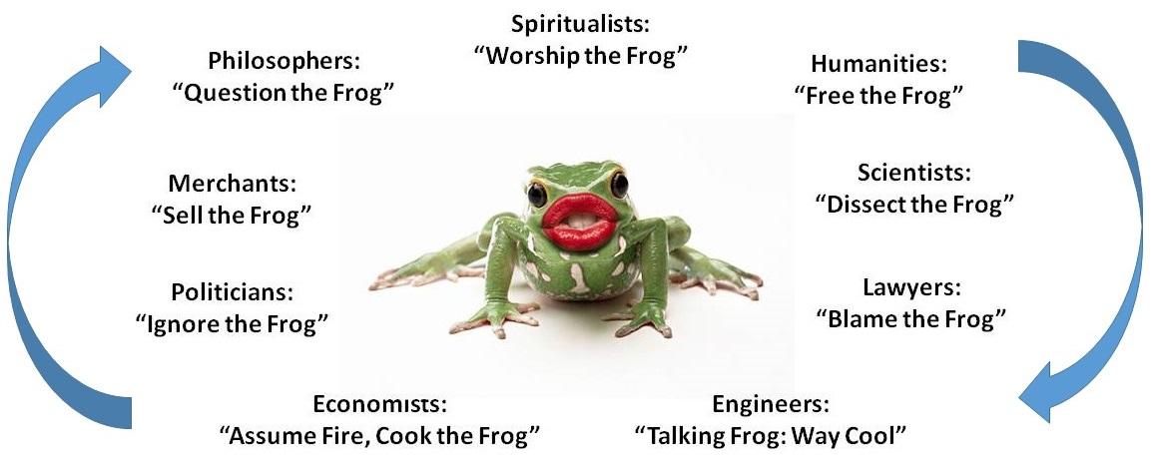
Fragmentation of Hearts, Minds, & Souls
No one - political or professional - is held accountable for informed consensus
Love the frog…
Notes:
There are those that think I lack a sense of humor so I thought to start by proving them right. This is as funny as I get, read it from lower left clockwise.
No one, political or professional, is held accountable for informed consensus. We live in a world of lies and waste because that is what the Deep State profits from, and we let them get away with it.
All hail Marianne Williamson, she’s funnier than I am.

Slide 4
3 Strikes, 3 Solutions, 9 Methods
This is the one-slide summary of the next 33 slides.
Donald Trump’s 3 Strikes
Not Defending the US Constitution
1st (Free Pass for BigTech Censorship)
1st (Free Pass for 27 Anti-BDS Laws)
2nd (Red Flag Gun Confiscation)
2nd (Not Challenging False Flag Operations)
4th (Re-Approved NSA Mass Surveillance)
4th (Allowing TSA to spill into Main Street)
Israel First Not America First, on EVERYTHING
Not Unrigging the System, 70% Disenfranchised
Robert Steele’s 3 Solutions
Defend the Constitution
Shut Down BigTech & Create Truth Channel
Challenge All 27 Anti-BDS Laws
Double-Down on Open Carry Everywhere
Terminate FBI/FEMA/PMC False Flag Ops
Cut Secret IC, Especially NSA & FBI, by 70%
Terminate TSA Including at Airports
America First, Expose Zionists (Epstein, 9/11)
#UNRIG Unity with Integrity Election Reform
9 Methods
Intelligence with Integrity
#UNRIG in time for 2022
Restructure/Downsize USG
Grand Strategy
Balanced Budget
Education is Root
Terminate IRS, Substitute Transaction Tax
LOCALIZE, Distribute, Autonomize
Open Source Everything Engineering (OSEE)
Notes:
Bill Binney and I agreed on 30 minutes each followed by an hour of give and take. I am not going to apologize for the density of this briefing, which could easily consume two hours if done slowly. I am going to firehose you. You can study the briefing, answers, and issues online at your leisure.
I reiterate my support for President Donald Trump. I do not think he can be beat, particularly as he begins to pull economic and social rabbits out of the hat going toward Election Day.
What I *can* do is educate the public – and particularly the 70% that are disenfranchised – on what they can demand for their vote in 2020: an honest Congress by 2022 and a government that makes evidence-based decisions for America First by 2024.

Slide 5
Natural Law, Cosmic Balance
“We hold these truths to be self-evident, that all men are created equal, that they are endowed by their Creator with certain unalienable Rights, that among these are Life, Liberty and the pursuit of Happiness.”
“But when a long train of abuses and usurpations, pursuing invariably the same Object evinces a design to reduce them under absolute Despotism, it is their right, it is their duty, to throw off such Government, and to provide new Guards for their future security.”
Notes:
Our Declaration of Independence is quite clear – we all have inalienable rights under natural law, and we created this government to serve us, not rule over us. When we are called cockroaches by the Zionist-trained police, or deplorables by the Deep State’s Front End, we have a DUTY to either fix or abolish the government we created.
This should not be negotiable, but after centuries of double-speak most of us have not learned that we are and should always be FREE.

Slide 6
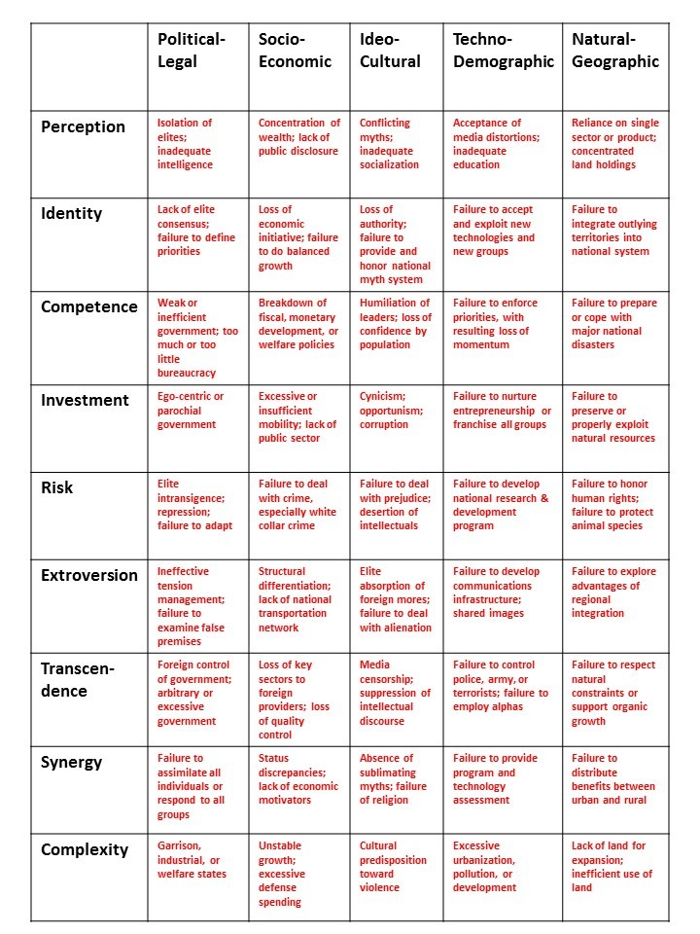
50% of Everything is a Lie or Waste
Lies, Lies & More Lies
Academia
Civil Society
Commerce
Government
Law Enforcement
Media
Military
Non-Profit
Waste & More Waste
Agriculture & Food
“Defense” = WAR
Energy
Foreign Assistance
Health
Homeland “Security”
Housing
Water
http://tinyurl.com/Steele-Revolution
Notes:
I am an intelligence professional. I think for a living. For the past forty years I have not only been an intelligence professional, I have also consumed non-fiction books across 97 categories of reading. I have also written two graduate theses, the first on predicting revolution, the second on strategic information mismanagement and information pathologies.
We live in a world of lies and waste that this keeps us from living in peace and prosperity.

Slide 7
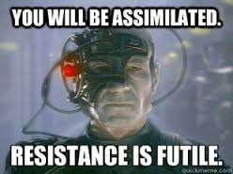
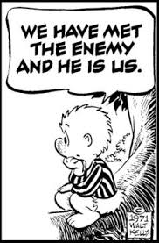
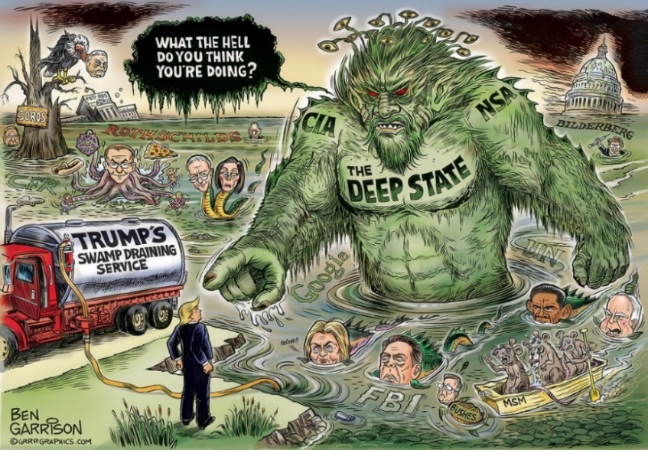
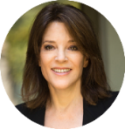
Two Enemies - Not China, Not Iran, Not Russia
Borg & Deep State
Love, just love….
Us
Notes:
China, Iran, and Russia are not our enemy. Anyone who says they are is either a traitor or an idiot. Yes, we compete with them, but the real enemies of America the Beautiful are the Borg – I buy into what David Icke and David Wilcock and others have studied so ably – and its Earthy enabler, the Deep State – and ourselves.
We are our own worst enemy because we have allowed the Borg and the Deep State to fragment our minds, hearts, souls, and bodies.

Slide 8
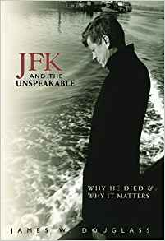
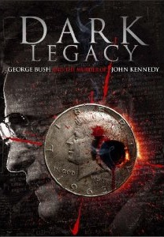
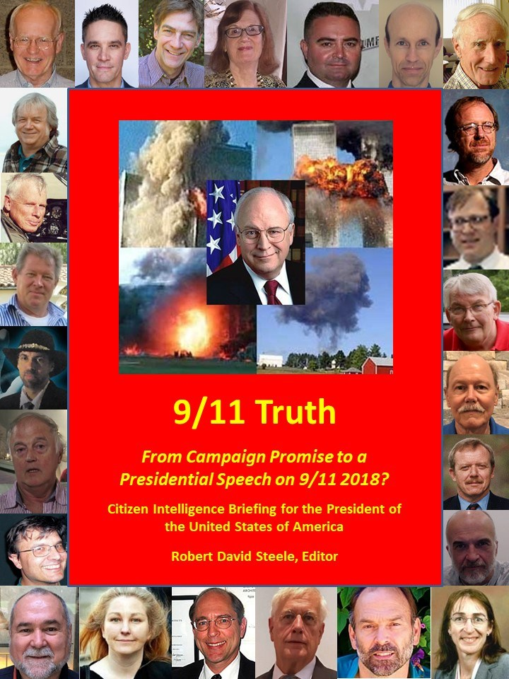
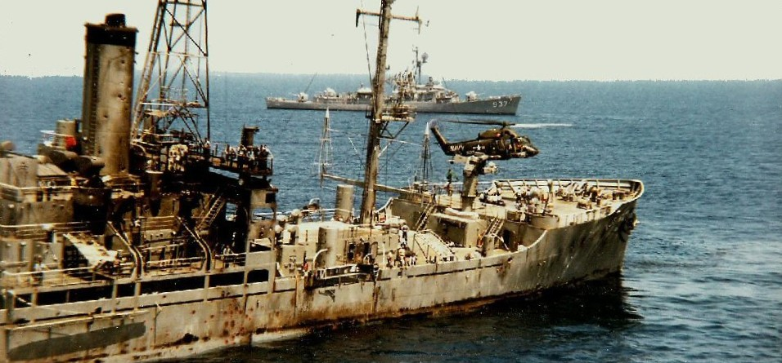
False Flags - JFK, USS Liberty & 9/11
Notes:
John F. Kennedy was assassinated by the CIA with the complicity of the FBI, the Secret Service, his Vice President, Texas energy barons, and New York money merchants. Israel had two witnesses in Dallas on the day: Yitzhak Rabin who is dead and Arnon Milchan who is not. Israel was complicit but not the prime mover for the JFK assassination.
Israel was very much the prime mover for the USS Liberty and 9/11 atrocities, with the complicity of US Government leaders who betrayed us all.
We cannot defend the 2nd Amendment without understanding false flag operations.

Slide 9
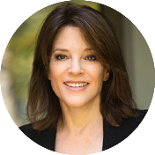
Epstein - Nine Veils of Evil
Robert Maxwell - Zionist Super-Spy (PROMIS in 1980’s)
Ghislaine Maxwell - Mossad Officer & NYC Madam
Mossad profiled Chelsea & Ivanka for capture by Zionists
Fake Billionaire funded by MEGA Founder Les Wexner
Mossad 4 Targets - Political, Cyber, Intellectual & Nuclear
CIA & FBI Complicity
49 Other Pedophilia Entrapment Cells Across USA
Satanic Ritual Abuse, Murder, Blood Drinking & Organ Eating
Fake News Media Cover Up - Many Bribed & Blackmailed
Love, don’t forget the love…
Notes:
How does Israel control not only the US Congress but 27 state legislatures across the USA that have made it a felony to criticize Israel?
Bribery and blackmail. Pedophilia entrapment is an art form, and the Mossad is very good at it. Take a moment to read these nine veils of evil, this is the fullness of the Epstein story no one will report.
The inside joke: how many pedophiles does it take to cover up our blackmail? Answer: all of them.
Yes, he is still alive. Hold your questions, please.

Slide 10
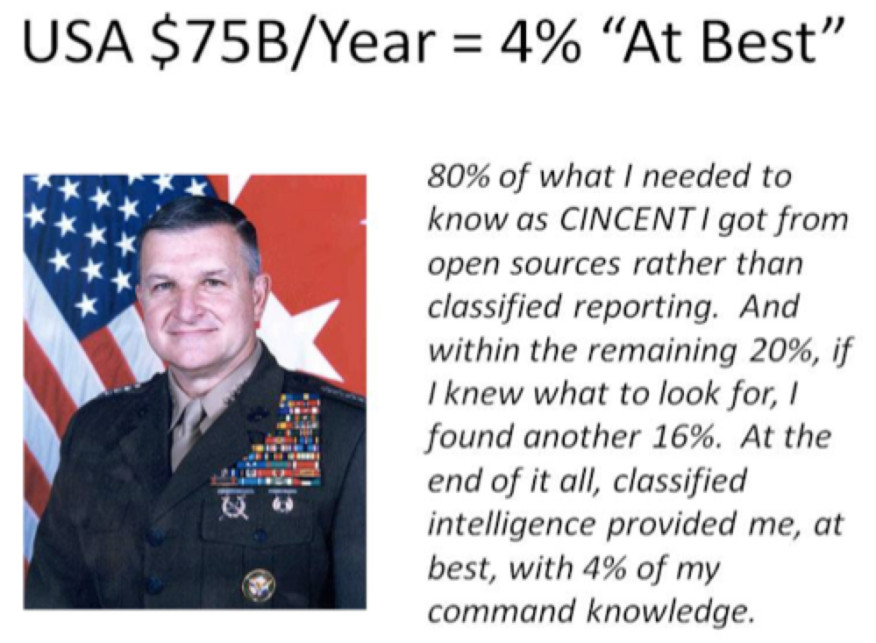
1% & 4% - Failing Across the Board
We process 1% of 1% of 1% of 1% of 1%
US IC answers “at best” 4% of we need to know
Notes:
Why are we so ignorant? This is by design. The CIA created the Artificial Intelligence Staff around me in 1986, I was the first speaker at Hackers on Planet Earth in 1994, and I am well familiar with the pathologies of the information world.
In a nutshell, we process 1% of what we collect, collect 1% of what is published which is 1% of what is written which is 1% of what is known. The secret world ignores multi-lingual open sources by and large, and produces, “at best” 4% of what is needed. Note the web of isolated academic domains.
This is completely apart from the Deep State and CIA active measures to dumb us down and drug us up.

Slide 11
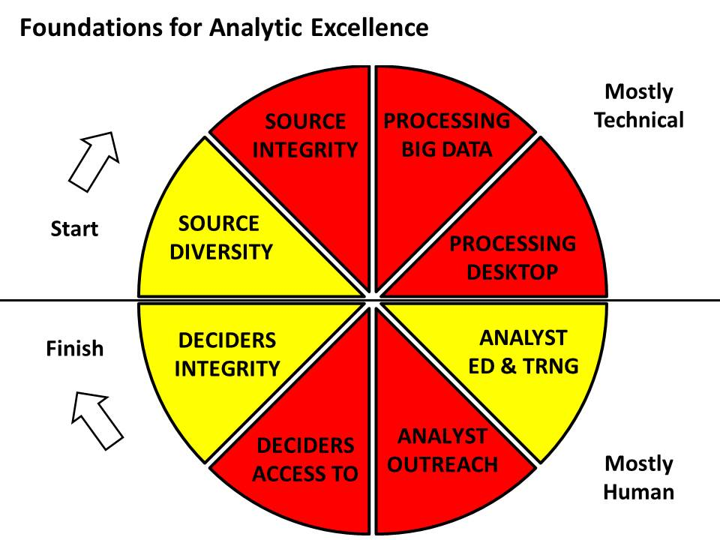
8 Slices of Stupid
Notes:
There are many reasons why we have a retarded information ecology.
First of course, this is what is wanted. Dick Cheney has publicly said his worst mistake ever was letting the public have the Internet.
Second, government contracting has corrupted the entire economy – we no longer do quality engineering, doing more with less. Instead we do government specification cost plus contracting.
This makes waste profitable and provides no incentive for general innovation.

Slide 12
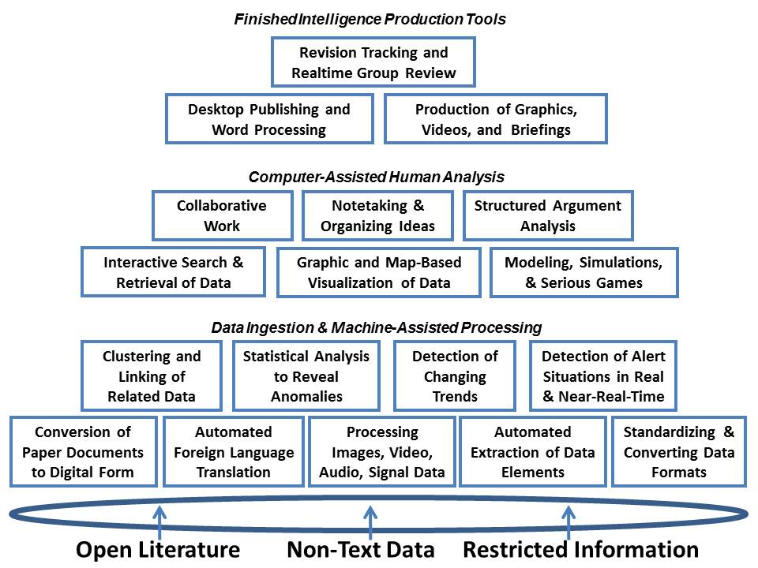
18 Tools for Thinking You Are Not Allowed
Notes:
CIA has had some truly brilliant people working for it – until they quit in frustration after five years. I lasted nine.
Diane Webb, Dennis McCormick, and Gordon Oehler, none of them under cover, in 1989 defined these eighteen functionalities as needed “tools for thinking” and we still do not have them today, in one integrated toolkit, never mind that it would only have access to 1% of 1% of 1% of 1% of 1% of the relevant information

Slide 13
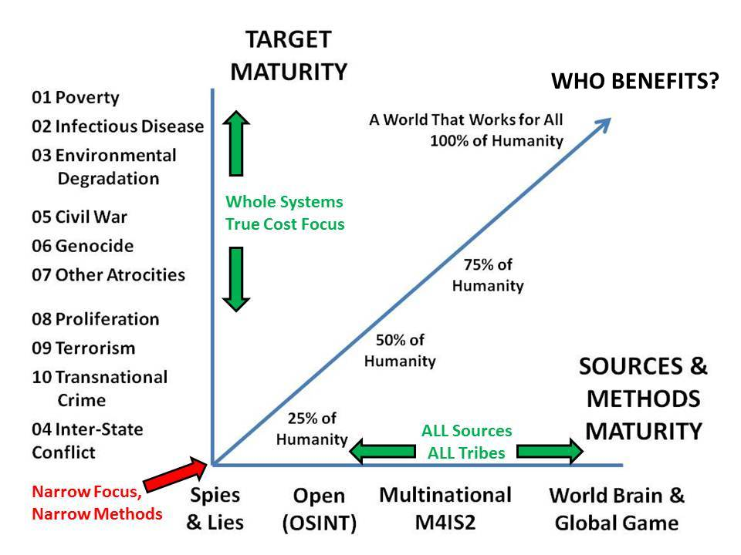
Intelligence (Decision-Support) Maturity
Notes:
This is one of my favorite graphics, created for a conference many years ago, when I was asked to answer the question, “why is US intelligence so retarded?”
The reality is that the US secret world exists to wreak havoc on others with regime change, torture & rendition, drone assassination, and miscellaneous mayhem.
It is not designed to think and it is most certainly not designed to help every Cabinet member serve the public interest.
We focus on spies, lies, and wars and ignore everything else.

Slide 14
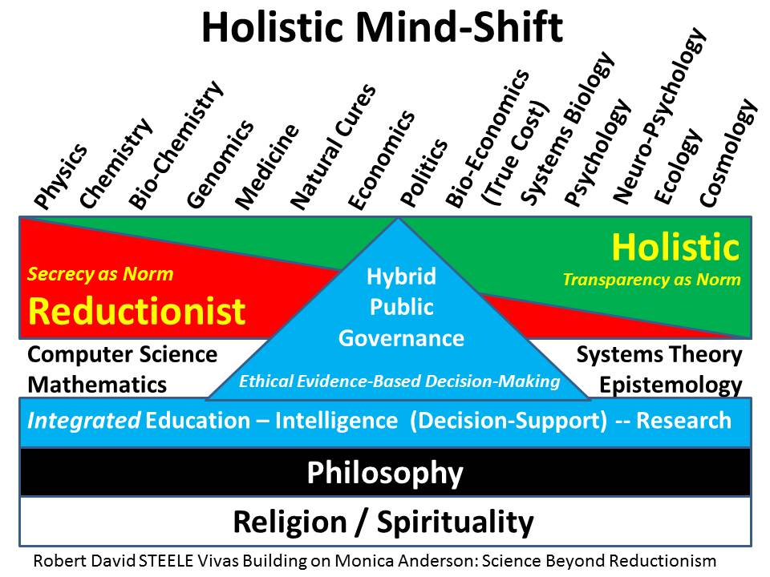
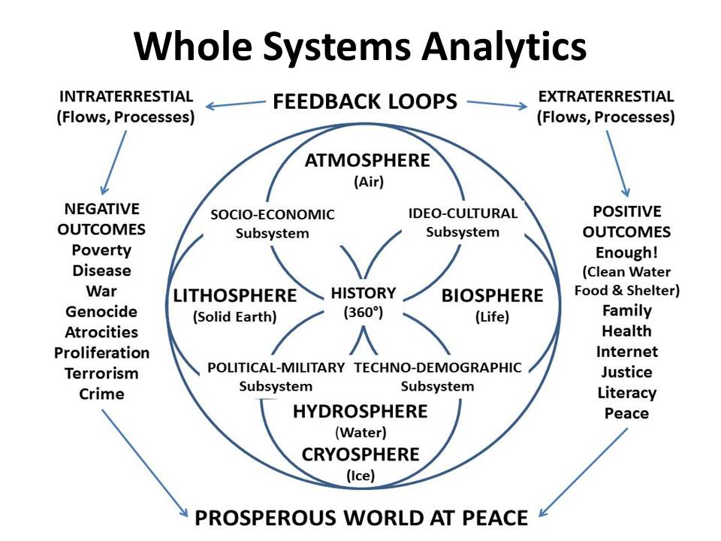
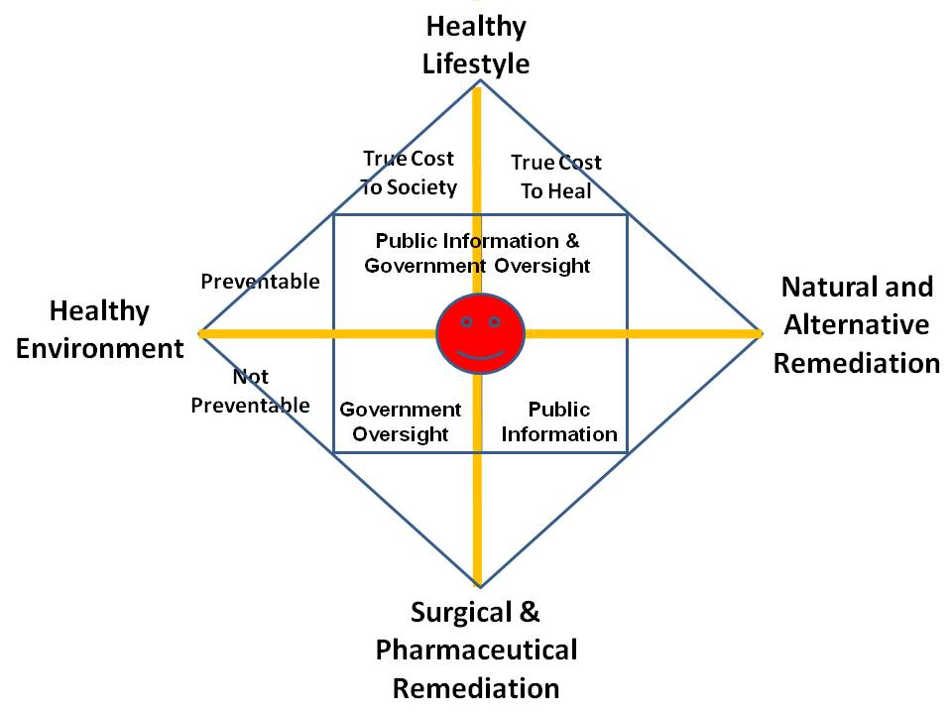
Holistic vs Reductionist Thinking
Yada, Yada, Yada…
Notes:
Even if we were paid to think, we do not know how to think. Our colleges today are shit – generally speaking you leave with the equivalent of a 1950’s high school education and a lot of debt.
You can study all these graphics later, the core point to make right now is that no one, anywhere, does holistic analytics, true cost economics, and Open Source Everything Engineering (OSEE) which is sad, because that is the shortest, fastest, cheapest path to creating a prosperous world at peace in which all 17 Sustainable Development Goals are met.

Slide 15
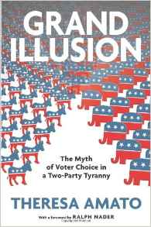
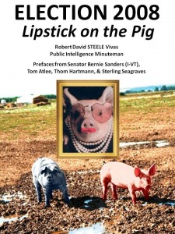
Democracy Myth - Lipstick on Two Pigs
Notes:
I’ve established that we are stupid, now allow me to establish that we are not free. Democracy does not exist.
What we have is a two-party tyranny that controls everything including electronic voting machines so as to ensure that the Deep State candidate is elected. In those rare instances when an independent spirit slips through – as with some Sandernistas and some Tea Party candidates – they are immediately bribed or blackmailed into line.
One bird, two wings, same shit.

Slide 16
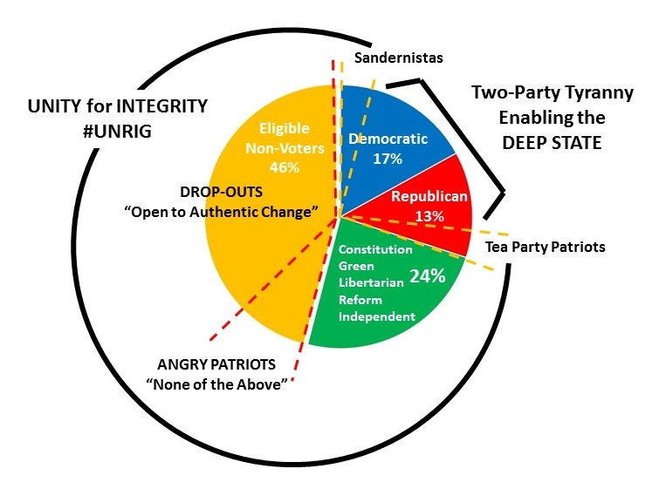
US Political Landscape
Notes:
If I could get President Trump to look at just one graphic, this is the one.
The two-party tyranny has shut 70% of the eligible voters out of the political process at all levels – local, state, and federal.
My goal with #UNRIG is to put the public – 100% of the public – back into politics.
The system is rigged, the President has said. The question we must all ask him is this: why is he not embracing #UNRIG to unrig the rigged system?

Slide 17
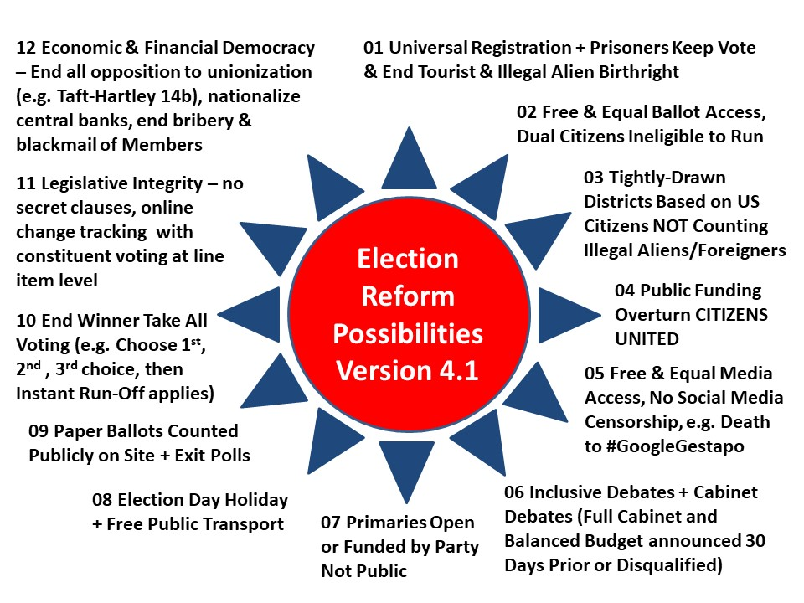
#UNRIG - 12 Non-Negotiable Fixes
Notes:
I meant to add a Marianne Williamson “yada yada yada ” insert here. She’s right, the general public does not want detailed policy positions, they just want to know that the politician feels their pain. That is what got Donald Trump elected and that is what will get him re-elected.
Having said that, someone has to do the hard work of thinking about solutions, and after years of studying what all others have done, this is what I have come up with.
This unrigs the system.

Slide 18
Big Bat USA - Small Donors Matter
2024 STEELE + +
$2 B to Win / $1 B Earned Media
SMALL DONOR MATH
1 M Voters, $20 each ➔ $20 M
10 M Voters, $20 each ➔ $200 M
25 M Voters, $20 each ➔ $500 M
50 M Voters, $20 each ➔ $1 B
100 M Voters, $20 each ➔ $2 B
200 M Voters, $20 each ➔ $4 B
My Experience with Non-Profit Giving
Many Enthusiasts give $50 - $100
Some Enthusiasts give $100 - $1000
2020 TRUMP
$1.5 B to Win / $1 B Earned Media
2016 TRUMP
$1 B to Win / $1 B Earned Media
2008 OBAMA
$1 B to Win / GOP Collaboration
2008 OBAMA
$1 B to Win / GOP Collaboration
We do not have a lack of money to donate
We lack FOCUS & UNITY!
Notes:
Howard Dean had enormous potential as a presidential candidate, but he was destroyed because he was not convenient for the Deep State.
I asked Joe Trippi to teach me the mysteries of the Big Bat process and I am satisfied that given a $10M mobilization investment, I can raise no less than $1B from small donors as well as $1B in earned media.
I will not reveal all of my top secret plans today, but they do include the use of comic impersonators on national tour, and 10,000 wrapped vans playing love songs.
We do not lack for money to win.

Slide 19
Web 3.0 - We BURY #GoogleGestapo
#GoogleGestapo
Amazon
Apple
Facebook
Google
MeetUp
Reddit
Twitter
Wikipedia
WordPress
YouTube
Instant Death to any Censoring Platform!
Federation Displacement Options
Four Core Integrated Networks
Protected Valuations (coin, savings, deeds, trusts, etc.)
Protected Tools (cannot be programmed to lie)
Protected Data (cannot be erased or manipulated)
Protected Communities (competition of ideas & no censors)
Many Existing Applications with Potential
Amazon - Alibaba, Barnes & Noble, AliExpress, Ebay, Newegg, Bol.com
Apple - new open source hardware & software offerings
Facebook - Friendica, Steemit, Minds, MeWe, Ello, Diaspora, Onstellar
Google - 70+ engines, various map offerings, various translators, etc.
MeetUp - Groupspaces, CitySocializer
Reddit - Voat, Riot
Twitter - Mastodon, Gap, GNU Social, Diaspora, Misskey, Pleroma
Wikipedia – OpenPedia - anyone can create, only masters can delete
WordPress - OpenOffice
YouTube - BitChute, PeerTube, DTube, Brighteon, LiveLeak, PewTube
Notes:
That takes care of money, what about #GoogleGestapo? When Cynthia McKinney and I launched #UNRIG the Zionists immediately saw the threat and destroyed us six ways in ninety days. What does not kill you makes you stronger. They have earned my attention as America’s main enemy.
I know how to displace #GoogleGestapo, and am planning two conferences for next spring, one to mobilize – world-wide – the pieces of a new federated Web 3.0, and the other to mobilize – world-wide – class action lawsuits against the guilty.

Slide 20
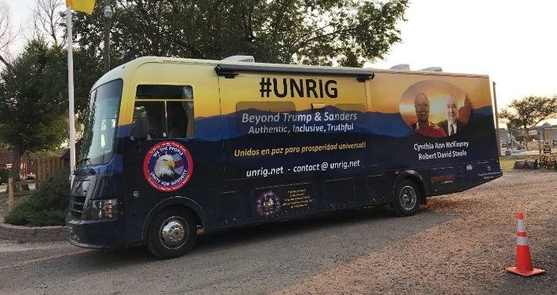
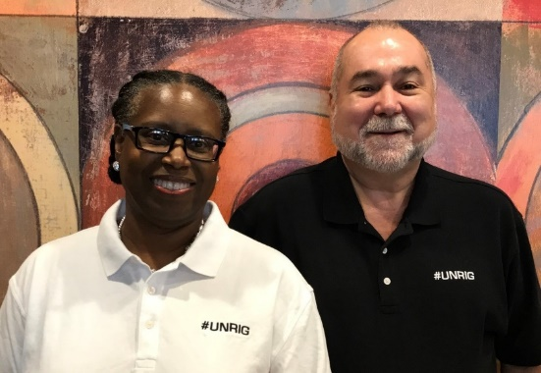
2020, 2022 & 2024
2020
Conditional support for President Donald Trump
He has what I want - the power to legislate #UNRIG
2022
#UNRIG elects Independents, Libertarians, Greens
2024
Beyond Trump
#UNRIG as his legacy - or not
If not, advance 2024 plans to 2020
Split ticket, Coalition Cabinet, Balanced Budget
America First not Israel First!
Notes:
President Donald Trump has something I want: the power to legislate #UNRIG. If he will embrace #UNRIG and end the hypocrisy of saying the system is rigged and then embracing the rigged system to his own ends, we can do a deal.
There is no question but that he would be better than any of the losers on the left and there is also no question but that we have moral, honest, competent leaders in the middle who have no chance at all of being elected.
This is my plan. I pray the President will make the deal.

Slide 21
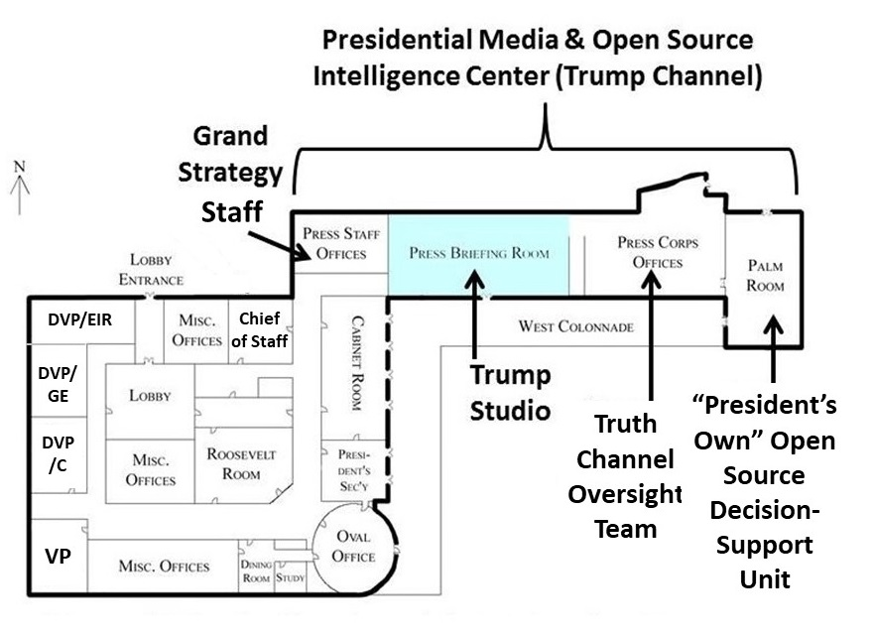
Greatest President Ever Needs a New White House
PRIORITY ONE:
Kick the scum (press) out of WH
Abolish National Security Council replace with very small Grand Strategy Staff
Establish DIRECT communications from White House to public and back
Focus on educating public with truth while leveraging Open Source Intelligence for evidence-based decision-making across all threat/policy domains
PRIORITY TWO:
No more staff intermediaries
VP & Three DVPs Work in WH
Distribute the Government across USA as part of cutting it by two thirds
Leverage modern technology to manage government with transparency and urgency – real time multi-media
Notes:
We must stop wasting the most precious real estate on the planet on scum – the media – and convert that space into a combination of Trump Studio and truth channel able to reach – and hear from – every American, while placing a grand strategy staff and an open source intelligence unit under the President’s direct command.
Second, we must restructure how our Commander in Chief commands – the Vice President and three Deputy Vice Presidents should be co-located with the President in the White House, and make better use of real-time multi-media to manage a distributed and much smaller federal government.

Slide 22
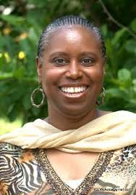
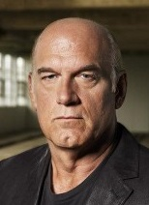
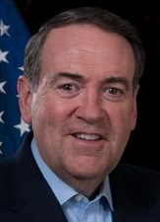
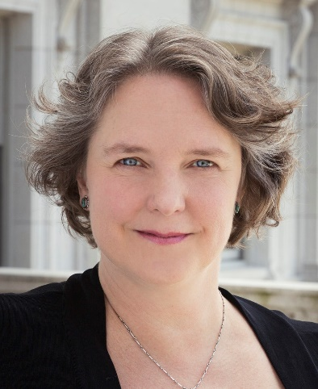
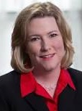
Vice President, Congress, Governors, & Mayors
Co-Governors General
Council of Governors
Co-Mayors General
Council of Mayors
Cynthia McKinney
aka
“Goddess” PhD in Leadership
Georgia, 6-Term
Jesse Ventura
Minnesota
Mike Huckabee
Arkansas
Satya
Rhodes-Conway
Madison, WI
Nan Whaley
Dayton, OH
Each person could help our current President be the greatest ever!
Notes:
Dr. Cynthia McKinney is the perfect choice as a unity and healing Vice President ideally suited to dealing with our existing Congress.
I have spent thousands of miles with Dr. McKinney and a staffer in an RV, and I will tell you from my up close and personal experience, this is an honest and intelligent woman who puts the used toilet paper in the bag instead of the toilet. RVs are like boats, the toilets cannot handle toilet paper. She can be TRUSTED in the small things, and therefore in the large things.
We need a Governors Council and a Mayors Council. The President needs these new organizations to both reinstate White House access for the fifty sovereign states, and to deal with the virtual city-states that exist across the country.

Slide 23
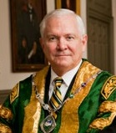
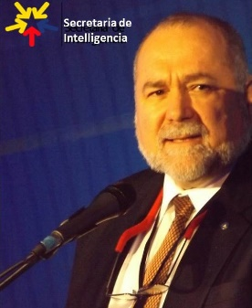
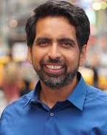
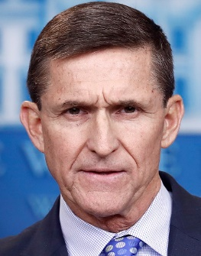
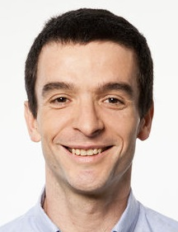
DVP Education, Intelligence & Research
NEW
REDUCE BY 70%
Central Intelligence Agency
Defense Intelligence Agency
National Geospace Agency
National Reconnaissance Office
National Security Agency
CONSOLIDATE
IC into CIA, OSA into EOP
DARPA & IC R&D to SecRes
Robert David Steele
Open Source Agency
Dr. Robert Gates
Salman Kahn
Secretary of Education
LT GEN Michael Flynn, USA (Ret)
Director of National Intelligence
Dr. Marcin Jakubowski
Secretary of Research
Notes:
Bob Gates has extraordinary experience and knows how to move the system at scale.
If president Trump wants someone who can do what needs to be done in relation to integrating and modernizing education, intelligence, and research as one coherent construct, Bob Gates has my vote.
The others are as good as it gets in their respective domains.

Slide 24
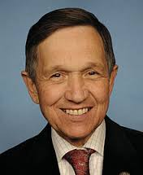
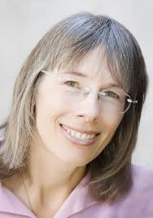
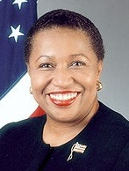
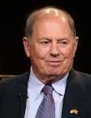
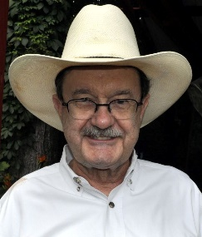
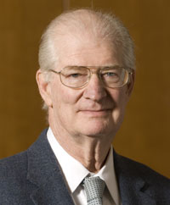
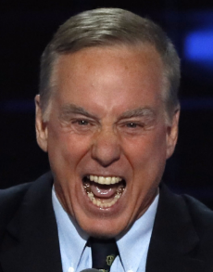
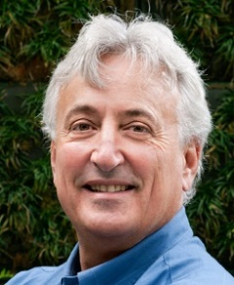
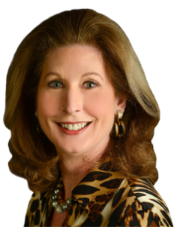
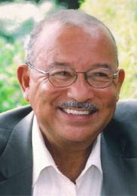
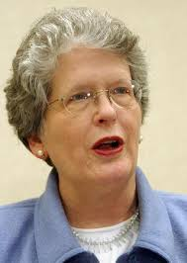
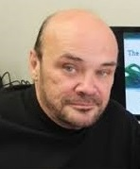
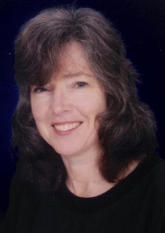
DVP Commonwealth
NEW
ABOLISH
Federal Bureau of Investigation
Homeland Security
Internal Revenue Service
Environmental Protection Agency
Housing & Urban Development
Small Business Administration
CONVERT
CDC into moral effective capability
Federal Reserve to Bank of the USA
Joan Blades
Citizen
Engagement
Carol Mosely Braun
Community & Family Values
Stuart Herrington
Counterintelligence Command*
Dennis Kucinich
Jim Hightower
Agriculture
Herman Daly
Energy
Howard Dean
Health
Robert Costanza
Interior
Sidney Powell
Justice*
Del Spurlock
Labor +
100% e-verify
Joan Claybook
Transportation
Martin Armstrong
Treasury*
Ellen Brown
Bank of the USA
* Direct Reports to President along with Office of Management & Budget
Notes:
Of all of the people I have observed in Washington over the years, the two that have resonated with me the most are Ron Paul and Dennis Kucinich. I cannot think of a better person to entrust the Commonwealth to than Dennis Kucinich.
Each of these others has been chosen as best in class – they already know what they need to know to be effective. You can see the new capabilities on the left and the abolishments on the right.
Hold your questions until the final hour, please.

Slide 25
DVP Global Engagement
NEW - $100B/Year
ABOLISH
NATO & UN Participation
Trade Representative
REDUCE
50% Defense
INCREASE
20% State
20% Commerce
20% Veterans
GEN Tony Zinni
USMC (Ret)
Inter-Agency Development Command
Dr. James Keagle
Inter-Agency University (D3C)*
Dr. Ron Paul
John Huntsman
State
Clyde Prestowitz
Commerce
Joe Sestak
Defense
Jeff Bezos
NASA
Max Cleland
Veterans
John McAfee
Envoy to Cuba
* Diplomacy, Development, Defense, & Commerce
Notes:
If we are to turn away from endless war there is no better person to oversee the beating of swords into plowshares, a foreign policy of peace, commerce, and friendship, than Dr. Ron Paul. Particularly priceless is his long-standing professional friendship with Dennis Kucinich, each of them reflecting a commitment to America First and evidence-based decisions in the public interest.
In keeping with having diplomacy, development, defense, and commerce (D3C) under one Deputy Vice President, we need an Inter-Agency Development Command and an Inter-Agency University, both to be located adjacent to the National Defense University complex at Fort McNair.
NASA is a defense agency and totally out of control. There may be someone better qualified than Jeff Bezos but for now he is my choice, partly in revenge against the second-generation Nazis that run the place now.
John tells me he was well-treated by Cuba, we have agreed he can make the deal there.
John can bring us the Libertarians and he is great at earned media in those circles.

Slide 26
Grand Strategy - Ends, Ways & Means
ENDS
Form a more perfect union
Establish justice
Insure domestic tranquility
Provide for the common defense
Promote the general welfare
Secure the blessings of liberty to ourselves and our posterity
WAYS
Cut federal government by one third before 2024, a second third by 2028
Terminate entitlements less public health and social security
Localize, autonomize, implement Open Source Everything Engineering (OSEE)
Public education, hand-held True Cost application instead of micro-regulation
With public education, put a stop to 5G, geoengineering, corporate toxins, etc.
MEANS
Terminate federal income tax & all other taxes except tariffs
Implement Automated Payment Transaction (APT) tax
Get Federal Government out of the weeds and back in the box!
Notes:
Grand Strategy is about establishing your ends, devising your ways, and then generating the means to fund the ways that achieve the ends. The USA does not have a grand strategy today and needs one most desperately.
I will address ways to cut the federal budget in the next slide, for now it simply merits emphasis that we need to cut the federal budget by two thirds, localize virtually everything other than global engagement, and reassert the natural rights of every citizen.
This includes zero tolerance for illegal immigration, white collar criminals, traitors, and any politicians that lie to the public.

Slide 27
Balanced Budget - Yes, We Can!
Public Education - National Referendums - End Unconstitutional Programs
YUGE Budget Cutters
Close all US bases overseas
End all foreign military assistance
End lifestyle medical insurance
End support to illegal aliens
End birthright citizenship for those born to tourists & illegals
Eliminate most federal regulators
Terminate agencies cited earlier
Negotiate all drug prices to match foreign generic prices
End corporate personality & legislatively overturn CITIZENS UNITED
MORE Budget Cutters
End all federal subsidies
States
Corporations
Loophole causes
Distribute Federal Government as part of reducing it by two thirds
Return state lands to states
Make medicine a public service
Eliminate public debt by nationalizing Federal Reserve & holding private banks accountable for all money they issue
Notes:
The only reason we have been borrowing two trillion dollars a year to pay for a three trillion dollar a year federal government is because We the People have been dumb asses and abdicated our role as the militia for integrity.
An honest President armed with an honest Congress and an attentive public can cut the federal government by two thirds within six years.
You can study this later. We can do this.

Slide 28
Automated Payment Transaction Tax
Notes:
This is the other graphic I would like to have the President understand, and I am told he already gets this and is thinking about abolishing the IRS and ending all federal income taxes in time for Election Day 2020 appreciation.
Because of treason by multiple presidents, the working class has borne the greatest burden.
Devised by Professor Edgar Feige of Wisconsin, this alternative triples revenue while ending the tax free ride of Wall Street and corporations.

Slide 29
Localize, Distribute & Autonomize
Return most Western land to states after eliminating many test ranges & underground military bases.
Notes:
The third element of my strategic plan for an American renaissance – the first was intelligence with integrity, the second #UNRIG for election reform that achieves unity with integrity – is localization.
Elinor Ostrom won a Nobel Economics Prize for demonstrating that only locals know enough to both govern (for example, local fisheries) and enforce (by presence and local knowledge). Nassim Nicholas Taleb is similarly gifted, and has put the stake in the heart of top-down government – it does not work.
It is my intent to see the return of two thirds of the lands stolen from states by the federal government – that is our next frontier for a new distributed population leveraging free energy that also allows unlimited desalinated water from the sea to the heartland.

Slide 30
Open Source Everything Engineering (OSEE)
Notes:
The fourth element of my strategic plan scares conventional corporations – I now have a clear picture of how to achieve a post-Western economy at 10-20% the cost of the Western model that is 50% waste and 90% profit for the banks.
I stand on the shoulders of others, such as Dr. Marcin Jakubowski, creator of the Global Village Construction Set, all open source.
Artificial Intelligence is not part of the solution. Artificial intelligence, like 5G and transhumanism, is a threat to humanity, not a solution.

Slide 31
America First - What Does This Mean?
ENDS | 2024 Objective State
Form a More Perfect Union | 50 sovereign states, none subverted by foreign powers (as have been 27 to date), all operating within the rule of law & in public interest
Establish Justice | No corrupt judges or prosecutors. DOJ, CIA, FBI, NSA not licensed to lie. Constitution upheld, especially 1st, 2nd & 4th Amendments
Insure Domestic Tranquility | Full employment, shared family values & not normalizing perverts
Provide for the Common Defense | DEFENSE is not OFFENSIVE - home-based military serving 99% not 1%, secret intelligence community not wreaking havoc everywhere
Promote the General Welfare | Healthy, educated public able to pursue happiness without fear of being shot or beaten by our police, or robbed by criminal gangs that get a free pass from the FBI & local law enforcement
Secure the Blessings of Liberty to Ourselves & Our Posterity | Hope for the future - children that are not in debt, not fat, not stupid & able to pull their own weight going forward
In brief, it does NOT mean Israel First, Deep State First, or Illegal Immigrants & Perverts First!
Yada, Yada, Yada…
Notes:
I can feel Marianne Williamson lurking in the rafters. She’s right, there is a lot of yada, yada, yada in national conversations, but there is no one, anywhere, that is actually trying to achieve America First consistent with the first principles of our Declaration of Independence, that I know of.
The President claims to be doing this, I have not yet seen the beef. I WANT our President to be the Greatest President Ever. I WANT our President to Make America Great Again.
These should be our goals. Why are they not?

Slide 32
Terminate Endless War Abroad
“We spent $6 trillion in Middle East and we are less than nowhere; far worse than 16 years ago.”
Donald Trump
Love, don’t forget the love…
“US Military Bases, both at home & abroad, are lily pads for smuggling drugs, guns, gold, cash, and small children.”
Robert David Steele
Notes:
Almost every American war including the wars on Cuba and Mexico, has been based on lies.
Our wars are also genocidal, ecocidal, and crimes against humanity in every possible sense of the term including those we imposed at Nuremberg.
The President must honor his promise to bring our troops home, and go a step further: close every military base we have around the world, each being used as lily pads for evil – for the smuggling of drugs, guns, gold, cash, and small children.

Slide 33
Terminate Police State at Home
Notes:
While much of America is not suffering the police state atrocities depicted here, the writing is on the wall. There will be another 9/11 false flag event, everyone will be declared mentally ill, disarmed, chipped, and turned into a virtual slave, which all too many are already today.
The best defense against both criminals and terrorists is not the police, but rather armed intelligent citizens who are both present and committed to the safety of their neighborhood.
We need to control crazies and criminals, not guns. Open Carry – and No Permit Needed Concealed Carry – should be the law of the land.

Slide 34
Freedom Should Be Fun - Cosmic Fun!
CHAKRA
12 Divine
11 Galactic
09 Universal
08 Spirit
07 Crown
06 Third Eye
05 Throat
04 Heart
03 Gut
02 Navel
01 Sacral
10 Earth Root
OUR GOAL
12 Infinity
11 Healing
09 OSEE
08 Transcend
07 Facts
06 Intuition
05 Consensus
04 Compassion
03 Fitness
02 Altruism
01 Happiness
10 Re-Birth
Feel the love…
Notes:
I am not what you would call a spiritual person in the California sense of the word, but I do believe I am a God particle, as are all of you, and we cannot ignore the wisdom of the ages that has been repressed by corrupt Western institutions.
No one should have to work as a slave to live.
Everyone should be able to blossom in freedom.
We have an opportunity, in becoming more aware and more active, to open an infinite range of possibilities both personal and communal.

Slide 35
The Gold Standard - Presidential, National & Global
Yada, Yada, Yada…
Notes:
Central to the future of humanity is the education of humanity. We have allowed Western governments captured by Western banks to turn us into ignorant consumers of drugs and poisons.
Plato had it right. Hans Morgenthau had it right. The core foundation for national power is an educated citizenry.
There are four values embedded here: Clarity, Diversity, Integrity, and Sustainability.

Slide 36
Call to Arms - With & Beyond Trump
Non-Negotiable Demands
Uphold the Constitution (especially 1st, 2nd, and 4th)
Terminate Zionist-Controlled Deep State America First!
Pass #UNRIG Legislation in Time for 2022 Congressional Elections
BUY
GUNS
One Nation under God, Indivisible,
with Liberty and Justice for All
Poke President – Spook the Rats…
www.marianne2020.com
http://tinyurl.com/Steele-DD-2019
Notes:
So here we are, with our President losing a portion of his base to unkept promises while also stating that he is not going to go after the swing vote.
My deal is simple: I will vote for President Trump in November 2020 if he starts defending the Constitution; puts America First starting with a challenge to the 27 states violating the 1st Amendment; and embraces #UNRIG.
Please poke our President by making a token donation to Marianne Williamson before the 28th of August, and buzz her up on social media. Unless and until Cynthia McKinney announces her Democratic candidacy in early 2020, the Democrats have no one – no one – that combines intelligence, integrity, and imagination. All losers.
One Nation under God, indivisible, with liberty and justice for all. Not what we have now but I do believe we can achieve this through #UNRIG. God Bless America and God Bless each and every one of you.

